Slide 1
WELCOME
The Reception Class Curriculum.

Slide 2
Our Mission Statement
Through following Jesus,
we aim to be a caring, happy school,
where everyone is valued and appreciated
and can reach their true potential.
We hope to act justly, love tenderly and walk humbly with our God.

Slide 3
The Early Years Foundation Stage Curriculum In St John Vianney Catholic Primary school, the Early Years Foundation Stage covers a child’s time in Nursery and Reception. The Early Years Foundation Stage Curriculum is based on four principles these are: A unique child – each child is special. Positive relationships – these are vital and occur between children, staff and parents. Enabling environments – well organised and thoughtfully resourced classrooms and outdoor areas encourage independent curious thinkers. Learning and development – acquiring knowledge, skills and attitudes. The curriculum is play-based with practical activities building on what the child already knows. New experiences to spark curiosity and enthusiasm are introduced and the children acquire new knowledge and skills. The children’s own particular interests are combined with topics such as ‘Journeys’ and teaching consists of a combination of teacher led- activities and planned purposeful play.

Slide 4
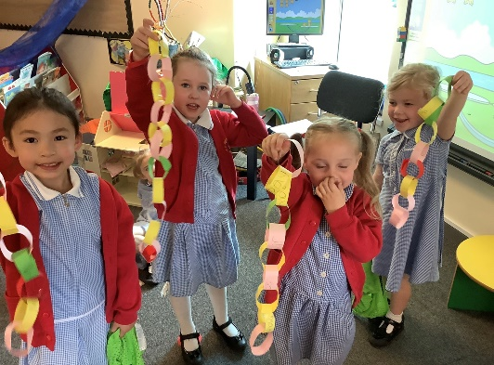
The Reception class Curriculum
The Early Years Foundation Stage Curriculum is divided into seven areas of learning.
Prime Areas – These are essential attributes for learning:
Personal, Social and Emotional Development – knowing yourself, building relationships and understanding emotions
Communication and Language –listening and attention, understanding and speaking
Physical Development - gross motor, fine motor, health and self-care
Specific Areas
Literacy – reading and writing
Mathematics – counting, number, spatial awareness, shape, measures and pattern
Understanding The World – people, cultures, community, past and present, natural world
Expressive Arts and Design – creating with materials, imagination
RE – Dioscean ‘Come and See’ scheme

Slide 5
Developing a good attitude to learning
To learn well, children must be curious, energetic and enthusiastic.
Developing these skills and attitudes will build strong learners who will make good progress.
Playing and exploring - engagement
Finding out and exploring Playing with what they know Being willing to ‘have a go’
Active Learning – Motivation
Being involved and concentrating Keep trying – persevere when things go wrong Enjoying achieving what they set out to do
Creative and critical thinking – thinking skills
Having their own ideas Making links Working with ideas

Slide 6
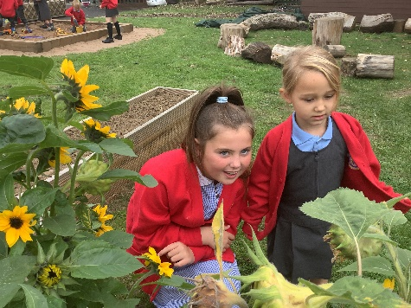
Positivity and Wellbeing
We use a variety of strategies to promote positive mental health in children:
Daily ‘Check In’ feelings chart.
Reading and discussing stories dealing with a range of feelings that children may experience.
Nurture groups.
In-school counselling service.
Buddy system – Each Reception child is linked with a Year 6 buddy and enjoys building a relationship with them through regular events such as a teddy Bears’ picnic or shared craft sessions.

Slide 7
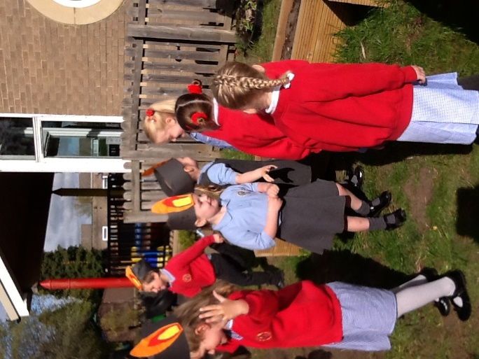
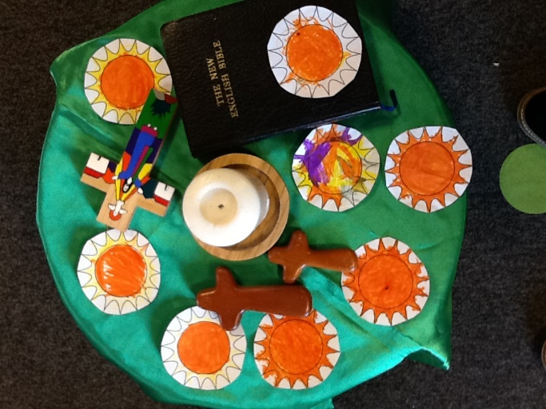
Religious Education
We use the ‘Come and See’ scheme which is rooted in scripture.
We follow the liturgical calendar and the children enjoy celebrating significant events
such as Advent, Christmas, Lent, Easter, and Pentecost.
They participate in prayer and liturgies and learn to pray both formally and informally.
The children are encouraged to live the Gospel values in all that they do and say.
We also find out about how people of other faiths celebrate

Slide 8
Half Termly Topics
We use topics as a springboard for learning.
Many of the activities we plan, the stories we read and the songs we sing link to the topic. However, we also follow the children’s particular interests and enthusiasms and include them in the classroom activities.
The children learn through practical play-based activities and spend part of each day learning outside.
Autumn 1 | Amazing Me
Autumn 2 | Celebrations
Spring 1 | Brilliant Books
Spring 2 | It’s Spring
Summer 1 | Going on a Journey
Summer 2 | Our Wonderful World

