Slide 1
United Against Bullying

Slide 2
What is bullying?
Time to discuss

Slide 3
Bullying is when someone, or a group, repeatedly intends to cause harm, either physically or emotionally, to another person or group.

Slide 4
Bullying is a repeated behaviour and is almost always a group behaviour.

Slide 5
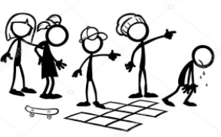
The different roles in bullying

Slide 6
The Ringleader
Their behaviour is hurtful to other people either physically or emotionally.
They are powerful in comparison to the target.
Their behaviour is encouraged and reinforced by others in the group.

Slide 7
The Target
They feel worried, threatened or sad because of the way they are being treated by others in the group.

Slide 8
The Reinforcer
They support the ringleader by encouraging them to continue with the bullying behaviour.
Their presence ensures the group is more powerful than the target.

Slide 9
The Assistant
They are not usually involved directly with the bullying, but they offer support to the ringleader, perhaps by laughing or encouragement.

Slide 10
The Outsider
They often see the bullying behaviour and even though they know it is wrong, they decide to ignore it and walk away.

Slide 11
There is one more role in a bullying situation…

Slide 12
The DEFENDER
They don’t stand by and watch when they see bullying.
What do they do instead?

Slide 13
Defenders follow the STOP code
See bullies
Tell someone
Offer kindness
Protect each other

Slide 14
Let’s be a SJV team of defenders!
Let’s be United Against Bullying!

