Slide 1
Roman Catholic Diocese of Hexham and Newcastle
St. John Vianney
Catholic Primary School
Curriculum Evening 2024
Mission Statement
Through following Jesus,
we aim to be a caring, happy school,
where everyone is valued and appreciated
and can reach their true potential.
We hope to: act justly, love tenderly and walk humbly with our God.
Notes:
Katherine

Slide 2
Roman Catholic Diocese of Hexham and Newcastle
St. John Vianney
Catholic Primary School
Our Year 5 Team
Miss Dolphin –Teacher
Mrs Haughton – Teacher
Mrs Black- Teacher (Y5JH on Mondays)
Mrs Bailey – Teaching Assistant
Miss McHugh – Teaching Assistant
Mrs Phillips – Teaching Assistant
Miss Davidson – Music Teacher
Mrs Rutherford – Teacher (PPA)
PE coaches (PPA)
Notes:
Katherine

Slide 3
Roman Catholic Diocese of Hexham and Newcastle
St. John Vianney
Catholic Primary School
Year 5 Timetable
8.30 – 8.45 Children arrive and complete morning task
Register
9.00 – 10.00 Lesson 1
10.00 – 10.45 Lesson 2
Playtime
11.00 – 12.15 Lesson 3
Lunch
1.15 – 3.10 Blocked foundation subjects
Lateness
Notes:
Katherine

Slide 4
Roman Catholic Diocese of Hexham and Newcastle
St. John Vianney
Catholic Primary School
Reading
Children have access to a rich Reading diet. They will participate in: whole class shared reading, VIPERS guided reading sessions, comprehension activities, daily story time and home-school reading.
Every class has access to school library books, which promote reading for pleasure. We have a new school library which will be accessed by children fortnightly. Children may bring a reading book in from home for a class reader too.
Please continue to leave comments in your child’s reading record. When your child has finished their book please indicate this and the book will be changed.
We are currently assessing all of the children’s reading using PM Bench Mark, which is a thorough and comprehensive programme. Their reading levels will be changed in accordance with this assessment.
Notes:
4
Katherine

Slide 5
Roman Catholic Diocese of Hexham and Newcastle
St. John Vianney
Catholic Primary School
Reading VIPERS
Reading Vipers is a whole school strategy for teaching the key reading skills as outlined in the National Curriculum.
It ensures that children are accessing and improving in every reading skill.
Notes:
5
Katherine

Slide 6
Roman Catholic Diocese of Hexham and Newcastle
St. John Vianney
Catholic Primary School
How to help your child with Reading in KS2
Use the range of VIPERS skills to discuss your child’s reading books with them:
Vocabulary – Discuss the meaning of new and unfamiliar words; discuss why an author has chosen certain words and their effects.
Inference – What clues has the author given you about characters, settings and atmosphere in the story? What does this make you think?
Prediction – What do you think is going to happen next?
Explanation/Evaluation – Why has the author set out the story in this way? Do you like the story so far? Why/why not?
Retrieval – Can your child remember key facts form the story?
Summarise – Ask your child to summarise a chapter or even the whole story. Can they make up a headline, summarise in 10 words or recap the story in one minute?
Even when the children become free readers, they still need to read aloud to an adult regularly and to hear adults reading aloud to them. Examples of questions you can ask your child can be found on our school website.
Notes:
6
Katherine

Slide 7
Roman Catholic Diocese of Hexham and Newcastle
St. John Vianney
Catholic Primary School
Year 5 Handwriting
-This term have introduced a new handwriting scheme which the children have taken to brilliantly.
We are using unlocking letters and sounds.
Secure handwriting helps with writing stamina, meaning that children will be able to write longer pieces of work when they are ready without tiring.
At Year 6 they need to join their writing to obtain the expected standard in writing so achieving this in Year 5 will be advantageous to them.
Notes:
Judith

Slide 8
Roman Catholic Diocese of Hexham and Newcastle
St. John Vianney
Catholic Primary School
Year 5 Handwriting
Notes:
Judith

Slide 9
Roman Catholic Diocese of Hexham and Newcastle
St. John Vianney
Catholic Primary School
Year 5 Spelling
Spelling tests take place every Friday in class.
To help your child learn their weekly spellings you can play games on Ed Shed.
Your child has been provided with a username and password for Ed Shed. It is a fun and engaging way to support spelling practise.
Notes:
Judith

Slide 10
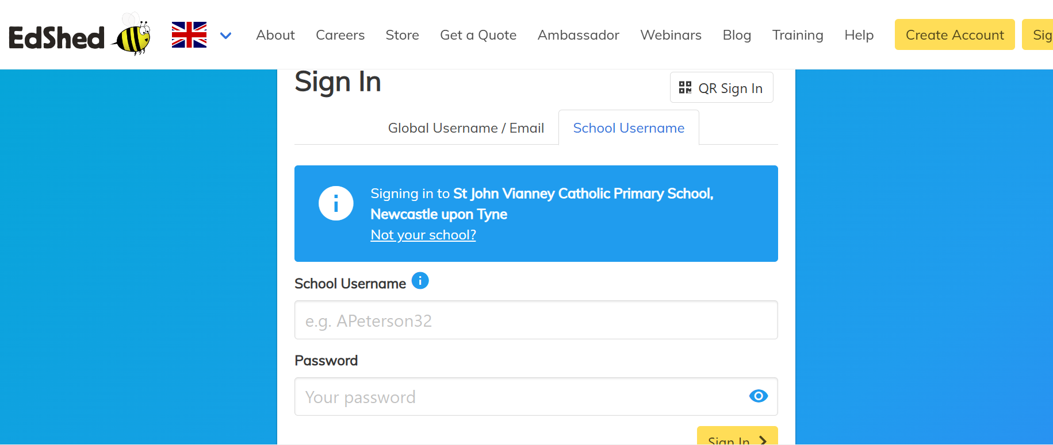
Roman Catholic Diocese of Hexham and Newcastle
St. John Vianney
Catholic Primary School
Notes:
Judith

Slide 11
Roman Catholic Diocese of Hexham and Newcastle
St. John Vianney
Catholic Primary School
Notes:
Welcome

Slide 12
Notes:
Judith

Slide 13
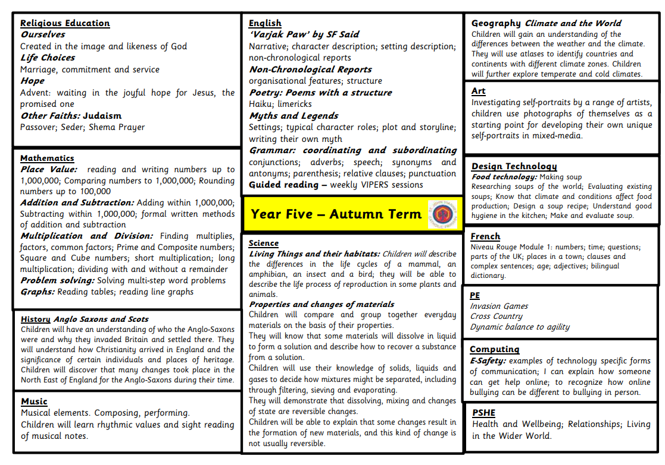
Roman Catholic Diocese of Hexham and Newcastle
St. John Vianney
Catholic Primary School
Year 5 Curriculum - Autumn
Notes:
Katherine – talk about grammarsaurus

Slide 14
Roman Catholic Diocese of Hexham and Newcastle
St. John Vianney
Catholic Primary School
Maths-No Problem!
We are continuing to embed the mastery approach of Maths No-Problem from Year 1 to Year 6. It is delivered using the concrete, pictorial and abstract methodology to ensure children have a deep understanding of mathematical concepts. It is much more focused on pupils refining their problem solving and reasoning skills.
Notes:
14
Katherine

Slide 15
Roman Catholic Diocese of Hexham and Newcastle
St. John Vianney
Catholic Primary School
Maths Calculation Policy
Our Maths Calculation Policy can be found on our school website and is a fabulous resources to see how we teach Maths in school.
Notes:
Katherine

Slide 16
Roman Catholic Diocese of Hexham and Newcastle
St. John Vianney
Catholic Primary School
How can you help at home?
- Listen to your child read little and often
Read to your child for pleasure
Encourage them to play TTRS. Fluent multiplication and division knowledge feeds into many areas of maths such as fractions, decimals, percentages, ratios and algebra
Support them to learn their spellings (Spelling Shed)
Notes:
Katherine

Slide 17
Roman Catholic Diocese of Hexham and Newcastle
St. John Vianney
Catholic Primary School
Uniform Policy
Please can you ensure EVERYTHING is labelled with your child’s name.
No earrings in school please.
Warm coat for winter playtimes.
PE kits to be worn on Tuesday.
Notes:
Judith

Slide 18
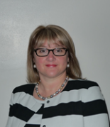
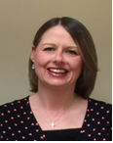
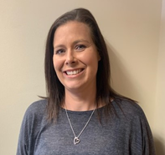
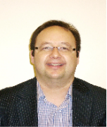
Roman Catholic Diocese of Hexham and Newcastle
St. John Vianney
Catholic Primary School
Safeguarding
St John Vianney is a safeguarding school where children’s safety is absolutely central to all that we do.
Please encourage your children to talk to a responsible adult if they have any concerns. It is this step that allows us to support vulnerable children.
As part of the Computing curriculum, the children will be taught about how to stay safe online.
Cyber-bullying is an important issue that children of all ages will be made aware of in lessons and assemblies throughout the year.
There are further resources for parents online, to address this subject sensitively. https://www.thinkuknow.co.uk/parents/
All staff are trained in the PREVENT agenda and our Designated Safeguarding Leads are:
Mrs Thorpe Mrs Meldrum Mrs McDine Miss Cherry Mrs Spencer Mr Bell
Notes:
18
Judith
Keeping children safe in school is our absolute priority.
There are designated safe guarding leads however it is the responsiblity of all staff to ensure children are kept safe.
The DLS are the people we report to with concerns or questions.
We ask that if your child is getting picked up from someone different to normal, that you please let the school office know.

Slide 19
Roman Catholic Diocese of Hexham and Newcastle
St. John Vianney
Catholic Primary School
Reporting about your children
Autumn parents evening
Spring parents evening
Summer reports
Notes:
Judith

Slide 20
Roman Catholic Diocese of Hexham and Newcastle
St. John Vianney
Catholic Primary School
Positivity and Wellbeing
Strategies used across school to promote positive mental health in children include:
Zones of regulation
Daily ‘Check In’
Worry boxes
Mindfulness activities and breathing techniques
GoNoodle
Notes:
Judith

Slide 21
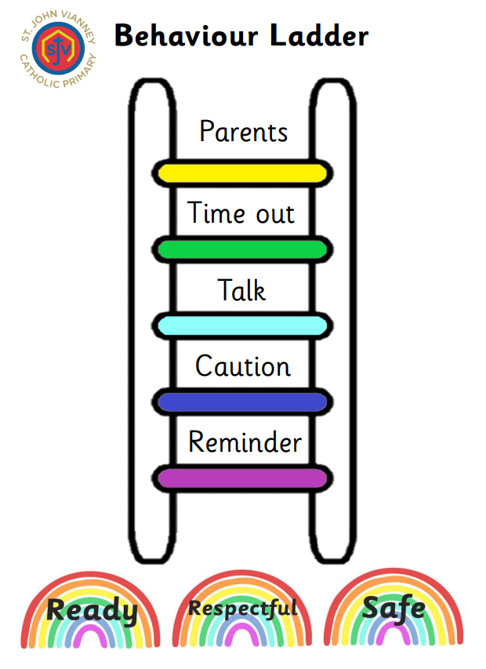
Roman Catholic Diocese of Hexham and Newcastle
St. John Vianney
Catholic Primary School
The Behaviour and Rewards System
The current Behaviour Policy was introduced in January 2023 and is now embedded across school. READY, RESPECTFUL, SAFE ensures all pupils know what is expected of them. It has had a really positive impact in school. This half term the focus is on manners.
We continue to emphasis and promote positive behaviour, rewarding those pupils who consistently behave appropriately and track those pupils who find it harder to meet our expectations of behaviour in school.
Notes:
21
Katherine

Slide 22
Roman Catholic Diocese of Hexham and Newcastle
St. John Vianney
Catholic Primary School
Behaviour and Rewards System
We continue to emphasis and promote positive behaviour, rewarding those pupils who consistently behave appropriately and track those pupils who find it harder to meet our expectations of behaviour in school.
Whole-school House Points system - Every child is part of a House Group (there are six houses in total) and children are awarded house points for following our school rules. Every Friday, the house points for each house are added together and the house with the most house points is praised during our Celebration Assembly. We know that these systems continue to enhance the behaviour and reward systems already in place here at St. John Vianney school.
Notes:
22
Katherine

Slide 23
Roman Catholic Diocese of Hexham and Newcastle
St. John Vianney
Catholic Primary School
Important Class Information
Spellings – given out half termly to learn for Friday
Homework – Daily (Spellings, Reading and Times Tables Rockstars)
P.E. – Tuesday
Reading Books – Changed weekly on a Thursday, if finished and signed off.
Notes:
23
Katherine

Slide 24
Roman Catholic Diocese of Hexham and Newcastle
St. John Vianney
Catholic Primary School
Questions
If you have any further questions arising from this PowerPoint, please contact us at office@stjohnvianneynewcastle.org and we will be more than happy to help.
Thank You.
Notes:
24

