Slide 1
Maths and reading in nursery.
St John Vianney catholic primary school.

Slide 2
Learning Through Play.
Mathematical development for young children grows through their play and exploration, active engagement, creative and critical thinking, serve and return interactions with adults, their embodied experiences and essentially their schematic patterns of thinking, such as an interest in trajectories (horizontal and vertical straight lines) and transporting (moving things from one place to another), where they gradually come to understand the concepts of length, distance, spatial awareness, speed, motion, direction, time, pattern, order, angles, sequencing and weight. (Chilvers 2021)

Slide 3
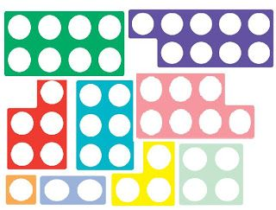
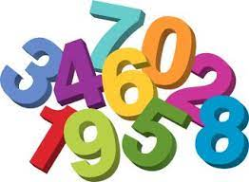
Maths opportunities in Nursery
Children use and develop their maths skills throughout our daily routines and activities.
Through our continuous provision areas in nursery the children have daily opportunities to develop their maths skills such as counting, number recognition, identifying quantities more and less, understanding one-to-one correspondence, matching sets, understanding size, shape and patterns.
Nursery continuous provision can support maths such as in:
SAND AND WATER – using the language and exploring the concepts of light, heavy, empty, full, making shapes and patterns, comparing weight and quantities.
PLAY DOUGH –develop the language such as short, long, thick, thin. Exploring patterns and shape, counting and sorting activities.
BRICKS – using the language of size, shape and weight. Counting, sorting, measuring and solving problems.
HOME CORNER/ROLE PLAY – developing number recognition through the use of clocks, telephones, scales, calendars. Counting, ordering and sorting opportunities.
MATHS INVESTIGATION AREA - stocked with counting materials, containers, numbers, sorting trays.

Slide 4
DAILY ROUTINE
Throughout the day our children have opportunities to develop their maths skills such as counting the number of children at registration time, finding out the date on our number line , making their lunch choice, lining up and describing their position, going home how many now as one child leaves. How many people need to put on their jumper? etc.
COUNTING TIME. After lunch each day the children gather together as a group to develop their skill of counting. We play counting games which encourage counting by rote from 1 -10, counting with actions and a steady beat.
Using number language and developing the understanding of addition and subtraction through number songs and rhymes.

Slide 5
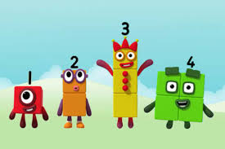
Numberblocks
Numberblocks is a BBC television series aimed at introducing children to early number. This programme uses animated characters combined with engaging storylines to introduce the concepts of number.
It has now been recognised by the NCETM (national centre for excellence in the teaching of mathematics)
In nursery we use this tool as a fun resource to support the children in their understanding of number, number recognition and mathematical language. This resource can also be used at home.
BAKING
During our baking sessions the children have many opportunities to develop number recognition, counting, estimating and making predictions and size and weight vocabulary.

Slide 6
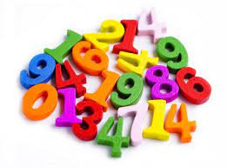
MATHS AT HOME
Numbers and number opportunities are all around us, here are a few ideas,
Practise counting perhaps when going up the stairs to bed, when sorting the washing, setting the table
Find the same amount of a different item. To understand what numbers mean maybe find 3 spoons, 3 shoes, 3 socks
Talk about shape and size of objects e.g. big car, small box, long sock
Talk about numbers around you such as calendars, remote controls, clocks, front doors
Reading number stories or counting how many objects in the picture
Playing games requiring moving counters, rolling the dice, matching dominoes
Baking activities

Slide 7
reading in nursery.
St John Vianney catholic primary school.

Slide 8
READING
In nursery we support the children to develop pre reading skills. We aim to encourage all children to develop a love of books and eventually a love of reading. By reading stories to the children each day we hope to encourage them to show an interest in books and for them to look and enjoy books independently.
BOOK AREA.
Our book area is set up to be comfortable, cosy and inviting with a range of books to develop childrens interest. We provide different cuddly toys such as teddies as reading buddies for the children to read a story to them. The children have stories read to them throughout the day whether in a large, small group or individually on request.
TALKING TABLE
This activity is a small group activity which encourages communication skills, story telling skills and developing an understanding the structure of stories such as characters, beginning and end.
LIBRARY
Our weekly library session allows the children to learn about different types of books such as fiction and non fiction, the structure of a book such as the front cover, the contents page, the back covers and that we read from the left to the right of the page. The children are encouraged to choose a book that they can take home for the week to share with their family at home. We ask that the children can be read this story by members of the family and talk about the story such as what is happening in the story, what do you think might happen next, did you enjoy the story and why.

Slide 9
PHONICS
LETTERS AND SOUNDS
The children are taught how to be a good listeners and encouraged to develop this skill when play the games and activities. The are encouraged to develop good sitting and have ears and eyes ready.
Phase One of letters and sounds supports the children to develop pre reading skills and is divided into seven aspects.
ASPECT 1 General sound discrimination – environmental sounds. Activities include sound walks and listening games
ASPECT 2 General sound discrimination – instrumental sounds. Activities include which instrument? Adjust the volume.
ASPECT 3. General sound discrimination – body percussion. Activities action songs, follow the sond
ASPECT 4. Rhythm and rhyme. Activities include rhyming books, nursery rhymes
ASPECT 5. Alliteration. Activities include I spy games silly soup
ASPECT 6. Voice sounds. Activities include give me a sound, singing songs with sounds made with the voice
ASPECT 7. Oral segmenting and blending. Activities include clapping games, say the sounds
Phonic activities are taught daily through small group activities and child initiated play. The activities are planned to be fun and engaging and built into the children’s day.
When the children are ready they will be introduced to learning individual letters and the sounds they make in words again through fun and play, Phase 2.

