Slide 1
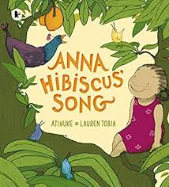
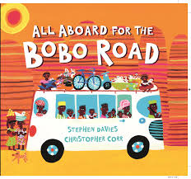
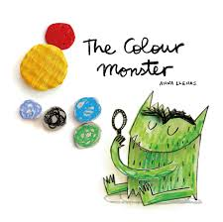
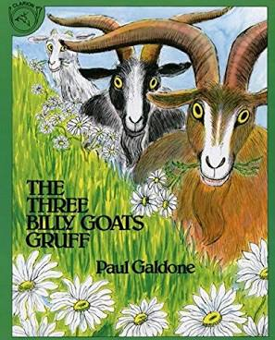
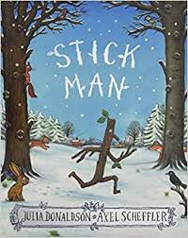
Phonics and Reading
The ability to read and write is a key life skill that paves the way to success at school and in the world beyond.
Children learn to read more easily if they love books. We foster a love of books by using a core book as a stimulus for all our weekly activities. We call this our ‘Book of the Week’ and it is displayed in our inviting class book area. Our end of day story is from a carefully chosen selection of significant authors. Over the course of the year there all areas of learning are covered and the children will experience a varied and diverse diet of books.

Slide 2
Daily Phonics Session
Each day the children take part in a daily phonics session which is the systematic method of teaching reading based on learning the sounds that the letters of the alphabet represent.
Some sounds come from single letters and other sounds are made by a combination of letters e.g. ‘oo’, ‘igh’
The teaching of phonics is divided into 6 phases. In Reception children will experience phases 1-4.
We use the terms:
Phonemes - sounds
Graphemes – letter shapes

Slide 3
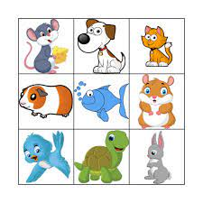
Phase 1
Oral blending – sharpen listening skills
can the children hear the sounds in a word?
Games with real objects – lotto –put your counter on the f-i-sh.
Actions – Can you h-o-p 3 times?
Simon says put your hands on your kn-ee
I –spy
As the children become more confident at hearing sounds and blending orally, they move on to phase 2.

Slide 4
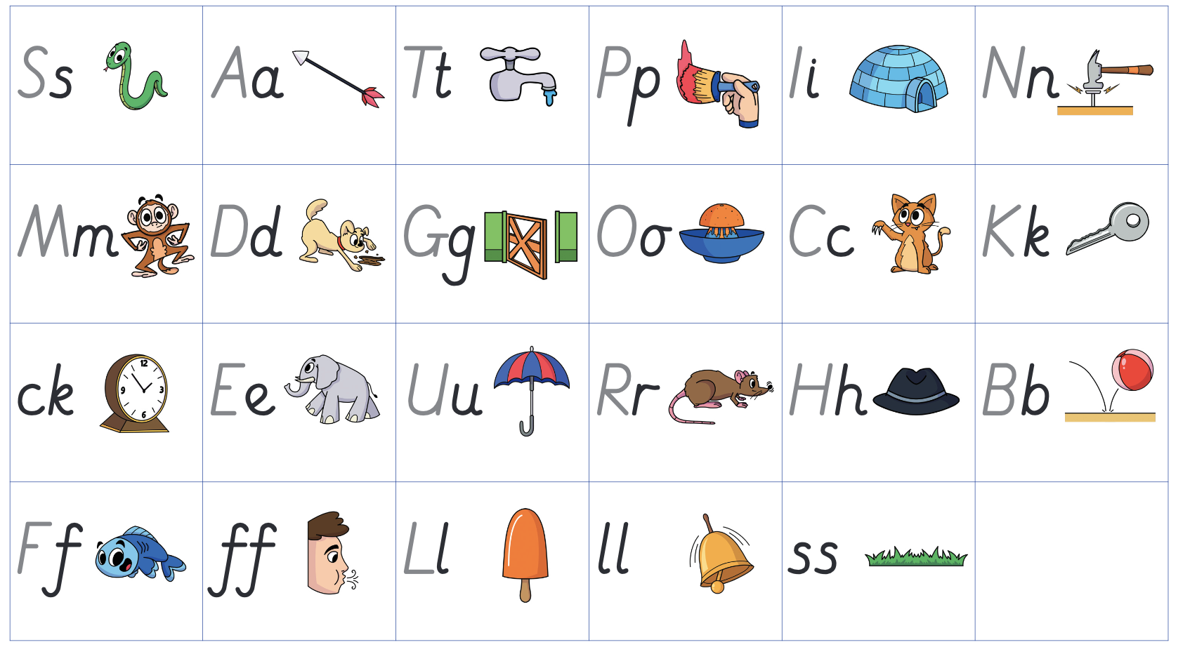
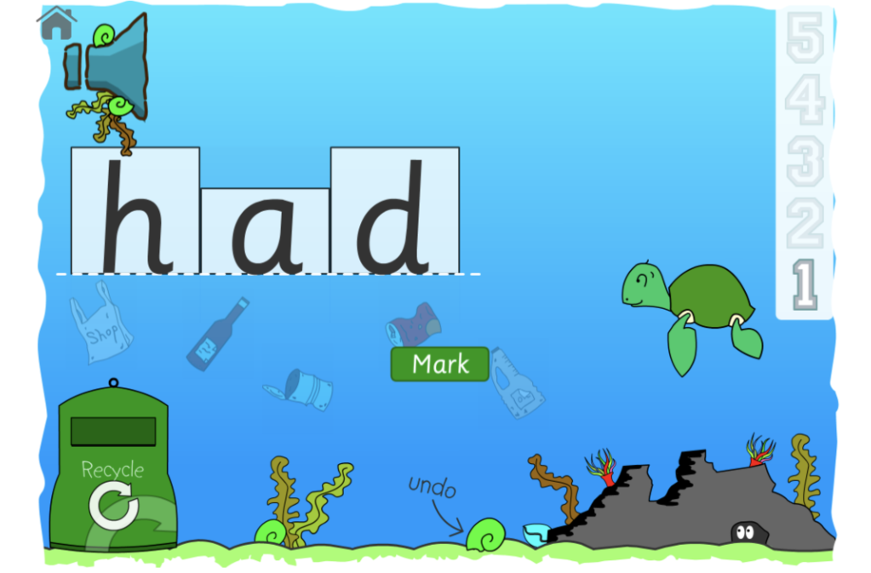
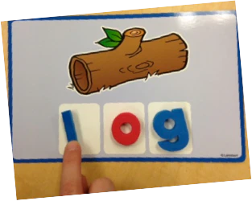
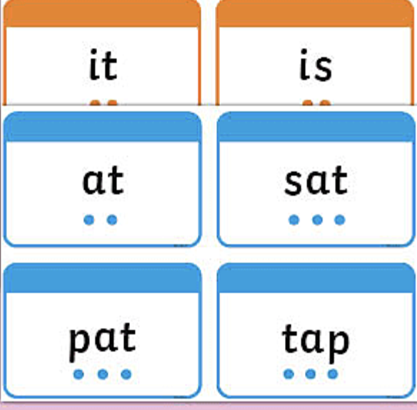
Phase 2
The children focus on recognising each letter by sight and saying its sound as they do the corresponding action. They read flashcards and play games throughout the day.
The next step is very important as they blend letters to read words.
The children look at words and point to each letter, quickly saying the corresponding sound. e.g. m-a-t.
This is difficult for many children and takes a lot of practise!
We use pure sounds; ‘mmmm’ not’ muh’, ’sssss’ not ‘suh’, etc. This is so that your child will be able to blend the sounds into words more easily. Please see school website for details

Slide 5
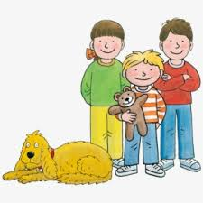
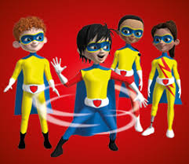
Reading books
Each week the children select a school library book to encourage discussion and encourage their enjoyment of reading.
As soon as the children can blend confidently, they are given books with short sentences.
The children’s phonic knowledge and their ability to blend are matched to our school reading books so the children will be given a book containing only sounds with which they are familiar.
We ask you to support them to read each book several times. This usually means that they become more fluent with each reading which gives them confidence.
It is important to explore the pictures because this adds to the children’s understanding of the book and the way that stories are organised.

Slide 6
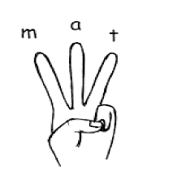
Segmenting to spell and write words
Then they segment to spell and write words.
The children use their fingers to help spell a word.
e.g. hat – They are told they need 3 fingers. They say each sound ‘pinching’ it on the end of their fingers and then write it .

Slide 7
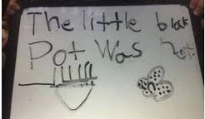
Writing sentences
As the children’s knowledge of sounds and their blending and segmenting skills develop and improve, they do ‘Hold a sentence’ activities.
They think of the sentence they want to write, say it several times to ‘Hold it’ in their head and then write it down from beginning to end without stopping.
This is an important step because it is vital to build up the stamina and concentration to write a whole sentence in one go. If the children break in the middle of a sentence they tend to miss out or repeat words and the sentence does not make sense.

Slide 8
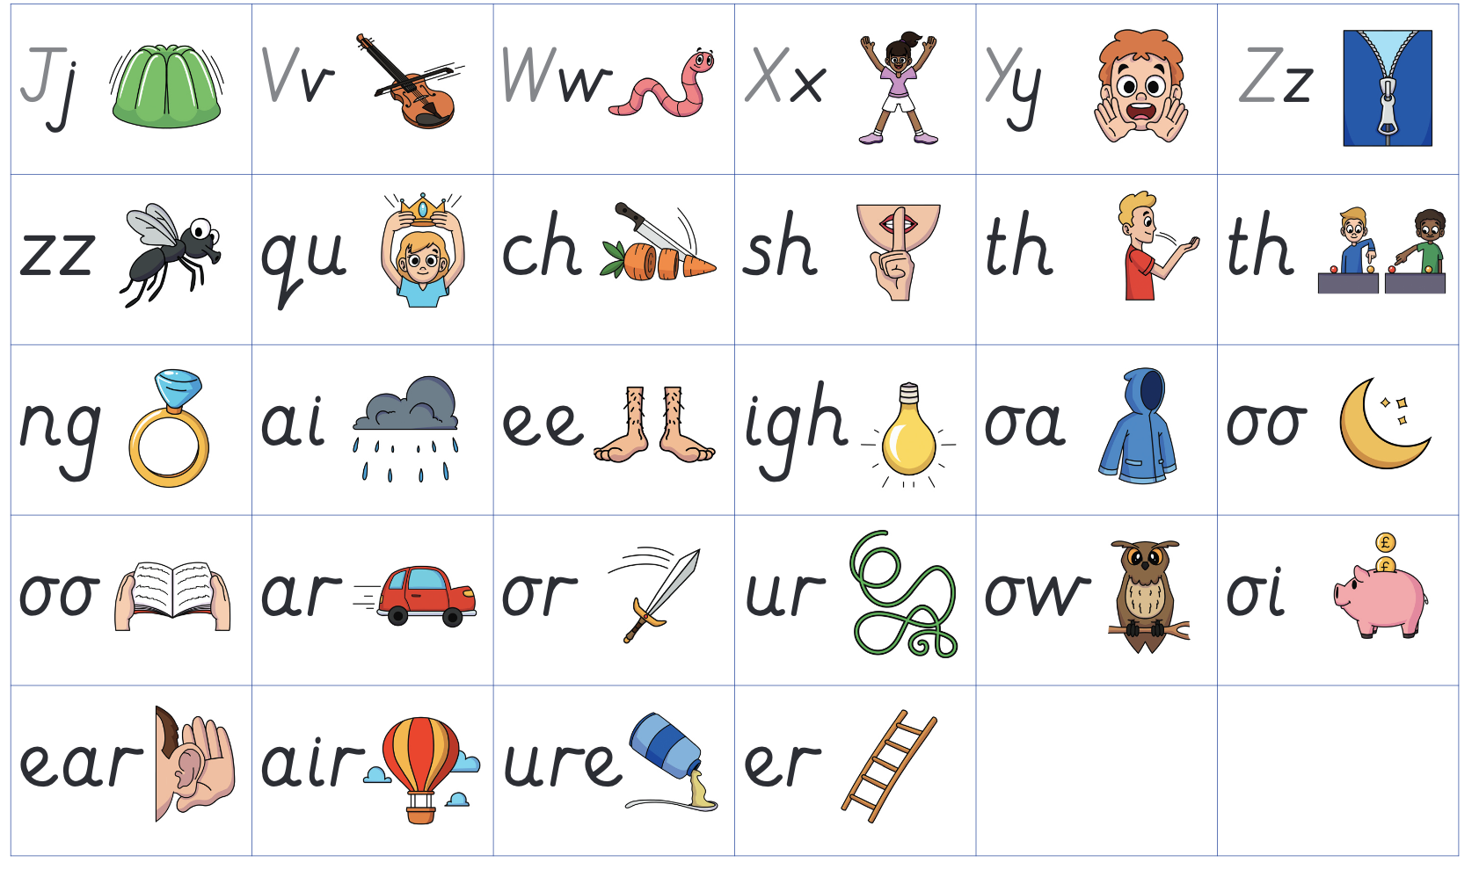
Phase 3
The children apply their blending and
segmenting skills using another set of
letters, some sounds are made using 2 or 3 letters Eg. C-ar-d, g-oa-t
Phase 4
All of the sounds learnt so far are used with adjacent consonants e.g. br-i-m, m-i-lk, p-ai-nt. The children learn to read and write these longer words,

Slide 9
Progression
We introduce several sounds each week but there are periods when we concentrate on assessing and reinforcing learning rather than moving on. This thorough and systematic approach ensure that there are no ‘gaps’ in this vital phase in their reading journey.
If children are struggling to keep up they have 1-1 extra phonics intervention sessions each day.

Slide 10
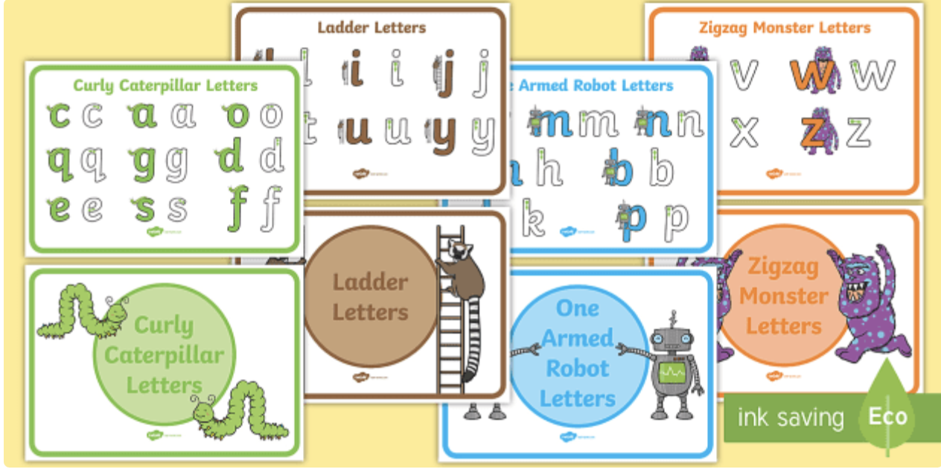
Handwriting
The letters of the alphabet can be divided into ‘families’ based on the movement made to start each letter. Mastering correct formation helps to avoid letter reversals from occurring.
Each time we write a letter we say the same sentence to help reinforce the correct movement.
The children may do this in pen, paint, shaving foam, dough.
E.g.“Let’s write r. Start at the top, down, back up and over.”

Slide 11
Common exception words
These are words which cannot be read by blending and so the children need to read them with instant recognition.
The only way to learn them is by lots of practise. We play games and activities every week which help the children to do this.
We will send home a set of cards so you can reinforce them at home.

Slide 12
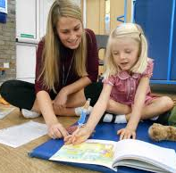
How you can support your child at home
Over the course of the year we will send home:
A pack of letter cards for phase 2 and later, phase 3 sounds.
Help them to recognise them by sight.
Games–play them as often as possible to develop blending skills.
Sets of common exception words – help your child to learn these by sight
A letter formation sheet – help your child to form letters correctly.
A reading book which will be changed weekly – Ask you child to read this at least 3 times.
Remember, reading is difficult so PRAISE, PRAISE, PRAISE!

Slide 13
Useful Resources
https://home.oxfordowl.co.uk/reading/reading-age-4-5-reception/
This is an excellent website which gives tips, ideas for games and information about reading.
There are also very short videos demonstrating the correct pronunciation of sounds and of blending
Some good free games for practicing blending. Select phase 2 initially then 3 and 4 when your child has moved on.
http://www.letters-and-sounds.com/phase-2-games.html

