Slide 1
Nursery
Literacy & Mathematics
at St. John Vianney Catholic Primary

Slide 2
Our daily routines
Our daily routine helps to support children with Literacy & Mathematics.
Children count how many of their class are having school lunch, practicing 1:1 correspondence and the cardinal principle. Through transition and small-group children are encouraged to practice listening skills and to make links between letters and meaning.
Throughout the day, there is opportunity in the provision for all children to access learning which will support their Literacy & Mathematics skills.

Slide 3

Literacy: Reading
In Nursery, we support the children to develop pre-reading skills.
We aim to encourage all children to develop a love of books and a love of reading. By reading stories to the children each day we hope to encourage them to show an interest in books and for them to look at, and enjoy, books independently.

Slide 4

Literacy: Reading
Our book area is set up to be comfortable, cosy and inviting with a range of books, both modern and classic, to develop children's interests.
Blankets, cushions and soft toys are provided, so children can create a calm, quiet space to enjoy stories. They are encouraged to ‘read’ to soft toys and each other, practicing the habit of turning pages and linking text to meaning.
Each day, children will hear a story as a whole class. Stories are also read, on request, to individuals and small groups.
Starting in Autumn 1, children will be shown how to access our classroom library and will choose a book to take home to read with their adults. We ask that you begin conversations around the story, asking them to tell you about the characters and the story, as well as asking for opinions about the story.

Slide 5

Phonics
At SJV, we follow the phonics scheme ‘Unlocking Letters and Sounds’.
Beginning in Autumn, the children are taught listening skills and are encouraged to develop these through whole-class games and individual activities in the provision. Listening is also taught as part of ‘super sitting’ where children are ready to learn through following our ‘rainbow rules’ of ‘ready, respectful, safe’.
Nursery then moves on to Phase 1 of’ Unlocking Letters and Sounds’. This supports the children to develop pre-reading skills and is divided into seven aspects.
General sound discrimination – environmental sounds: sound walks and listening games
General sound discrimination – instrumental sounds: using instruments and considering volume
General sound discrimination – body percussion: action songs
Rhythm and rhyme: rhyming books and Nursery rhymes
Alliteration: silly stories and games
Voice sounds: singing songs and making noise with their voice
Oral segmenting and blending: clapping games
Phonics activities are taught daily. These are taught as whole-class activities and are integrated into our provision and small-group activities.

Slide 6
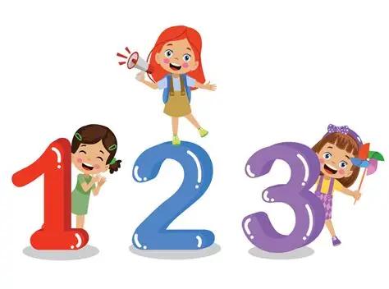
Opportunities for Mathematics
Through our continuous provision areas in Nursery, the children have daily opportunities to develop their Maths skills such as counting, number recognition, identifying quantities (more and less), understanding one-to-one correspondence, matching sets, understanding size, and shape and patterns.
Nursery’s continuous provision can support Maths in a variety of ways:
Sand & water – using language and exploring the concepts of light, heavy, empty, full, making shapes and patterns, and comparing weight and quantities.
Malleable– develop language such as short, long, thick, thin; exploring patterns and shape, counting and sorting activities.
Bricks – using the language of size, shape and weight; counting, sorting, measuring and solving problems.
Role play – developing number recognition using clocks, telephones, scales, calendars; counting, ordering and sorting opportunities.
Maths area - counting materials, containers, numbers, sorting

Slide 7
Mathematics at home
Practicing Mathematics at home is very helpful for the children to develop important skills.
Ideas to practice Mathematics at home could be:
Practice counting in real world contexts, for example, when going up stairs, sorting items, setting the table etc.
Finding amounts i.e., find 3 spoons, 3 shoes, 3 socks
Talk about shape and size of objects e.g., big car, small box, long sock
Talk about numbers around you such as calendars, remote controls, clocks, front doors
Reading number stories or counting how many objects in a picture
Playing games requiring moving counters, rolling the dice, matching dominoes
Baking and cooking activities to introduce measure and weight

Slide 8
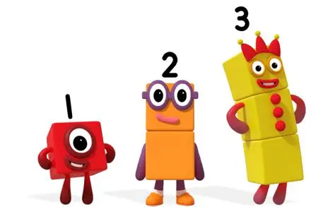
Number Blocks
Number Blocks is a BBC television series aimed at introducing children to early number.
This programme uses animated characters combined with engaging storylines to introduce the concepts of number. It has now been recognised by the NCETM (National Centre for Excellence in the Teaching of Mathematics).
In Nursery, we use this tool as a fun resource to support the children in their understanding of number, number recognition and mathematical language. This resource can also be used at home.

