Slide 1
WELCOME
The Reception Class Curriculum.
Through following Jesus,
we aim to be a caring, happy school,
where everyone is valued and appreciated
and can reach their true potential.
We hope to act justly, love tenderly and walk humbly with our God.

Slide 2
THE RECEPTION CURRICULUM
The Early Years Foundation Stage Curriculum is divided into seven areas of learning.
Prime Areas – These are essential attributes for learning:
Personal, Social and Emotional Development – knowing yourself, building relationships and understanding emotions
Communication and Language –listening and attention, understanding and speaking
Physical Development - gross motor, fine motor, health and self-care
Specific Areas
Literacy – reading and writing
Mathematics – counting, number, spatial awareness, shape, measures and pattern
Understanding The World – people, cultures, community, past and present, natural world
Expressive Arts and Design – creating with materials, imagination

Slide 3
The Early Years Foundation Stage Curriculum
In St John Vianney Catholic Primary school, the Early Years Foundation Stage covers a child’s time in Nursery and Reception.
The Early Years Foundation Stage Curriculum is based on four principles these are:
A unique child – each child is special.
Positive relationships – these are vital and occur between children, staff and parents.
Enabling environments – well organised and thoughtfully resourced classrooms and outdoor areas encourage independent curious thinkers.
Learning and development – acquiring knowledge, skills and attitudes.
The curriculum is play-based with practical activities building on what the child already knows.
New experiences to spark curiosity and enthusiasm are introduced and the children acquire new knowledge and skills.
The children’s own particular interests are combined with topics such as ‘Journeys’ and teaching consists of a combination of teacher led- activities and planned purposeful play.

Slide 4
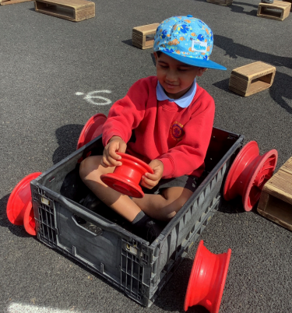
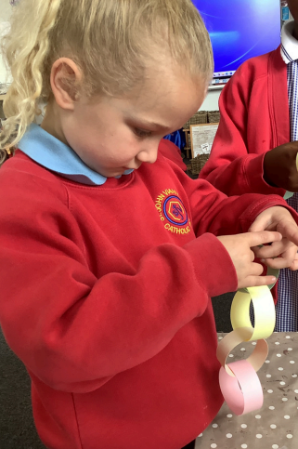
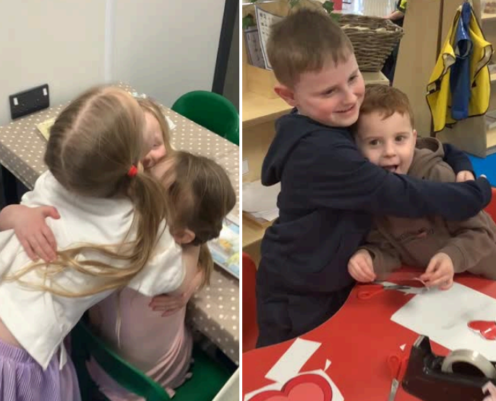
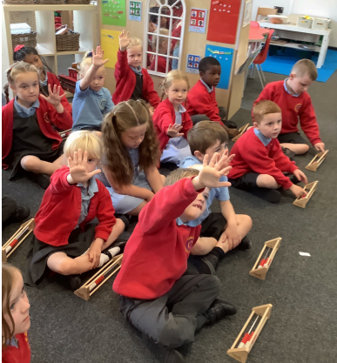
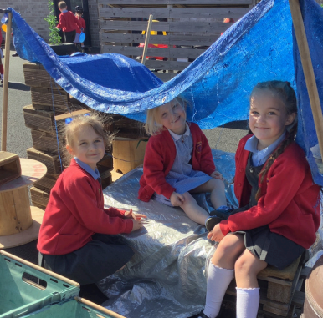
Developing a good attitude to learning
To learn well, children must be curious, energetic and enthusiastic.
Developing these skills and attitudes will build strong learners who will make good progress. The Characteristics of learning are;
Playing and exploring - engagement
Finding out and exploring Playing with what they know Being willing to ‘have a go’
Active Learning – Motivation
Being involved and concentrating Keep trying – persevere when things go wrong Enjoying achieving what they set out to do
Creative and critical thinking – thinking skills
Having their own ideas Making links Working with ideas

Slide 5
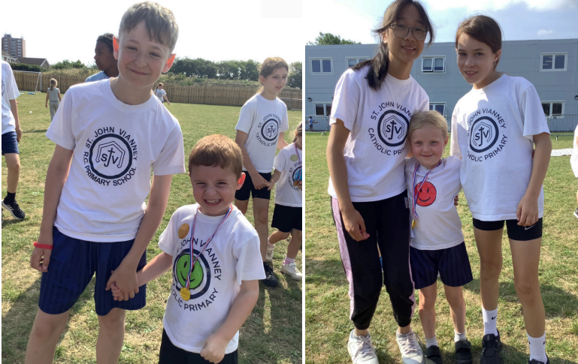
Positivity and Wellbeing
We use a variety of strategies to promote positive mental health in children:
Daily ‘Check In’ feelings chart.
Reading and discussing stories dealing with a range of feelings that children may experience.
Nurture groups.
In-school counselling service.
Buddy system – Each Reception child is linked with a Year 6 buddy and enjoys building a relationship with them through regular events such as a teddy Bears’ picnic or shared craft sessions.

Slide 6
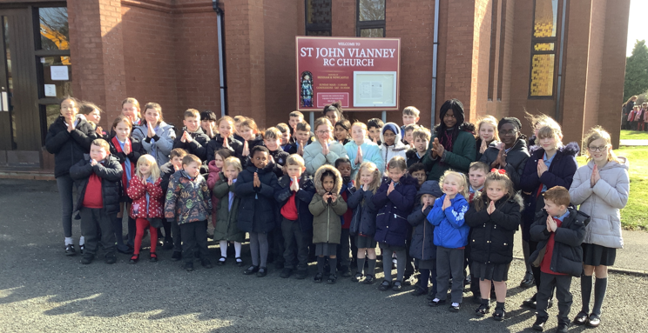
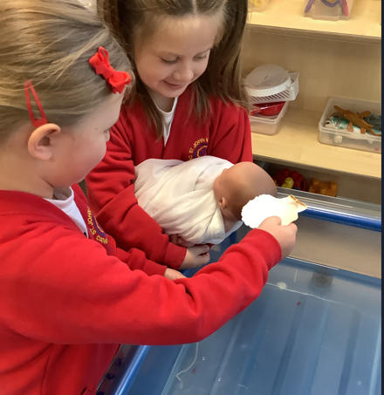
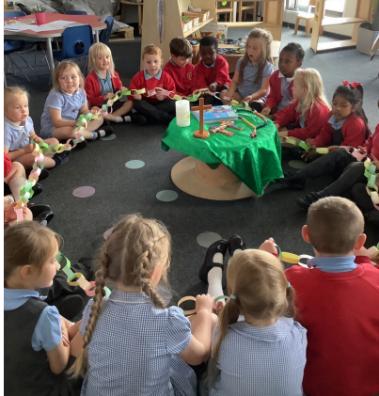
Religious Education
We follow the liturgical calendar and the children enjoy celebrating significant events
such as Advent, Christmas, Lent, Easter, and Pentecost.
They participate in prayer and liturgies and learn to pray both formally and informally.
The children are encouraged to live the Gospel values in all that they do and say.
We also find out about how people of other faiths celebrate.

Slide 7
Half Termly Topics
We use topics as a springboard for learning.
We have a different story book each week that we share as a class and base our activities around this book.
However, we also follow the children’s particular interests and enthusiasms and include them in the classroom activities.
The children learn through practical play-based activities and spend part of each day learning outside.
Autumn 1 | Amazing Me
Autumn 2 | Celebrations
Spring 1 | Traditional Tales
Spring 2 | It’s Spring
Summer 1 | Going on a Journey
Summer 2 | Our Wonderful World

Slide 8
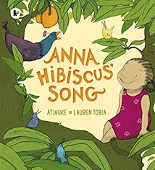
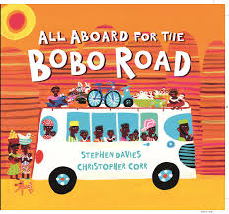


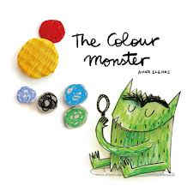
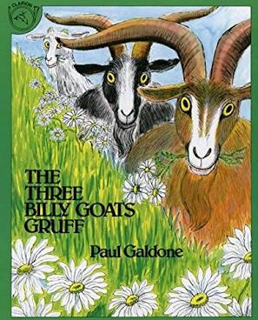
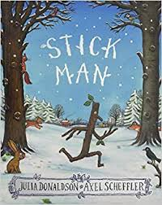



Phonics and Reading
The ability to read and write is a key life skill that paves the way to success at school and in the world beyond.
Children learn to read more easily if they love books. We foster a love of books by using a core book as a stimulus for all our weekly activities. We call this our ‘Book of the Week’ and it is displayed in our inviting class book area. Our end of day story is from a carefully chosen selection of significant authors. Over the course of the year there all areas of learning are covered and the children will experience a varied and diverse diet of books.

Slide 9

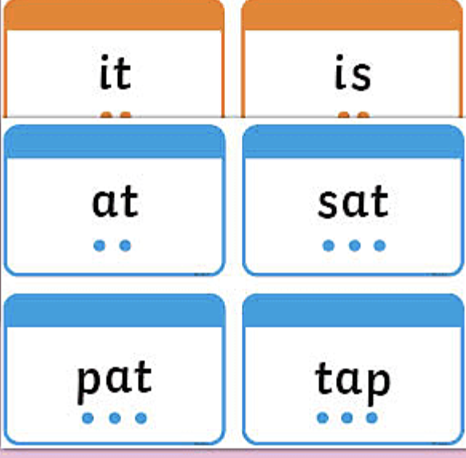
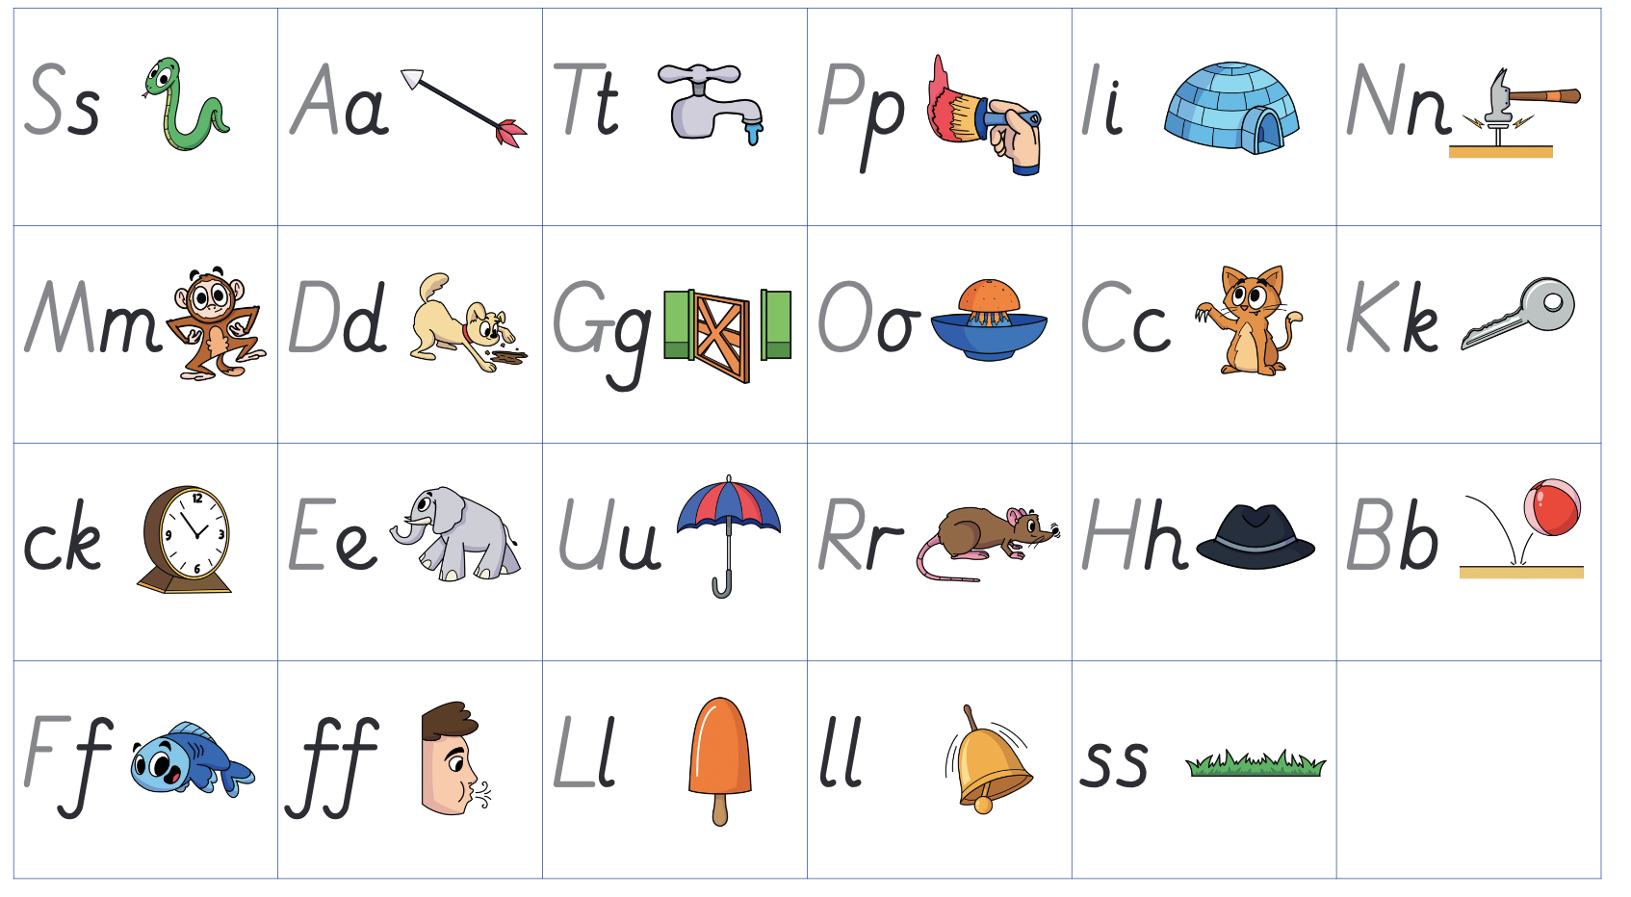
Daily Phonics Session
Each day the children take part in a daily phonics session which is the systematic method of teaching reading based on learning the sounds that the letters of the alphabet represent.
Some sounds come from single letters and other sounds are made by a combination of letters e.g. ‘oo’, ‘igh’
The teaching of phonics is divided into 6 phases. In Reception children will experience phases 1-4.
We use the terms:
Phonemes - sounds
Graphemes – letter shapes
Phase 2
The children focus on recognising each letter by sight and saying its sound as they do the corresponding action. They read flashcards and play games throughout the day.
The next step is very important as they blend letters to read words.
The children look at words and point to each letter, quickly saying the corresponding sound. e.g. m-a-t.
This is difficult for many children and takes a lot of practise!
We use pure sounds; ‘mmmm’ not’ muh’, ’sssss’ not ‘suh’, etc. This is so that your child will be able to blend the sounds into words more easily. Please see school website for details

Slide 10
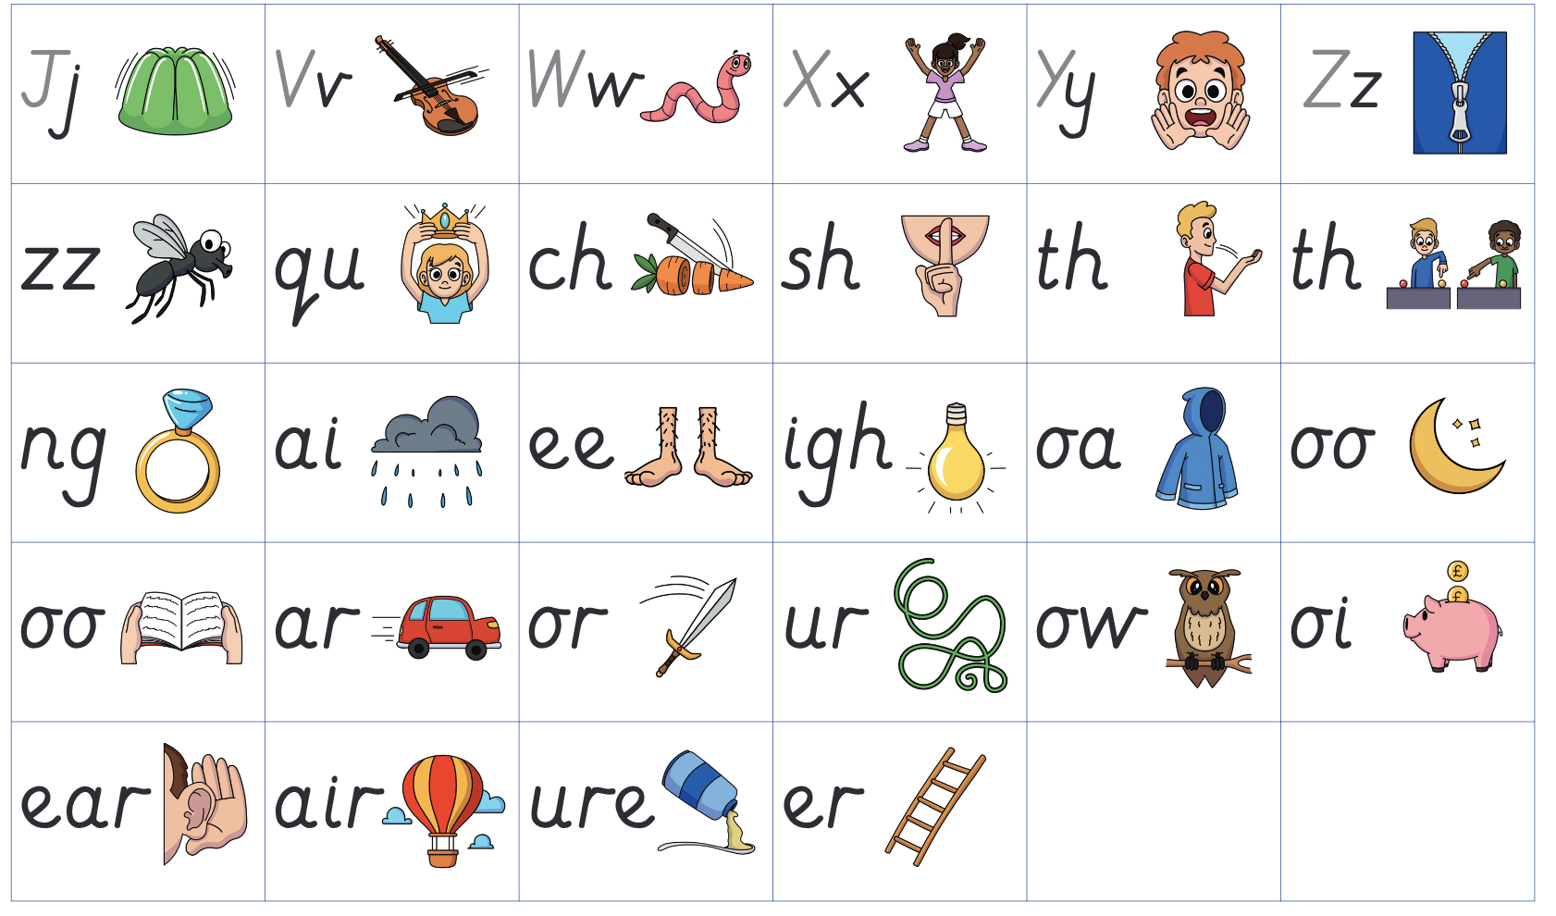
Phase 3
The children apply their blending and
segmenting skills using another set of
letters, some sounds are made using 2 or 3 letters Eg. C-ar-d, g-oa-t
Phase 4
All of the sounds learnt so far are used with adjacent consonants e.g. br-i-m, m-i-lk, p-ai-nt. The children learn to read and write these longer words,

Slide 11
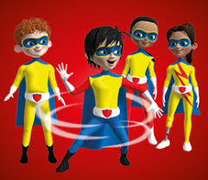
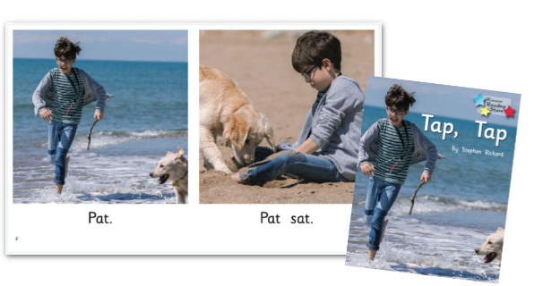
Reading books
Each week the children select a school library book to encourage discussion and encourage their enjoyment of reading.
As soon as the children can blend confidently, they are given books with short sentences.
The children’s phonic knowledge and their ability to blend are matched to our school reading books so the children will be given a book containing only sounds with which they are familiar.
We ask you to support them to read each book several times. This usually means that they become more fluent with each reading which gives them confidence.
It is important to explore the pictures because this adds to the children’s understanding of the book and the way that stories are organised.

Slide 12
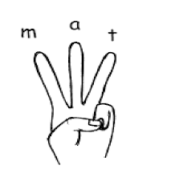
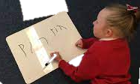
Segmenting to spell and write words
Then they segment to spell and write words.
The children use their fingers to help spell a word.
e.g. hat – They are told they need 3 fingers. They say each sound ‘pinching’ it on the end of their fingers and then write it .

Slide 13
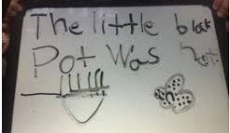
Writing sentences
As the children’s knowledge of sounds and their blending and segmenting skills develop and improve, they progress from writing words to phrases and sentences.
We use the ‘Drawing Club’ approach, which gives the children ownership of their writing and has proven to be extremely motivating.
They think of the sentence they want to write, say it several times to ‘Hold it’ in their head and then write it down from beginning to end, without stopping.
This is an important step because it is vital to build up the stamina and concentration to write a whole sentence in one go. If the children break in the middle of a sentence they tend to miss out or repeat words and the sentence does not make sense.

Slide 14
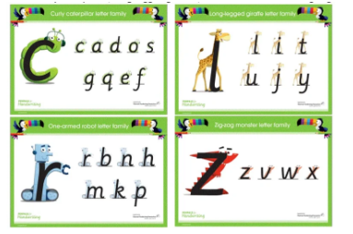
Handwriting
The letters of the alphabet can be divided into ‘families’ based on the movement made to start each letter. Mastering correct formation helps to avoid letter reversals from occurring.
Each time we write a letter we say the same sentence to help reinforce the correct movement.
The children may do this in pen, paint, shaving foam, dough.
E.g.“Let’s write a. Make a curve, go up to the top, back down and flick.”

Slide 15

Common exception words
These are words which cannot be read by blending and so the children need to read them with instant recognition.
The only way to learn them is by lots of practise. We play games and activities every week which help the children to do this.
We will send home a set of cards so you can reinforce them at home.

Slide 16
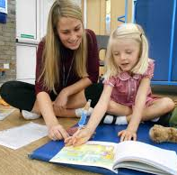
How you can support your child at home
Over the course of the year we will send home:
A pack of letter cards for phase 2 and later, phase 3 sounds.
Help them to recognise them by sight.
Games–play them as often as possible to develop blending skills.
Sets of common exception words – help your child to learn these by sight
A letter formation sheet – help your child to form letters correctly.
A reading book which will be changed weekly – Ask you child to read this at least 3 times.
Remember, reading is difficult so PRAISE, PRAISE, PRAISE!

Slide 17
Useful Resources
https://home.oxfordowl.co.uk/reading/reading-age-4-5-reception/
This is an excellent website which gives tips, ideas for games and information about reading.
There are also very short videos demonstrating the correct pronunciation of sounds and of blending
Some good free games for practicing blending. Select phase 2 initially then 3 and 4 when your child has moved on.
http://www.letters-and-sounds.com/phase-2-games.html

Slide 18
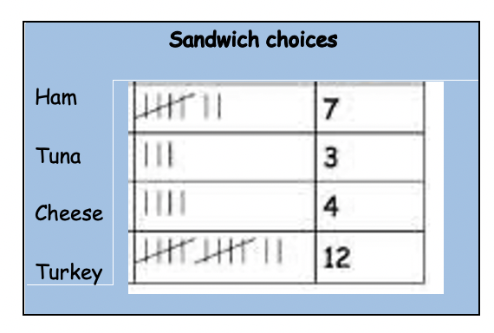

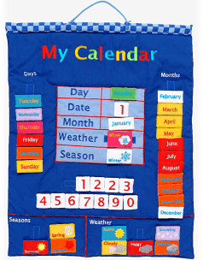
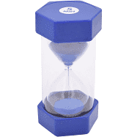
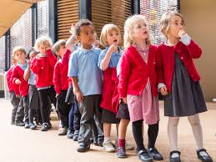

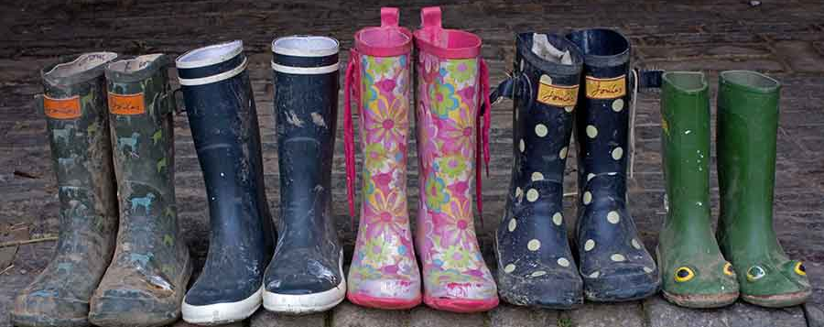

Maths as part of the
daily routine
Maths is part of our daily routine – tallies for lunch choices, counting children in and out of the classroom, counting in 2s as we pair wellies, matching , sorting and counting equipment at tidy up times. Counting to 20 as we wash our hands, sorting ourselves into pairs and 4s for activities. Talking about different times of day, looking at the clock, using a timer, voting for the home time story…..the list is endless.
We enjoy maths songs and rhymes to count forwards and backwards
We enjoy stories which introduce maths concepts
We have number and maths opportunities all over the classroom.
We play games and use practical resources before moving on to abstract pictorial representations and then numbers

Slide 19
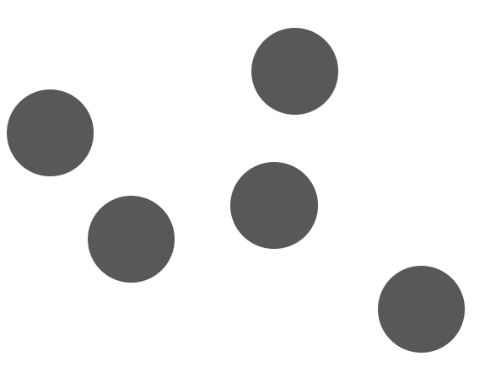
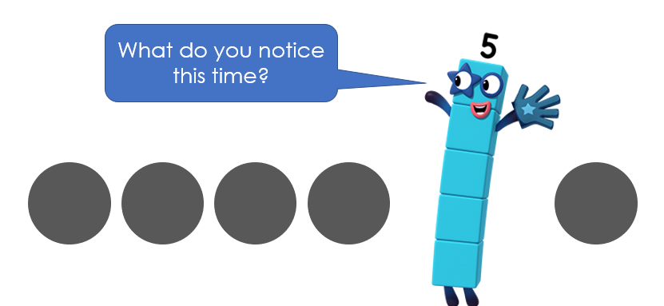

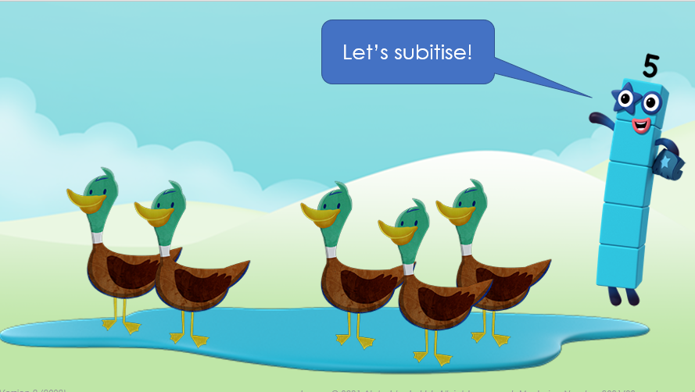
NCETM
We follow the Mastering Number curriculum where teaching Maths is taught
through the use of manipulatives and practical work. It incorporates clips from BBC ‘ ‘Numberblocks’ and which helps to embed learning and is motivating for children.
During the first term in Reception, pupils will build on previous experiences of number from their home and nursery environments, and further develop their subitising and counting skills. They will explore the composition of numbers within 5. They will begin to compare sets of objects and use the language of comparison.
Pupils will continue to develop their subitising and counting skills and explore the composition of numbers within and beyond 5. They will begin to identify when two sets are equal or unequal and connect two equal groups to doubles. They will begin to connect quantities to numerals.
Pupils will consolidate their counting skills, counting to larger numbers and developing a wider range of counting strategies. They will secure knowledge
of number facts through varied practice.

Slide 20
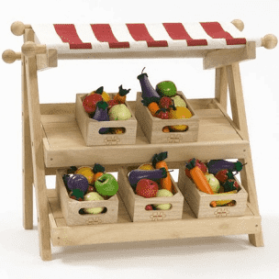
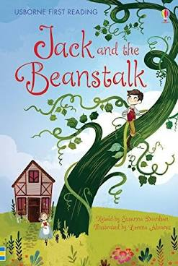
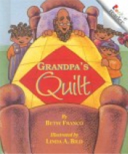
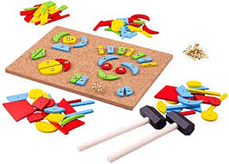
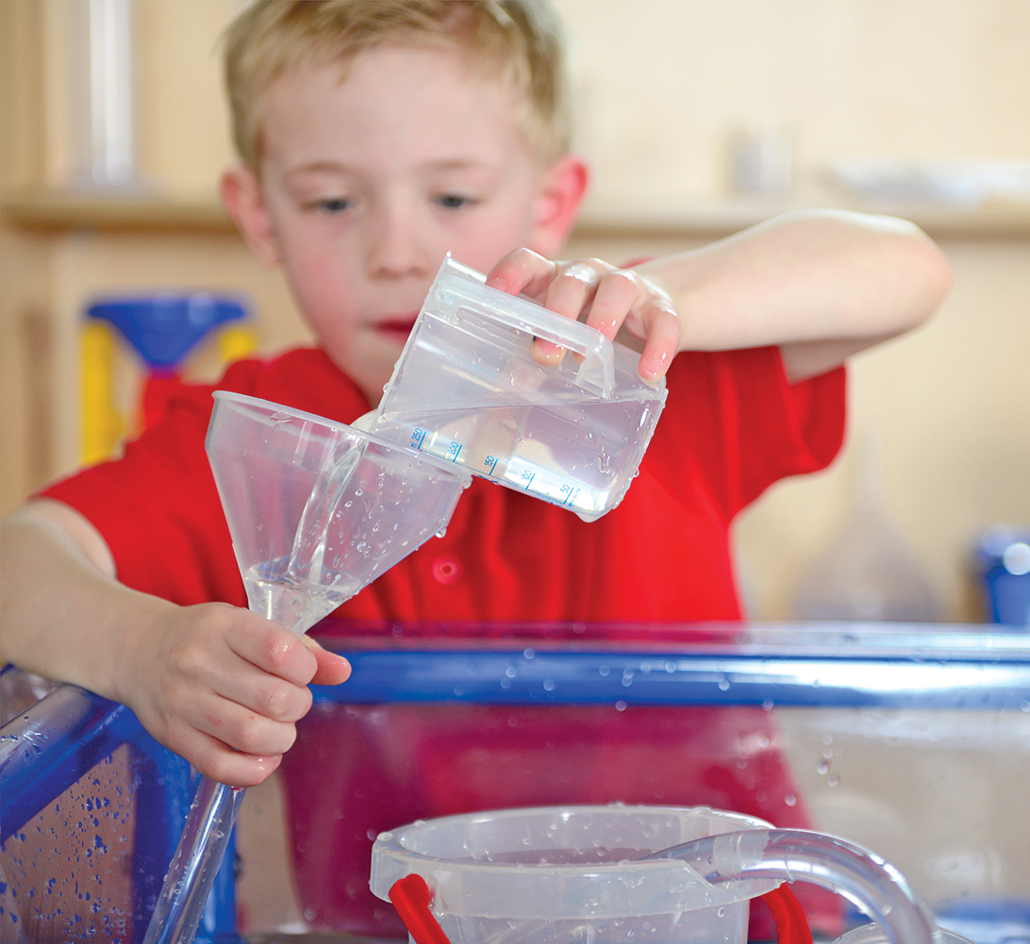
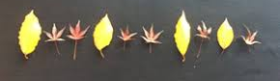
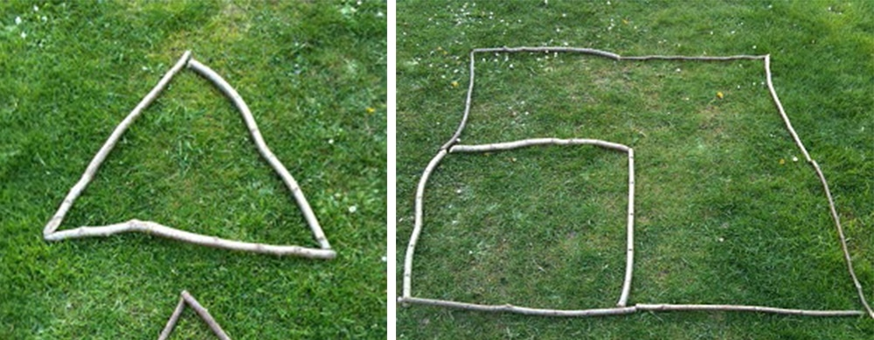
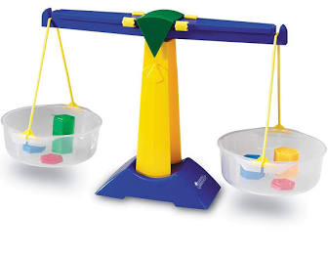
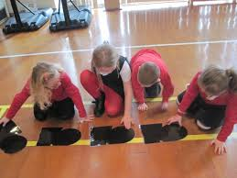
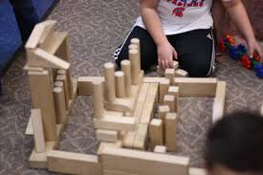
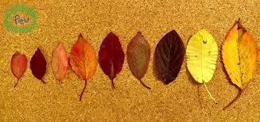
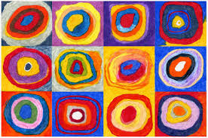
Shape, space and measure
We introduce and teach our shape, space and measure through a variety of books and songs.
Children enjoy exploring mathematical concepts of size, length, weight, capacity, time, money and position through story, songs, art and outdoor activities.
They use comparative language.
They explore characteristics of everyday objects and shapes, including making models and pictures.
They notice, copy, continue and create patterns.
They solve problems and communicate their mathematical thinking in a range of ways.

Slide 21
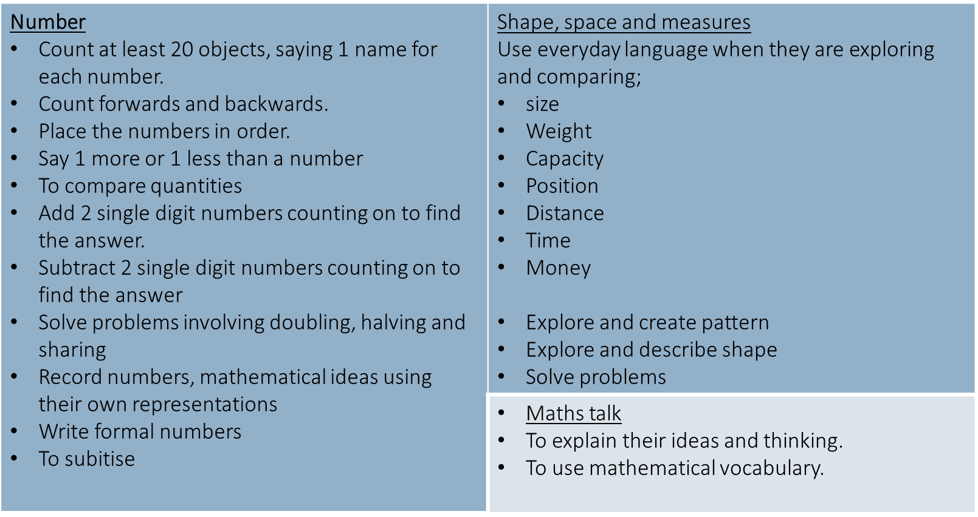
By the end of Reception we expect children to be able to…

Slide 22
How to help your child at home
In the street • Recognising bus numbers • Number plate hunt. Who can find a 7? Add the numbers up. • Comparing door numbers • Counting–how many lampposts on the way to school? | Doing the washing • Counting in 2s – matching shoes • Sorting by colour and size. • Matching/pairing up socks. • Find four shoes that are different sizes. Can you put them in order. | Time • What day is it yesterday, today, tomorrow? • Use timers, phones and clocks to measure short periods of time. • Count down 10/ 20 seconds to get to the table/ into bed etc. • Recognising numbers on the clock. If you cover a number, what number was missing?
Food! • Can you cut your toast into 4 pieces? Can you cut it into triangles? • Setting the table. Counting the right number of plates etc. How many more do we need? • Can you make shapes/ patterns out of the knives and forks. Can you put them in the right place in the drawers? • Helping with the cooking by measuring and counting ingredients. • Setting the timer. • Positional language at dinner time: what is on the rice, where are the carrots etc? | Going shopping • Reading price tags • Counting items into the basket • Finding and counting coins • Comparing weights – which is heavier? Shapes • Cut a potato into shapes (circles, triangle etc). Use with paint to make pictures and patterns. • Cut out shapes from coloured paper and arrange into pictures. • Shape hunt: Can you find a square in your house (windows etc), a circle ... | Measuring • Are you taller than a ...? • Marking height on the wall. • Cut hand shapes out of paper. How many hands long is the couch? How long is the table? Which is longer? • Who has the biggest hands in our family? • How many steps from the gate to the front door?

Slide 23
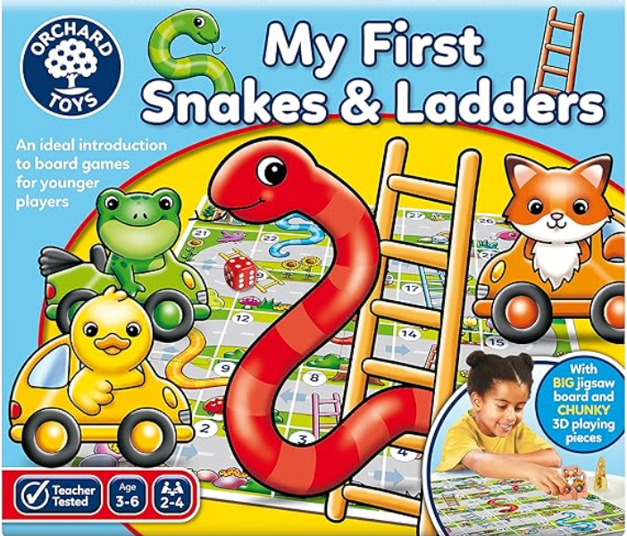
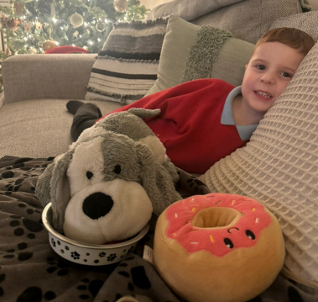
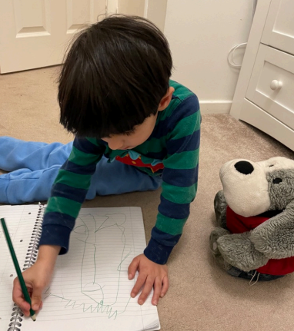
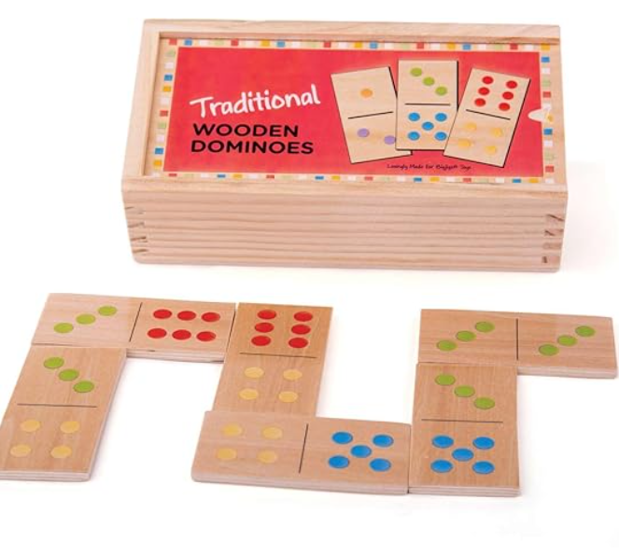
Extra Activities
Class pet
Throughout the year each child will have the opportunity to keep our class dog Bruno for a weekend. This is just a little bit of fun for children to look after Bruno for the weekend and have a fun sleepover.
Please share the pictures of your child with Bruno on tapestry and we will then share them as a class. This is a great way to build children’s confidence in talking for an audience and also sharing stories about their own lives and experiences. You do not need to do any special activities but rather, Bruno snuggled up on the sofa, playing a game or sharing tea!
Games Bag
Each child will also have the opportunity to take home our Games Bag. This includes some turn taking games as well as mathematical games and puzzles. Again this is just something to enjoy with families, siblings or friends. This will also help build children’s turn taking abilities, determination with puzzles and exploring ways of having fun.

Slide 24
Important Information
Every Thursday we will collect your childs’ book bag and keep it in school on a Thursday night.
Children will choose a book from our library to share with you for the week and we will also change your child’s reading book when they are at this stage of learning.
Please ensure that your child’s reading book is in their book bag everyday as we will read the same book with your child in school for consistency and to encourage their fluency in reading.
We will then return your childs’ book bag on a Friday and send out any games or homework for the week. We encourage you to make sure to check their book bags on a Friday evening after school to help with their home learning.

Slide 25
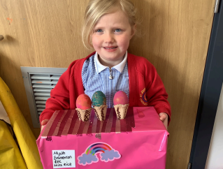








Thank- You
We look forward to sharing all the fun times on our learing journey ahead.
Please do not hesitate to ask Miss Rice or Mrs O’Neill any questions you may have.

