Slide 1
Roman Catholic Diocese of Hexham and Newcastle
St. John Vianney
Catholic Primary School
Curriculum PowerPoint 2022
Mission Statement
Through following Jesus,
we aim to be a caring, happy school,
where everyone is valued and appreciated
and can reach their true potential.
We hope to: act justly, love tenderly and walk humbly with our God.

Slide 2
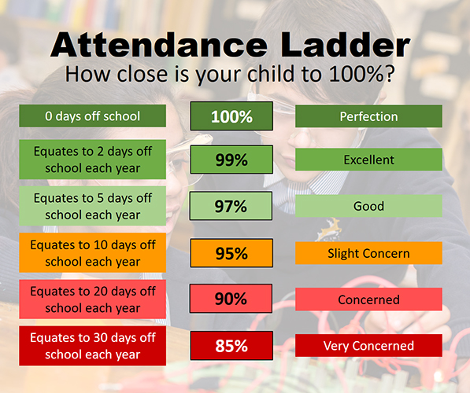
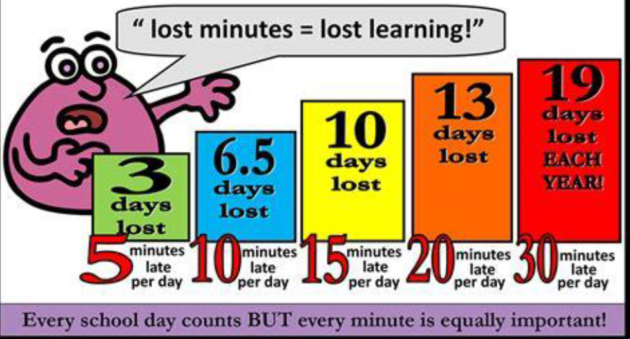
Roman Catholic Diocese of Hexham and Newcastle
St. John Vianney
Catholic Primary School
Attendance and Lateness

Slide 3
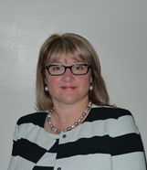
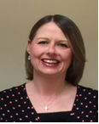
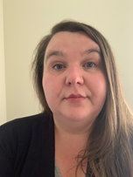
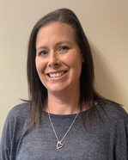
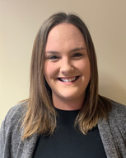
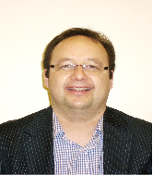
Roman Catholic Diocese of Hexham and Newcastle
St. John Vianney
Catholic Primary School
Safeguarding
St John Vianney is a safeguarding school where children’s safety is absolutely central to all that we do.
Please encourage your children to talk to a responsible adult if they have any concerns. It is this step that allows us to support vulnerable children.
As part of the Computing curriculum, the children will be taught about how to stay safe online.
Cyber-bullying is an important issue that children of all ages will be made aware of in lessons and assemblies throughout the year.
There are further resources for parents online, to address this subject sensitively. https://www.thinkuknow.co.uk/parents/
All staff are trained in the PREVENT agenda and our Designated Safeguarding Leads are:
Mrs Thorpe Mrs Meldrum Mrs McDine Miss Cherry Mrs Spencer Mrs Watanabe Mr Bell
Notes:
3

Slide 4
Roman Catholic Diocese of Hexham and Newcastle
St. John Vianney
Catholic Primary School
Curriculum
Our foundation (non-core subjects) curriculum has recently been reviewed in order to provide children with a range of new learning experiences, which may include educational visits linked to their new topics.
A copy of the updated foundation curriculum is available on the school website.
stjohnvianneynewcastle.org

Slide 5
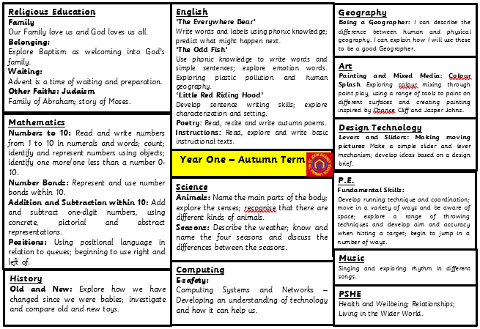
Roman Catholic Diocese of Hexham and Newcastle
St. John Vianney
Catholic Primary School

Slide 6
Roman Catholic Diocese of Hexham and Newcastle
St. John Vianney
Catholic Primary School
Reading: Year One children are taught to:
Apply phonic knowledge and skills to decode words
Read accurately by blending sounds in words
Read ‘tricky’ words that cannot be decoded using phonics (e.g. the)
Read words of more than one syllable
Listen to and discuss a wide range of poems, stories and non-fiction at a level beyond that at which they can read independently
Become very familiar with key stories, fairy tales and traditional tales
Predict what might happen next in stories
Explain clearly their understanding of what is read to them
Notes:
Reading is taught within English and Phonics lessons, as well as one to one reading weekly with a teacher or teaching assistant. It is very helpful if children can bring their reading books and reading records into school daily so they can be read with at any point during the week.

Slide 7
Roman Catholic Diocese of Hexham and Newcastle
St. John Vianney
Catholic Primary School
Reading
Children have access to a rich Reading diet. They will participate in: daily phonics sessions, whole class shared reading, comprehension activities, daily story time and home-school reading.
Every class has a library, which promotes reading for pleasure, and we also have the Reading Hub which is accessed by children weekly.
School has recently updated the reading scheme with new books, including a wider range of classic and non-fiction texts.
Please continue to leave comments in your child’s reading record, as this allows us to tailor reading experiences for all children.
Notes:
7
Daily phonics, shared reading in class with comprehension activities, stories before hometime and home-school reading of levelled books.
We have access to the school Reading Hub, where we choose a book weekly to keep in class.
It is very important that children access a range of different texts, our new reading scheme reflects this a range of fiction, non-fiction and classic texts.

Slide 8
Roman Catholic Diocese of Hexham and Newcastle
St. John Vianney
Catholic Primary School
How to help your child with Reading in KS1
By encouraging a variety of strategies to decode words e.g. using the sounds of letters.
By asking your child about what has happened in the story so far.
By asking them to make predictions about what will happen.
By reading a variety of texts of different genres and authors.
By discussing the text: I wonder…? Why…? What…? How…? Who…?
Even when the children become free readers, they still need to read aloud to an adult regularly and to hear adults reading aloud to them.
Notes:
8
Encourage and demonstrate segmenting of unfamiliar words rather than just giving them the answer.
Discuss what has happened or might happen in a story to promote comprehension skills.
It is so important that children have the opportunity to read aloud to an adult as much as possible as well as hearing adults read to them, by hearing expressive and fluent reading chn can pick up new skills in their own reading.
Progression of Reading Skills on school website, as well as Phonics sound mats for practise of digraph recognition at home or to support identifying graphemes in their reading.

Slide 9
Roman Catholic Diocese of Hexham and Newcastle
St. John Vianney
Catholic Primary School
Writing: Year One children are taught to:
Use phonic skills and knowledge to spell words
Spell common exception words (tricky words)
Write from memory simple sentences dictated by the teacher
Sit correctly at a table, holding a pencil comfortably and correctly
Form lower case and capital letters using the correct letter formation
Compose a sentence orally before writing it
Sequence sentences to form short narratives
Read aloud what they have read to check it makes sense
Notes:
Use of phonics to form words is the foundation of Year 1 writing. We encourage say it, sound it, write it to tackle new words.
CEW are learnt, practised and revisited in phonics lessons and available on display in class.
3 times a week we have stand alone handwriting sessions were we focus on correct sitting, pencil grip and letter formation to promote good writing technique in lessons.
We start from dictating sentences for the chn to write, then building their own sentences (counting out the words in their sentence and reciting it to writing it down). Eventually chn will confidently sequence sentences together to form short narratives.
By the end of the year chn will be able to use capital letters and full stops in sentences, as well as understanding why a writer uses these and commas, question marks and exclamation marks. end of year expectations on website.

Slide 10
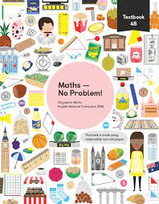
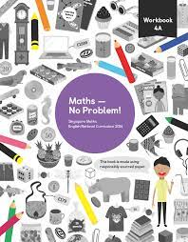
Roman Catholic Diocese of Hexham and Newcastle
St. John Vianney
Catholic Primary School
Maths-No Problem!
This September, we have fully adopted a Maths-No Problem! mastery scheme from Reception to Year 6. It is delivered using the concrete, pictorial and abstract methodology to ensure children have a deep understanding of mathematical concepts.
Notes:
10

Slide 11
Roman Catholic Diocese of Hexham and Newcastle
St. John Vianney
Catholic Primary School
Maths: Year One children are taught to:
Use and understand maths vocabulary
Count to and across 100, forwards and backwards from any given number
Count, read and write numbers to 100 in numerals
Read and write numbers from 1-20 in numerals and words
Identify 1 more and 1 less than a given number
Use number bonds and related subtraction facts within 20
Count in multiples of 2, 5 and 10
Recognise, find and name a half as 1 of 2 equal parts and a quarter as 1 of 4 equal parts of an object, shape or quantity
Solve measurement problems
Tell the time to the hour and half past the hour
Notes:
Focus on use and understanding of vocabulary across subjects.
Counting to and back from 100.
Writing numbers to 100 in numerals and numbers to 20 in words.
Identify one more and less than a number.
Use number bonds to 20, addition and subtraction facts.
Counting in multiples of 2s 5s and 10s.
Simple fractions, measuring and telling the time to half past the hour on an analogue clock.
Taught during maths lessons using Maths No Problem mastery curriculum, as well as Rekenrek which is a mastering number programme

Slide 12
Roman Catholic Diocese of Hexham and Newcastle
St. John Vianney
Catholic Primary School
Calculation Policy
The Calculation Policy can be found on the school website. It is in line with the National Curriculum and reflects the strategies and methods taught in each year group.
The National Curriculum is more challenging than ever before. Examples of expectations for each year group are provided.
Notes:
12

Slide 13
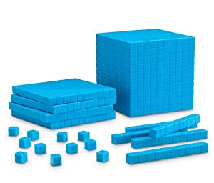
Roman Catholic Diocese of Hexham and Newcastle
St. John Vianney
Catholic Primary School
Progression of skills - Calculation
Concrete Pictorial Abstract
Children manipulate
hands on materials
Children use diagrams and
pictures to support their
mathematical understanding
Children use mathematical symbols and numbers
5 = 3 + 2
Notes:
13
New programme bases all skills and elements on concrete skills first then to collecting and answering problems as a pictorial before progressing to the abstract.
notice the organisation of the calculation, equals symbol has to be recognised almost as a balancing scale.

Slide 14
Roman Catholic Diocese of Hexham and Newcastle
St. John Vianney
Catholic Primary School
Times Tables
Children in Year One will learn to count in 2s, 5s and 10s.
These skills will support their progression in Year 2 where they will practise times tables
Notes:
14
Initially counting then practising as a times table 1 x 2 is 2.

Slide 15
Roman Catholic Diocese of Hexham and Newcastle
St. John Vianney
Catholic Primary School
PSHE
Personal, Social, Health and Economic (PSHE) Education is a subject through which pupils develop the knowledge, skills and attributes they need to manage their lives, now and in the future. It helps children to stay healthy and safe, while preparing them to make the most of life and work.
(PSHE Association 2021)
The PSHE Curriculum is broken up into three core themes:
Health and Wellbeing
Relationships
Living in the Wider World
Notes:
15
Contents:
NURSERY - Wonder at God's Love
RECEPTION - God loves each of us in our uniqueness
YEAR ONE - We meet God's love in our family
YEAR TWO - We meet God's love in the community
YEAR THREE - How we live in love
YEAR FOUR - God loves us in our differences
YEAR FIVE - God loves me in my changing and development
YEAR SIX - The wonder of God's love in creating new life
JOURNEY OF LIFE
SOME PERSPECTIVES ON MARRIAG

Slide 16
Roman Catholic Diocese of Hexham and Newcastle
St. John Vianney
Catholic Primary School
Positivity and Wellbeing
Strategies used across school to promote positive mental health in children include:
Daily ‘Check In’ feelings chart
Worry boxes
Positive quote of the week
Rainbows (Bereavement/ Separation Anxiety)
SEMH Mentor
Counselling (from specially trained counsellors)

Slide 17
Roman Catholic Diocese of Hexham and Newcastle
St. John Vianney
Catholic Primary School
Children’s Reports
Children will receive a school report, detailing whether they are in line with, working above or working towards national levels of expectation for all subjects taught across the curriculum.
The children are continually assessed and their development closely monitored and tracked as part of our rigorous and on-going assessment process.

Slide 18
Roman Catholic Diocese of Hexham and Newcastle
St. John Vianney
Catholic Primary School
Important Class Information
Spellings – given on a Friday to learn for the following Friday
Homework – Daily (Spellings, Reading and NumBots)
P.E. – Monday Afternoon (Sports Coaches) & Wednesday Morning (Mrs O’Neill & Miss Young)
Reading Books – Changed weekly, collected in on a Monday and handed back out on a Tuesday
NumBots – Logins are in children’s Reading Records, this supports the foundations for Maths in Year One.
Notes:
18
NumBots- helps with fluency in mathematics skills

Slide 19
Roman Catholic Diocese of Hexham and Newcastle
St. John Vianney
Catholic Primary School
Life Long Learning
At St John Vianney, we promote a love of learning and encourage children to be ‘Life Long Learners’. We want children to apply their learning to all areas of their life, to equip them to deal with a range of situations. This includes: academic learning, emotional learning (i.e. tolerance and resilience) and life skills. Our aim is for all children to become well rounded adults, who never stop wanting to learn.

Slide 21
Roman Catholic Diocese of Hexham and Newcastle
St. John Vianney
Catholic Primary School
Our new Behaviour and Rewards System
We are currently reviewing our Behaviour Policy across school to include pupil voice and pupil’s opinions. Parents will be informed when the new policies have been agreed by Governors.
We continue to emphasis and promote positive behaviour, rewarding those pupils who consistently behave appropriately and track those pupils who find it harder to meet our expectations of behaviour in school.
Last year, we revised our whole-school House Points system. Every child is part of a House Group (there are six houses in total) and children are awarded house points for following our school rules. Every Friday, the house points for each house are added together and the house with the most house points is praised during our Golden Book Assembly. We know that these systems continue to enhance the behaviour and reward systems already in place here at St. John Vianney school.
Notes:
21

Slide 22
Roman Catholic Diocese of Hexham and Newcastle
St. John Vianney
Catholic Primary School
Questions
If you have any further questions arising from this PowerPoint, please contact us at office@stjohnvianneynewcastle.org and we will be more than happy to help.
Thank You.
Notes:
22

