Slide 1

Roman Catholic Diocese of Hexham and Newcastle
St. John Vianney
Catholic Primary School
Curriculum Evening 2025
Mission Statement
Through following Jesus,
we aim to be a caring, happy school,
where everyone is valued and appreciated
and can reach their true potential.
We hope to: act justly, love tenderly and walk humbly with our God.
Notes:
Welcome

Slide 2
Roman Catholic Diocese of Hexham and Newcastle
St. John Vianney
Catholic Primary School
Our Year 3 Team
Mrs Bowden - Teacher
Miss Davison - Teacher
Miss Sales – Teaching assistant
Mrs Stafford – Wednesday morning
Miss Davidson – Music teacher
Miss Hurley – Music teacher
PE coaches
Notes:
Welcome

Slide 3
Roman Catholic Diocese of Hexham and Newcastle
St. John Vianney
Catholic Primary School
Year 3 Timetable
8.30 – 8.45 Children arrive and complete morning job
Register
9.00 – 10.00 Lesson 1
10.00 – 10.25 Lesson 2
Playtime
10.40 – 11.15 Lesson 2 continued
11.15 – 12.15 Lesson 3
Lunch
1.15 – 3.00 Blocked foundation subjects
Notes:
Welcome

Slide 4

Roman Catholic Diocese of Hexham and Newcastle
St. John Vianney
Catholic Primary School
Reading
Children have access to a rich Reading diet. They will participate in: whole class shared reading, VIPERS guided reading sessions, comprehension activities, daily story time and home-school reading.
Every class has access to school library books, which promote reading for pleasure.
Please continue to sign and leave comments in your child’s reading record. When your child has finished their book please indicate this and the book will be changed.
We are currently assessing all of the children’s reading using PM Bench Mark, which is a thorough and comprehensive programme. Their reading levels will be changed in accordance with this assessment.
Notes:
4

Slide 5

Roman Catholic Diocese of Hexham and Newcastle
St. John Vianney
Catholic Primary School
Reading VIPERS
Reading Vipers is a whole school strategy for teaching the key reading skills as outlined in the National Curriculum.
It ensures that children are accessing and improving in every reading skill.
Notes:
5

Slide 6
Roman Catholic Diocese of Hexham and Newcastle
St. John Vianney
Catholic Primary School
How to help your child with Reading in KS2
Use the range of VIPERS skills to discuss your child’s reading books with them:
Vocabulary – Discuss the meaning of new and unfamiliar words; discuss why an author has chosen certain words and their effects.
Inference – What clues has the author given you about characters, settings and atmosphere in the story? What does this make you think?
Prediction – What do you think is going to happen next?
Explanation/Evaluation – Why has the author set out the story in this way? Do you like the story so far? Why/why not?
Retrieval – Can your child remember key facts form the story?
Summarise – Ask your child to summarise a chapter or even the whole story. Can they make up a headline, summarise in 10 words or recap the story in one minute?
Even when the children become free readers, they still need to read aloud to an adult regularly and to hear adults reading aloud to them. Examples of questions you can ask your child can be found on our school website.
Notes:
6

Slide 7
Roman Catholic Diocese of Hexham and Newcastle
St. John Vianney
Catholic Primary School
Year 3 Handwriting
-This term we are concentrating on the basic skills including handwriting and presentation.
Children need to be have a secure pencil grip and ability to form letters correctly and accurately.
Secure handwriting helps with writing stamina, meaning that children will be able to write longer pieces of work when they are ready without tiring.
Notes:
Welcome

Slide 8
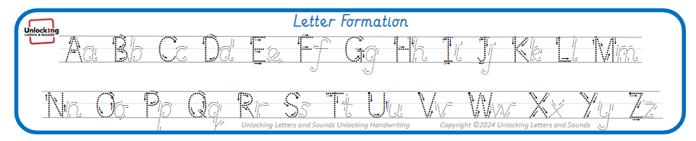
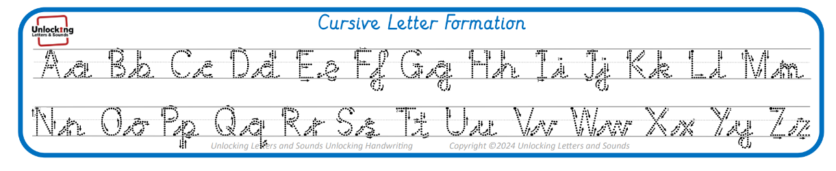
Roman Catholic Diocese of Hexham and Newcastle
St. John Vianney
Catholic Primary School
Year 3 Handwriting
Notes:
Welcome

Slide 9

Roman Catholic Diocese of Hexham and Newcastle
St. John Vianney
Catholic Primary School
Year 3 Spelling
Spelling tests take place every Friday in class.
To help your child learn their weekly spellings you can play games on Ed Shed.
Your child will be provided with a username and password for Ed Shed. It is a fun and engaging way to support spelling practise.
Notes:
Welcome

Slide 10
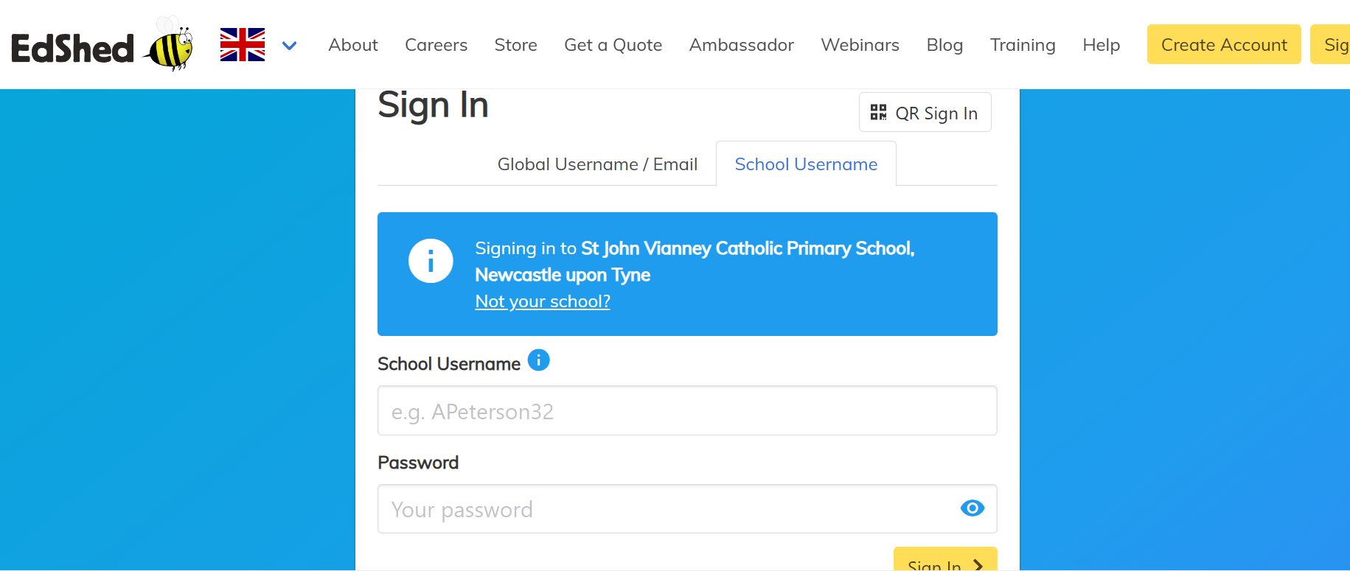
Roman Catholic Diocese of Hexham and Newcastle
St. John Vianney
Catholic Primary School
Notes:
Welcome

Slide 11

Roman Catholic Diocese of Hexham and Newcastle
St. John Vianney
Catholic Primary School
Notes:
Welcome

Slide 12


Slide 13
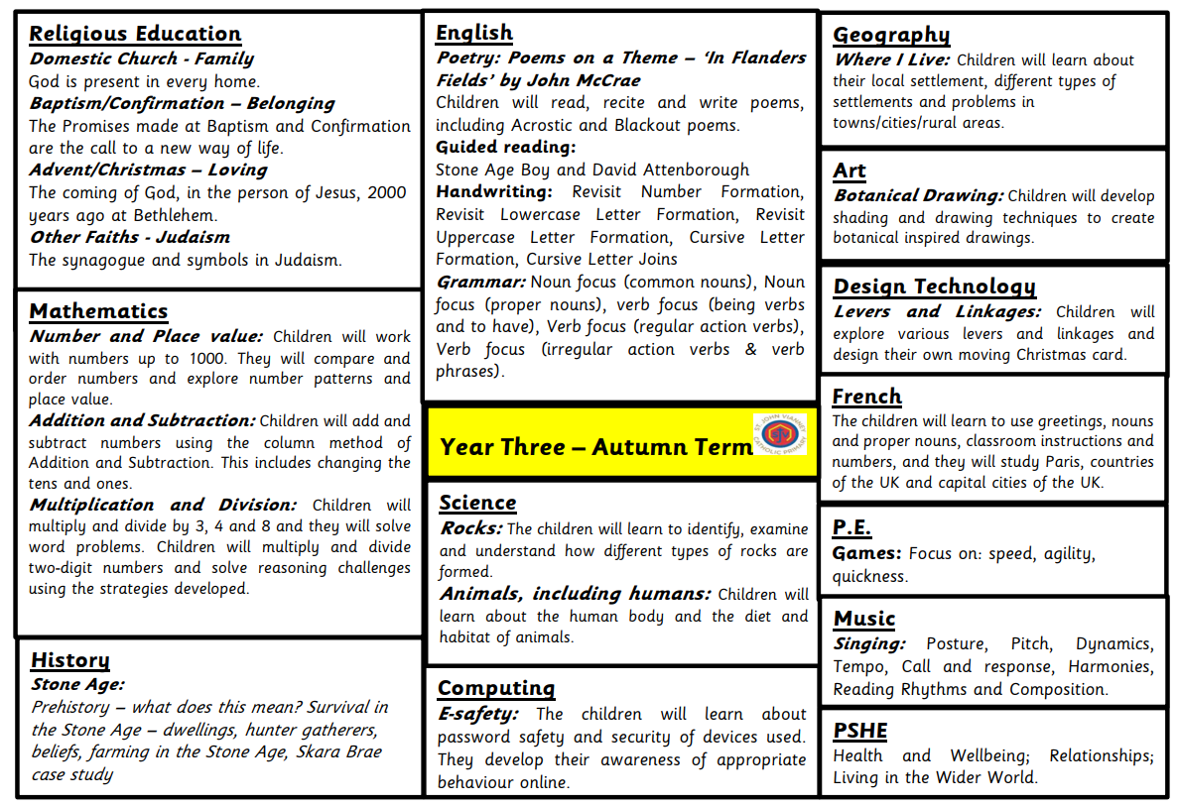
Roman Catholic Diocese of Hexham and Newcastle
St. John Vianney
Catholic Primary School
Year 3 Curriculum - Autumn
Notes:
Welcome

Slide 14


Roman Catholic Diocese of Hexham and Newcastle
St. John Vianney
Catholic Primary School
Maths-No Problem!
We are continuing to embed the mastery approach of Maths No-Problem from Year 1 to Year 6. It is delivered using the concrete, pictorial and abstract methodology to ensure children have a deep understanding of mathematical concepts. It is much more focused on pupils refining their problem solving and reasoning skills.
Notes:
14

Slide 15
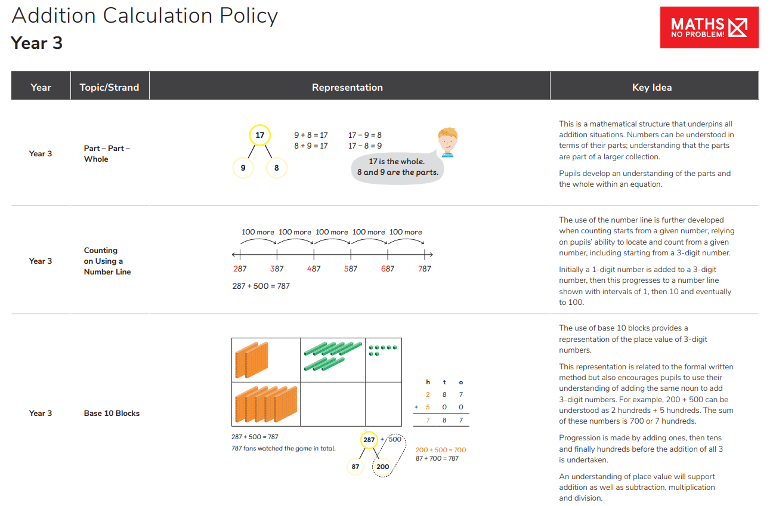
Roman Catholic Diocese of Hexham and Newcastle
St. John Vianney
Catholic Primary School
Maths Calculation Policy
Our Maths Calculation Policy can be found on our school website and is a fabulous resources to see how we teach Maths in school.
Notes:
Welcome

Slide 16
Roman Catholic Diocese of Hexham and Newcastle
St. John Vianney
Catholic Primary School
Year 3 Times tables
-Year 3 children will learn to count in steps of 3, 4 and 8
Times Tables can be practised using Times Tables Rockstars. This online programme is designed to advance as your child makes progress. Don’t worry if they struggle at first as they will pick it up and gain speed and maths fluency the more they play.
If your child struggles with TTRS please login to Numbots, which supports fluency in addition and subtraction.
Notes:
Welcome

Slide 17
Roman Catholic Diocese of Hexham and Newcastle
St. John Vianney
Catholic Primary School
How can you help at home?
-Listen to your child read little and often
Read to your child for pleasure
Encourage them to play TTRS, Numbots or Maths games on EdShed
Support them to learn their spellings (Spelling Shed)
Help them to form letters correctly and accurately during homework activities or when writing at home (shopping lists, birthday cards etc)
Notes:
Welcome

Slide 18
Roman Catholic Diocese of Hexham and Newcastle
St. John Vianney
Catholic Primary School
Uniform Policy
Please can you ensure EVERYTHING is labelled with your child’s name.
No earrings in school please. Children will not take part in PE if they have earrings in (even if they are taped).
Warm coat for winter playtimes.
PE kits to be worn on Wednesday.
Notes:
Welcome

Slide 19
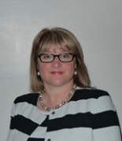
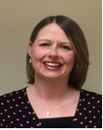

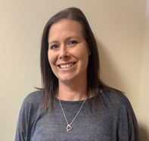
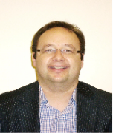
Roman Catholic Diocese of Hexham and Newcastle
St. John Vianney
Catholic Primary School
Safeguarding
St John Vianney is a safeguarding school where children’s safety is absolutely central to all that we do.
Please encourage your children to talk to a responsible adult if they have any concerns. It is this step that allows us to support vulnerable children.
As part of the Computing curriculum, the children will be taught about how to stay safe online.
Cyber-bullying is an important issue that children of all ages will be made aware of in lessons and assemblies throughout the year.
There are further resources for parents online, to address this subject sensitively. https://www.thinkuknow.co.uk/parents/
All staff are trained in the PREVENT agenda and our Designated Safeguarding Leads are:
Mrs Thorpe Mrs Meldrum Mrs McDine Miss Cherry Mr Bell
Notes:
19
Keeping children safe in school is our absolute priority.
There are designated safe guarding leads however it is the responsiblity of all staff to ensure children are kept safe.
The DLS are the people we report to with concerns or questions.
We ask that if your child is getting picked up from someone different to normal, that you please let the school office know.

Slide 20

Roman Catholic Diocese of Hexham and Newcastle
St. John Vianney
Catholic Primary School
Positivity and Wellbeing
Strategies used across school to promote positive mental health in children include:
Daily ‘Check In’
Mindfulness activities and breathing techniques
GoNoodle
Whole class sensory circuits

Slide 21
Roman Catholic Diocese of Hexham and Newcastle
St. John Vianney
Catholic Primary School
Reporting about your children
Autumn parents evening
Spring parents evening
Summer reports

Slide 22

Roman Catholic Diocese of Hexham and Newcastle
St. John Vianney
Catholic Primary School
The Behaviour and Rewards System
The current Behaviour Policy was introduced in January 2023 and is now embedded across school. READY, RESPECTFUL, SAFE ensures all pupils know what is expected of them. It has had a really positive impact in school. This half term the focus is on manners.
We continue to emphasis and promote positive behaviour, rewarding those pupils who consistently behave appropriately and track those pupils who find it harder to meet our expectations of behaviour in school.
Notes:
22

Slide 23
Roman Catholic Diocese of Hexham and Newcastle
St. John Vianney
Catholic Primary School
High Expectations so that everyone can
reach their true potential
Standards are high and a certain expectation is required – from writing 1 digit in each box in a Mathematics book to writing on the line with the long date for all pieces of work. Underlining titles and dates using a ruler is new for the children so practice at home would be beneficial!
Positive behaviour is promoted through house points. The gospel values are referred to and encouraged daily. Boundaries are established and respected to ensure our classroom remains a safe and welcoming learning environment.
Notes:
23

Slide 24
Roman Catholic Diocese of Hexham and Newcastle
St. John Vianney
Catholic Primary School
Behaviour and Rewards System
We continue to emphasis and promote positive behaviour, rewarding those pupils who consistently behave appropriately and track those pupils who find it harder to meet our expectations of behaviour in school.
Whole-school House Points system - Every child is part of a House Group (there are six houses in total) and children are awarded house points for following our school rules. Every Friday, the house points for each house are added together and the house with the most house points is praised during our Celebration Assembly. We know that these systems continue to enhance the behaviour and reward systems already in place here at St. John Vianney school.
Notes:
24

Slide 25
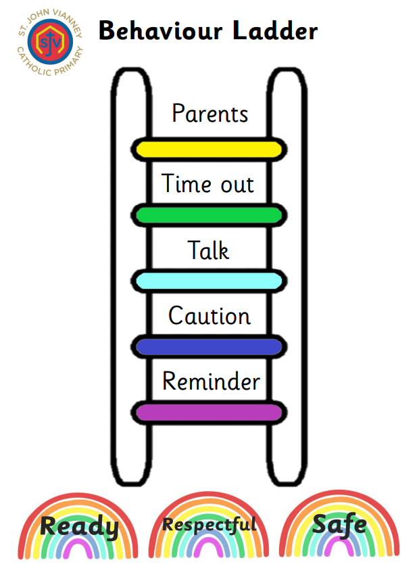
Roman Catholic Diocese of Hexham and Newcastle
St. John Vianney
Catholic Primary School
Notes:
25

Slide 26
Roman Catholic Diocese of Hexham and Newcastle
St. John Vianney
Catholic Primary School
Important Class Information
Spellings – given out half termly to learn for Friday’s test.
Homework – Daily (Spellings, Reading and Times Tables Rockstars)
P.E. – Wednesday
Reading Books – Changed weekly.
AB: books to be handed in on a Tuesday and new books to be given out on a Wednesday.
FD: books to be handed in on a Thursday and new books to be given out on a Friday.
Notes:
26

Slide 27
Roman Catholic Diocese of Hexham and Newcastle
St. John Vianney
Catholic Primary School
Questions
If you have any further questions arising from this PowerPoint, please contact us at office@stjohnvianneynewcastle.org and we will be more than happy to help.
Thank You.
Notes:
27

