Slide 1

Roman Catholic Diocese of Hexham and Newcastle
St. John Vianney
Catholic Primary School
Curriculum PowerPoint 2025
Mission Statement
Through following Jesus,
we aim to be a caring, happy school,
where everyone is valued and appreciated
and can reach their true potential.
We hope to: act justly, love tenderly and walk humbly with our God.

Slide 2
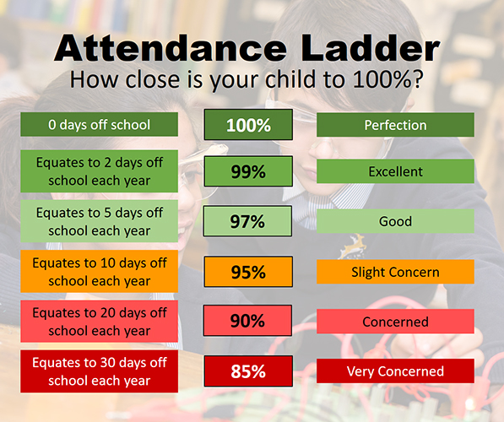
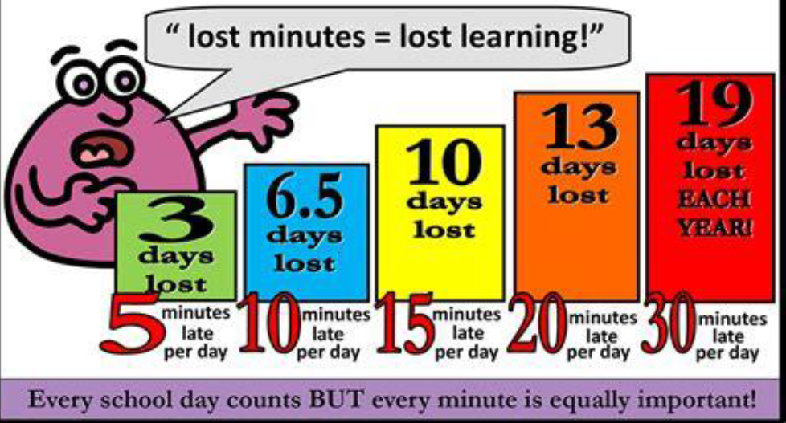
Roman Catholic Diocese of Hexham and Newcastle
St. John Vianney
Catholic Primary School
Attendance and Lateness

Slide 3
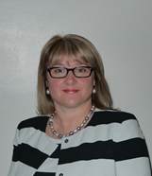
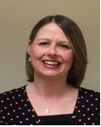
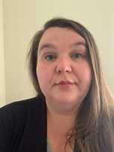
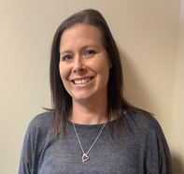
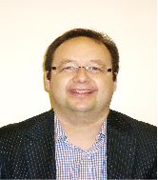
Roman Catholic Diocese of Hexham and Newcastle
St. John Vianney
Catholic Primary School
Safeguarding
St John Vianney is a safeguarding school where children’s safety is absolutely central to all that we do.
Please encourage your children to talk to a responsible adult if they have any concerns. It is this step that allows us to support vulnerable children.
As part of the Computing curriculum, the children will be taught about how to stay safe online.
Cyber-bullying is an important issue that children of all ages will be made aware of in lessons and assemblies throughout the year.
There are further resources for parents online, to address this subject sensitively. https://www.thinkuknow.co.uk/parents/
All staff are trained in the PREVENT agenda and our Designated Safeguarding Leads are:
Mrs Thorpe Mrs Meldrum Mrs McDine Miss Cherry Mr Bell
Notes:
3

Slide 4
Roman Catholic Diocese of Hexham and Newcastle
St. John Vianney
Catholic Primary School
Curriculum
Our Foundation (non-core subjects) subject curriculum has recently been reviewed in order to provide children with a range of new learning experiences, which may include educational visits linked to their new topics.
A copy of the updated foundation curriculum is available on our school website.

Slide 5
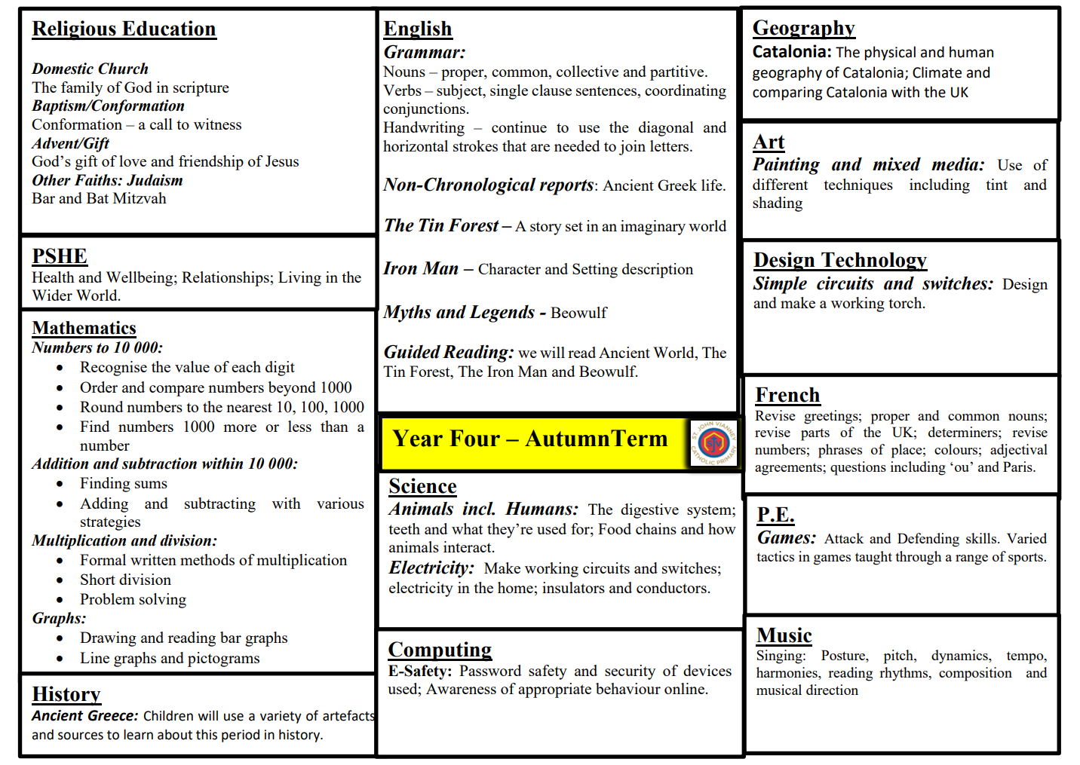

Roman Catholic Diocese of Hexham and Newcastle
St. John Vianney
Catholic Primary School

Slide 6
Roman Catholic Diocese of Hexham and Newcastle
St. John Vianney
Catholic Primary School
What children should know by the end of Year 4
Year 4 Reading
Give a personal point of view on a text. Re-explain a text with confidence. Justify inferences with evidence, predicting what might happen from details stated or implied. Use appropriate voices for characters within a story. Recognise apostrophe of possession (plural). Identify how sentence type can be changed by altering word order, tenses, adding/deleting words or amending punctuation. Explain why a writer has used different sentence types or a particular word order and the effect it has created. Skim and scan to locate information and/or answer a question.

Slide 7
Roman Catholic Diocese of Hexham and Newcastle
St. John Vianney
Catholic Primary School
What children should know by the end of Year 4
Year 4 Writing
Place value of punctuation Vary sentence structure, using different openers. Use adjectival phrases (e.g. biting cold wind). Use appropriate choice of noun or pronoun. Use fronted adverbials. Use apostrophe for plural possession. Use a comma after fronted adverbial (e.g. Later that day, I heard bad news.). Use commas to mark clauses. Use inverted commas and other punctuation to punctuate direct speech. Use paragraphs to organise ideas around a theme. Use connecting adverbs to link paragraphs. Write with increasing legibility, consistency and fluency using cursive style.
Notes:
Vary sentence structure, using different openers.
Use adjectival phrases (e.g. biting cold wind).
Use appropriate choice of noun or pronoun.
Use fronted adverbials.
Use apostrophe for plural possession.
Use a comma after fronted adverbial (e.g. Later that day, I heard bad news.).
Use commas to mark clauses.
Use inverted commas and other punctuation to punctuate direct speech.
Use paragraphs to organise ideas around a theme.
Use connecting adverbs to link paragraphs.
Write with increasing legibility, consistency and fluency.

Slide 8
Roman Catholic Diocese of Hexham and Newcastle
St. John Vianney
Catholic Primary School
Year 4 Maths
Count backwards through zero to include negative numbers. Compare and order numbers beyond 1,000. Compare and order numbers with up to 2 decimal places. Read Roman numerals to 100. Find 1,000 more/less than a given number. Count in multiples of 6, 7, 9, 25 and 1000. Recall and use multiplication and division facts all tables to 12 x 12. Recognise PV of any 4-digit number. Round any number to the nearest 10, 100 or 1,000. Round decimals with 1dp to nearest whole number. Add and subtract numbers with up to 4-digits using written columnar method. Multiply: 1. 2-digit by 1-digit 2. 3-digit by 1-digit Count up/down in hundredths. Recognise and write equivalent fractions. Add and subtract fractions with same denominator. Read, write and convert time between analogue and digital 12 and 24 hour clocks.
Notes:
Give a personal point of view on a text.
Re-explain a text with confidence.
Justify inferences with evidence, predicting what might happen from details stated or implied.
Use appropriate voices for characters within a story.
Recognise apostrophe of possession (plural).
Identify how sentence type can be changed by altering word order, tenses, adding/deleting words or amending punctuation.
Explain why a writer has used different sentence types or a particular word order and the effect it has created.
Skim and scan to locate information and/or answer a question.

Slide 9
Roman Catholic Diocese of Hexham and Newcastle
St. John Vianney
Catholic Primary School
Reading
Children have access to a rich Reading diet. They will participate in: whole class shared reading, VIPERS guided reading sessions, comprehension activities, daily story time and home-school reading.
Every class has a selection of books, which promotes reading for pleasure, and we also have a school library which is accessed by children weekly.
School has recently updated the reading scheme with new books, including a wider range of classic and non-fiction texts.
Please continue to leave comments in your child’s reading record, as this allows us to tailor reading experiences for all children.
Notes:
9

Slide 10
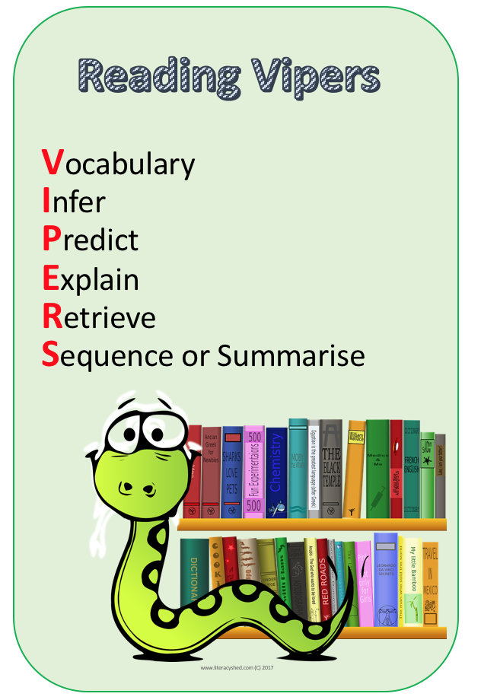
Roman Catholic Diocese of Hexham and Newcastle
St. John Vianney
Catholic Primary School
Reading VIPERS
Reading Vipers is a whole school strategy for teaching the key reading skills as outlined in the National Curriculum.
It ensures that children are accessing and improving in every reading skill.
Notes:
10

Slide 11
Roman Catholic Diocese of Hexham and Newcastle
St. John Vianney
Catholic Primary School
How to help your child with Reading in KS2
Use the range of VIPERS skills to discuss your child’s reading books with them:
Vocabulary – Discuss the meaning of new and unfamiliar words; discuss why an author has chosen certain words and their effects.
Inference – What clues has the author given you about characters, settings and atmosphere in the story? What does this make you think?
Prediction – What do you think is going to happen next?
Explanation/Evaluation – Why has the author set out the story in this way? Do you like the story so far? Why/why not?
Retrieval – Can your child remember key facts form the story?
Summarise – Ask your child to summarise a chapter or even the whole story. Can they make up a headline, summarise in 10 words or recap the story in one minute?
Even when the children become free readers, they still need to read aloud to an adult regularly and to hear adults reading aloud to them. Examples of questions you can ask your child can be found on our school website.
Notes:
11

Slide 12


Roman Catholic Diocese of Hexham and Newcastle
St. John Vianney
Catholic Primary School
Maths-No Problem!
We have fully adopted a Maths-No Problem! mastery scheme from Reception to Year 6. It is delivered using the concrete, pictorial and abstract methodology to ensure children have a deep understanding of mathematical concepts.
Notes:
12

Slide 13
Roman Catholic Diocese of Hexham and Newcastle
St. John Vianney
Catholic Primary School
Calculation Policy
The Calculation Policy can be found on the school website. It is in line with the National Curriculum and reflects the strategies and methods taught in each year group.
The National Curriculum is more challenging than ever before. Examples of expectations for each year group are provided.
Notes:
13

Slide 14
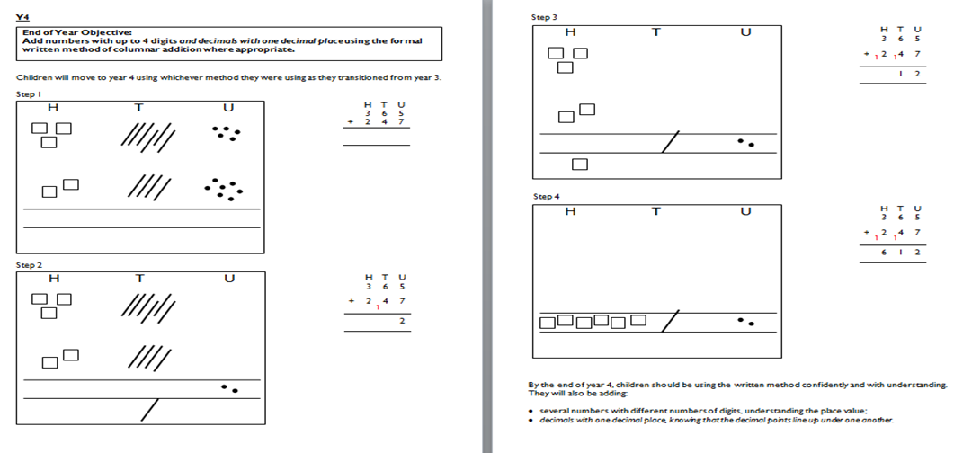
Roman Catholic Diocese of Hexham and Newcastle
St. John Vianney
Catholic Primary School
Calculation Examples: Addition
Notes:
14

Slide 15
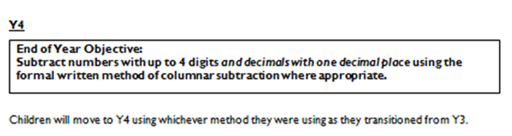
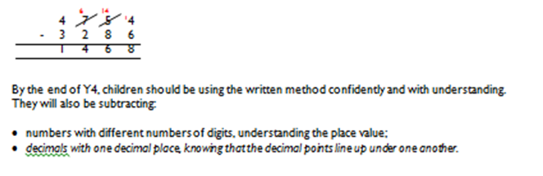
Roman Catholic Diocese of Hexham and Newcastle
St. John Vianney
Catholic Primary School
Calculation Examples: Subtraction
Notes:
15

Slide 16
Roman Catholic Diocese of Hexham and Newcastle
St. John Vianney
Catholic Primary School
Calculation Examples: Multiplication
Notes:
16

Slide 17
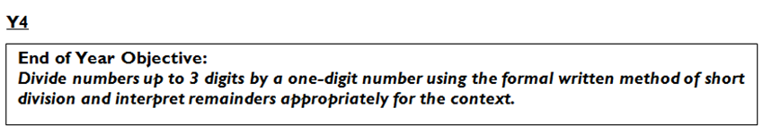
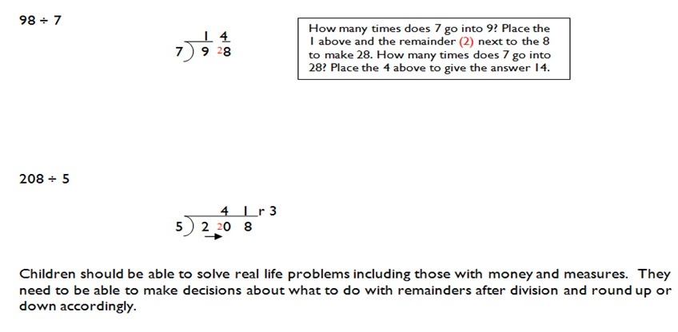
Roman Catholic Diocese of Hexham and Newcastle
St. John Vianney
Catholic Primary School
Calculation Examples: Division
Notes:
17

Slide 18

Roman Catholic Diocese of Hexham and Newcastle
St. John Vianney
Catholic Primary School
Times Tables
The teaching of times tables is crucial in allowing children to access more advanced mathematical concepts and strategies. We appreciate your support in helping your child to learn their tables.
Your child will sit a national assessment of times tables this year. Information will be provided nearer to the time.
Every child has a ‘Times Tables Rock Stars’ login, which allows them to practise their tables in a fun and engaging way, both in school and at home.
Notes:
18

Slide 19
Roman Catholic Diocese of Hexham and Newcastle
St. John Vianney
Catholic Primary School
PSHE
Personal, Social, Health and Economic (PSHE) Education is a subject through which pupils develop the knowledge, skills and attributes they need to manage their lives, now and in the future. It helps children to stay healthy and safe, while preparing them to make the most of life and work.
(PSHE Association 2021)
The PSHE Curriculum is broken up into three core themes:
Health and Wellbeing
Relationships
Living in the Wider World
KAPOW is also used to support our work in the subject.
Notes:
19
Contents:
NURSERY - Wonder at God's Love
RECEPTION - God loves each of us in our uniqueness
YEAR ONE - We meet God's love in our family
YEAR TWO - We meet God's love in the community
YEAR THREE - How we live in love
YEAR FOUR - God loves us in our differences
YEAR FIVE - God loves me in my changing and development
YEAR SIX - The wonder of God's love in creating new life
JOURNEY OF LIFE
SOME PERSPECTIVES ON MARRIAG

Slide 20
Roman Catholic Diocese of Hexham and Newcastle
St. John Vianney
Catholic Primary School
PSHE - Health and Wellbeing
Throughout this theme, children will learn about:
Healthy lifestyles and physical wellbeing
Mental health and mental wellbeing
Growth and change
Keeping safe (including online)
Notes:
20
Contents:
NURSERY - Wonder at God's Love
RECEPTION - God loves each of us in our uniqueness
YEAR ONE - We meet God's love in our family
YEAR TWO - We meet God's love in the community
YEAR THREE - How we live in love
YEAR FOUR - God loves us in our differences
YEAR FIVE - God loves me in my changing and development
YEAR SIX - The wonder of God's love in creating new life
JOURNEY OF LIFE
SOME PERSPECTIVES ON MARRIAG

Slide 21
Roman Catholic Diocese of Hexham and Newcastle
St. John Vianney
Catholic Primary School
PSHE - Relationships
Throughout this theme, children will learn about:
Families and close positive relationships
Friendships
Managing hurtful behaviour and bullying
Safe relationships
Respecting self and others
Notes:
21
Contents:
NURSERY - Wonder at God's Love
RECEPTION - God loves each of us in our uniqueness
YEAR ONE - We meet God's love in our family
YEAR TWO - We meet God's love in the community
YEAR THREE - How we live in love
YEAR FOUR - God loves us in our differences
YEAR FIVE - God loves me in my changing and development
YEAR SIX - The wonder of God's love in creating new life
JOURNEY OF LIFE
SOME PERSPECTIVES ON MARRIAG

Slide 22
Roman Catholic Diocese of Hexham and Newcastle
St. John Vianney
Catholic Primary School
PSHE – Living in the Wider World
Throughout this theme, children will learn about:
Shared responsibilities and rules
Different roles and responsibilities people have in their community
Economic wellbeing: Money
Economic wellbeing: Personal aspirations
Notes:
22
Contents:
NURSERY - Wonder at God's Love
RECEPTION - God loves each of us in our uniqueness
YEAR ONE - We meet God's love in our family
YEAR TWO - We meet God's love in the community
YEAR THREE - How we live in love
YEAR FOUR - God loves us in our differences
YEAR FIVE - God loves me in my changing and development
YEAR SIX - The wonder of God's love in creating new life
JOURNEY OF LIFE
SOME PERSPECTIVES ON MARRIAG

Slide 23

Roman Catholic Diocese of Hexham and Newcastle
St. John Vianney
Catholic Primary School
Positivity and Wellbeing
Strategies used across school to promote positive mental health in children include:
Daily ‘Check In’ feelings chart
Worry boxes
Rainbows (Bereavement/ Separation Anxiety)
Counselling (from specially trained counsellors)

Slide 24
Roman Catholic Diocese of Hexham and Newcastle
St. John Vianney
Catholic Primary School
Children’s Reports
Children will receive a report at the end of the Summer term, detailing whether they are in line with, working above or working towards national levels of expectation for all subjects taught across the curriculum.
The children are continually assessed and their development closely monitored and tracked as part of our rigorous and on-going assessment process.

Slide 25
Roman Catholic Diocese of Hexham and Newcastle
St. John Vianney
Catholic Primary School
Important Class Information
Spellings – given every half term for a test every Friday. The weekly spellings will also be available on Ed shed to help practise them.
Homework – Spellings, Reading and Times Tables Rockstars.
Your child may also get topic specific homework as and when.
P.E. – Wednesday and they should come to school in their kit.
Reading Books – Changed weekly on Monday if finished and signed off. The new book will be sent home on Tuesday/Wednesday.
Notes:
25

Slide 26

Roman Catholic Diocese of Hexham and Newcastle
St. John Vianney
Catholic Primary School
Life Long Learning
At St John Vianney, we promote a love of learning and encourage children to be ‘Life Long Learners’. We want children to apply their learning to all areas of their life, to equip them to deal with a range of situations. This includes: academic learning, emotional learning (i.e. tolerance and resilience) and life skills. Our aim is for all children to become well rounded adults, who never stop wanting to learn.

Slide 27
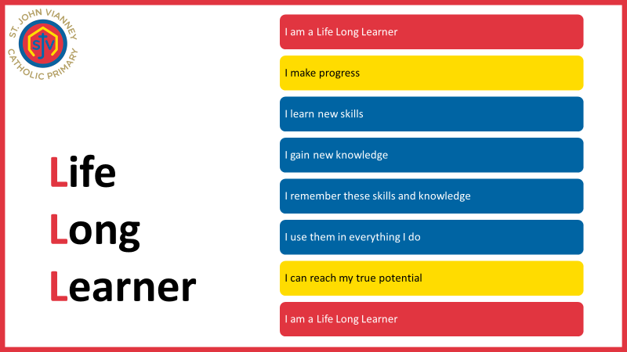
Roman Catholic Diocese of Hexham and Newcastle
St. John Vianney
Catholic Primary School

Slide 28


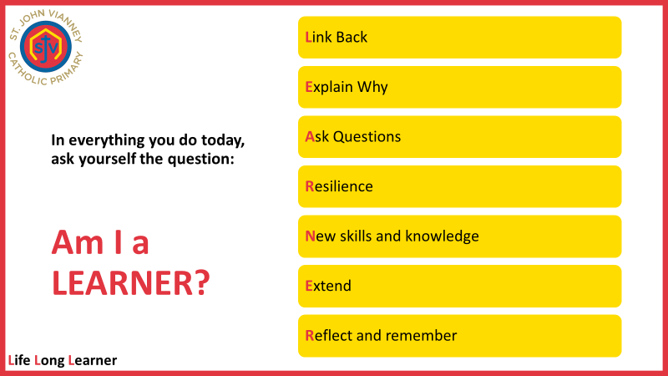

Slide 29
Roman Catholic Diocese of Hexham and Newcastle
St. John Vianney
Catholic Primary School
High Expectations so that everyone can
reach their true potential
Standards are high and a certain expectation is required – from writing 1 digit in each box in a Mathematics book to writing on the line with the long date for all pieces of work. Underlining titles and dates using a ruler is new for the children so practice at home would be beneficial!
Positive behaviour is promoted through house points. The gospel values are referred to and encouraged daily. Boundaries are established and respected to ensure our classroom remains a safe and welcoming learning environment.
Notes:
29

Slide 30
Roman Catholic Diocese of Hexham and Newcastle
St. John Vianney
Catholic Primary School
Our Behaviour and Rewards System
We continue to emphasis and promote positive behaviour, rewarding those pupils who consistently behave appropriately and track those pupils who find it harder to meet our expectations of behaviour in school.
We have revised our whole-school House Points system. Every child is part of a House Group (there are six houses in total) and children are awarded house points for following our school rules. Every Friday, the house points for each house are added together and the house with the most house points is praised during our Celebration Assembly. We know that these systems continue to enhance the behavior and reward systems already in place here at St. John Vianney school.
Notes:
30

Slide 31



Roman Catholic Diocese of Hexham and Newcastle
St. John Vianney
Catholic Primary School
Ready, Respectful, Safe.
Our new behaviour system follows the mantra of ‘Ready, Respectful and Safe’.
The children’s actions in school should always reflect these three core values that underpin our policy.
Notes:
31

Slide 32
Roman Catholic Diocese of Hexham and Newcastle
St. John Vianney
Catholic Primary School
Questions
If you have any further questions arising from this PowerPoint, please contact us at office@stjohnvianneynewcastle.org and we will be more than happy to help.
Thank You.
Notes:
32

