Slide 1
One Page Policy - Behaviour
Three core behaviour principles for children: Ready, Respectful, Safe. All behaviour in school (positive and negative falls under these umbrella terms. Posters should be displayed in all classrooms and communal areas for children.
Each half term, there will be a focus for behaviour in school. This focus will be planned in advance by SLT, shared with staff in the half term before during staff meeting time and shared with all pupils during the first Monday morning assembly of each half term.
All staff should spend this half term noticing and positively commenting whenever they see this behaviour being used by children. Rewards should be especially focused on this behaviour.
Rewards and Systems
House Points/stars – given to children by all members of staff
8 Star certificates (KS1) – awarded to children when their chart is full
20 HP certificates (KS2) – awarded to children on a Friday
Half-termly house group rewards – an afternoon out of class for the house group that has won the most house points that half term
Secret Student – Daily behaviour strategy to use in all classes. School will provide rewards for these daily prizes, with a central stock of appropriate rewards to be kept in Laura’s SEN room.
Board of Recognition – each week a new focus is selected – the first week of each half term (minimum) this should link to the school’s behaviour focus for that half term, after which teachers can use the focus to respond to identified needs in their own classrooms. Example: lovely language – that week any children who are ‘spotted’ using polite language to communicate with staff and peers will have their name placed on the board as recognition.
Head Teacher’s Awards/Golden Book Certificate – two children from each class are chosen each week to receive a Golden Book award. All staff, including support staff and lunchtime supervisors, should be allowed to give these awards and this should be said during assembly (e.g. this award comes from (support staff name)
Ready, Respectful, Safe stickers – all staff will have a bank of RRS stickers, which they can give to children at any point in the day (lunchtime supervisors included). There should be one or two children a day in each class being given these stickers. If staff see a child wearing a sticker, they should stop and ask that child how they got the sticker.
Positivity Postcards – postcards that can sent sparingly to parent’s of children for exceptional behaviour.
Visitor Comment Book – a book which is available for visitors to write positive comments about children’s behaviour in (this can be written in by teachers if comments have been made out of school on trips etc). These comments will be shared with children during half termly behaviour assemblies.
Greetings – teachers stand at the door of their classroom to welcome children into the room at the start of the day and after each playtime and lunchtime.

Slide 2
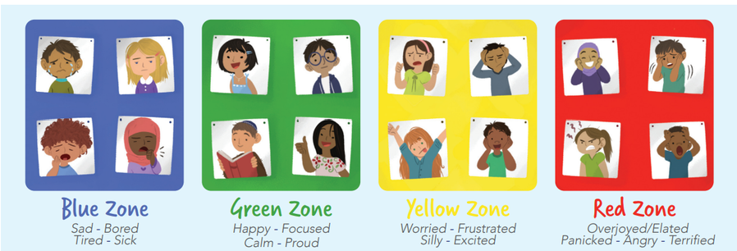
Negative Behaviour
Low level behaviour – follow the behaviour ladder (there is one version for staff and one for children). Bear in mind that this ladder may need adjustments for SEN children. Please stick as closely as possible to the scripts as this ensures all staff are using the same language and there is no room for interpretation of different staff members or bargaining with children.
Violent physical behaviour – if a child is showing serious violent physical behaviour, such as hitting, punching, kicking, spitting at others etc, then they should be immediately moved to step 4 – phase leader/SLT. A phone call home should be made, by the class teacher in the first instance; however, if this is repeated behaviour, any subsequent calls can be made by phase leaders and then SLT/DHT/HT.
Regulation
Dysregulation – if a child is showing signs of being dysregulated (all children including SEN children) then will need time to calm and become regulated again before behaviour issues can be dealt with following the behaviour ladder.
- In class/playtime: if a child has a SEN need/plan, they should have a designated area as their breakout space. If child doesn’t have a SEN plan, but they are showing signs of dysregulation, they should be removed from class and given time and strategies to reregulate before then discussing their behaviour using the behaviour ladder. Children should then be returned to learning. This short intervention could be carried out by support staff, phase leader or SLT.
- At lunchtime: one member of SLT will be on duty at lunchtime in the SEMH room, which will allow children to be removed from the yard and given time to reregulate, before SLT deal with the incident and feedback to staff as necessary. This space can be accessed independently by children who are dysregulated.
Regulating Activities – every classroom and key breakout area will be equipped with a booklet of strategies to support staff in regulating children
EYFS Rewards
Ted’s Best Listener (daily)
Star of the Day (used to motivate children to work – all will get a turn across the school year)
Writer of the Week
Golden Book
Recognition Board (linked to the whole school behaviour focus)

