Slide 1
Mathematics in Reception Class St John Vianney Catholic Primary School

Slide 2
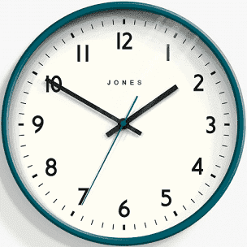
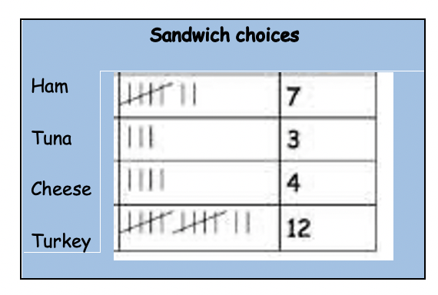
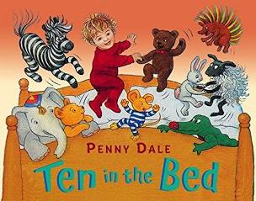
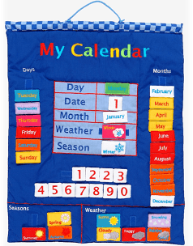
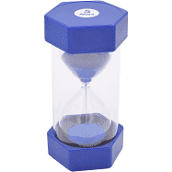
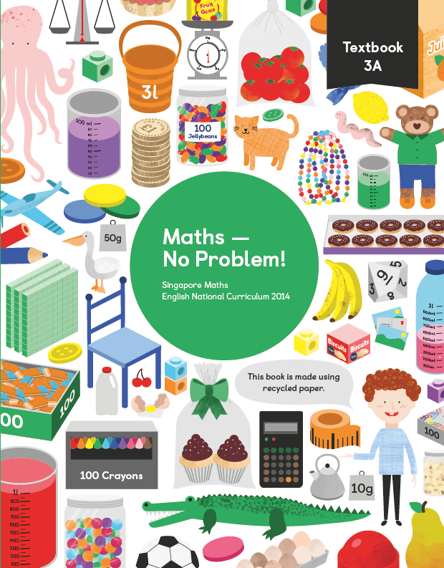
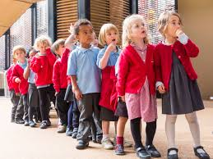
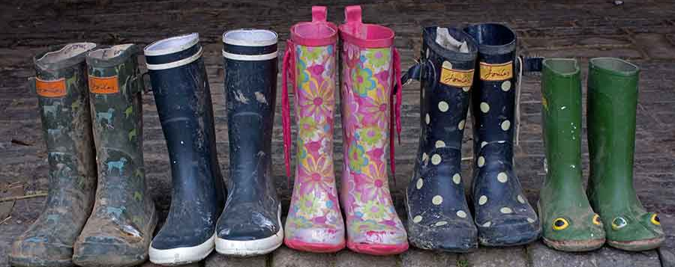
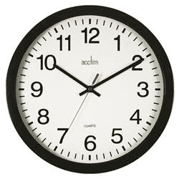
Maths as part of the
daily routine
Maths is part of our daily routine – tallies for lunch choices, counting children in and out of the classroom, counting in 2s as we pair wellies, matching , sorting and counting equipment at tidy up times. Counting to 20 as we wash our hands, sorting ourselves into pairs and 4s for activities. Talking about different times of day, looking at the clock, using a timer, voting for the home time story…..the list is endless.
We enjoy maths songs and rhymes to count forwards and backwards
We enjoy stories which introduce maths concepts
We have number and maths opportunities all over the classroom.
We play games and use practical resources before moving on to abstract pictorial representations and then numbers

Slide 3
At the end of Reception class we expect the children to do the following;
Number Count at least 20 objects, saying 1 name for each number. Count forwards and backwards. Place the numbers in order. Say 1 more or 1 less than a number To compare quantities Add 2 single digit numbers counting on to find the answer. Subtract 2 single digit numbers counting on to find the answer Solve problems involving doubling, halving and sharing Record numbers, mathematical ideas using their own representations Write formal numbers To subitise | Shape, space and measures Use everyday language when they are exploring and comparing; size Weight Capacity Position Distance Time Money Explore and create pattern Explore and describe shape Solve problems
 | Maths talk To explain their ideas and thinking. To use mathematical vocabulary.

Slide 4
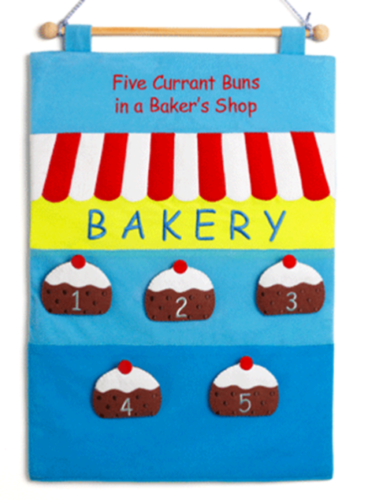
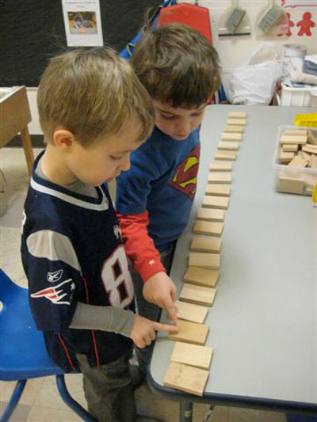
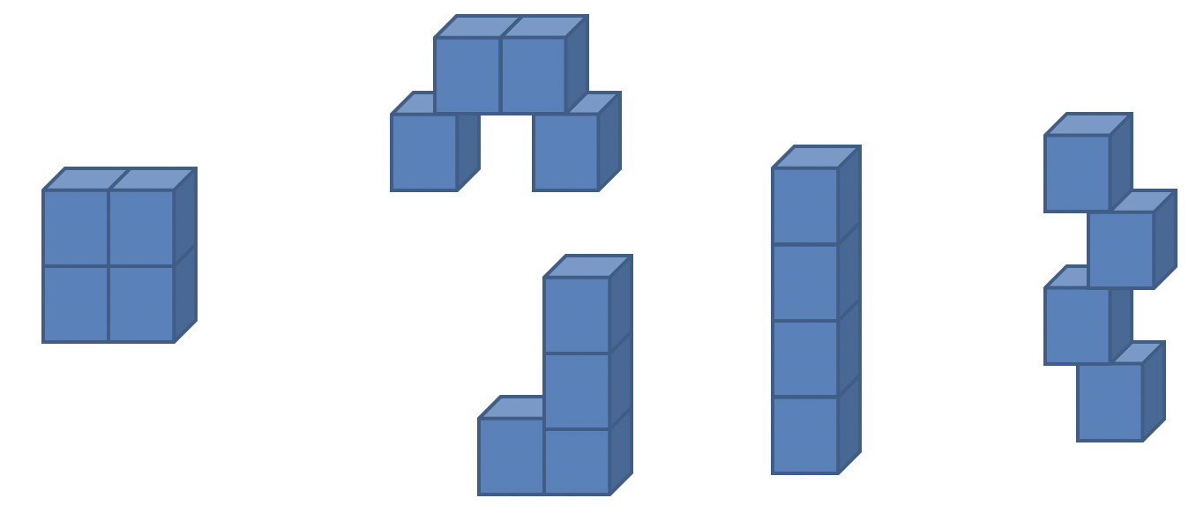
Number-Counting The children will develop their understanding of counting concepts:
Enjoy counting forwards and backwards through number songs and rhymes.
They will count by rote, enjoying saying big numbers which they do not yet understand.
Count objects with 1-1 correspondence – as they touch each one, they say a number name.
They know that the last number they say when counting is the total number of objects in the group.
They can count out a given number of objects from a bigger group.
Can count out things which cannot be touched including sounds and movements eg.jumps.
They recognize that the number of objects is the same, regardless of their arrangement.

Slide 5
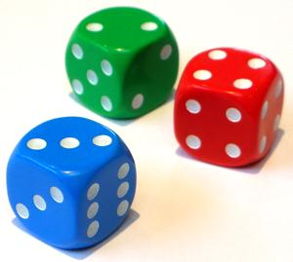
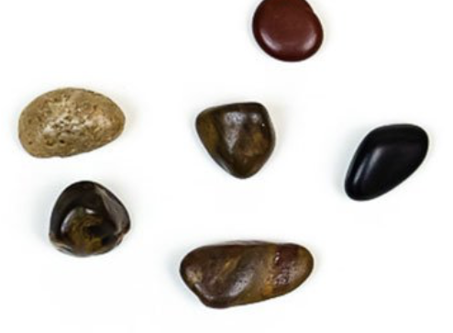
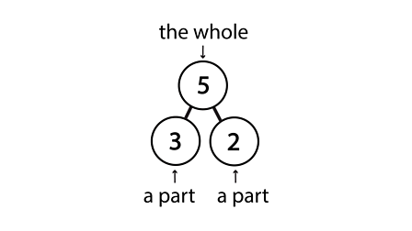
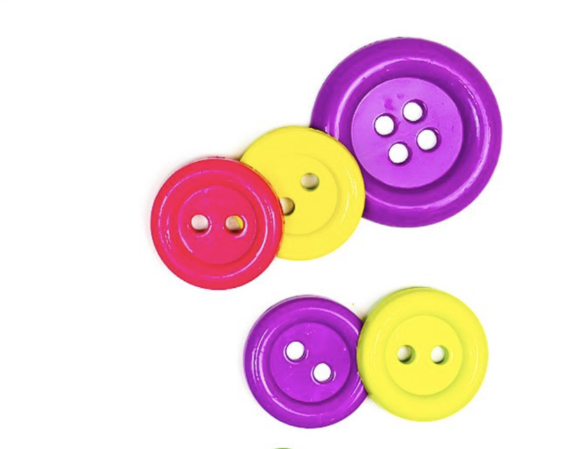
Subitising and Composition
How many rocks can you see? How did you work out there were 6?
I saw 3 on the top and 3 on the bottom
Subitising is the ability to instantly recognise the number of objects in a small group without the need to count them. E.g.instantly recognising the number of dots on the face of the dice.
Why is this important?
In Reception, most children will learn to count by rote and although they may sound convincing, don’t always fully understanding the meaning behind the numbers they are counting.
Encouraging students to subitise groups of items allows them to develop an understanding of how a number is made up of a collection of items. This feeds into their understanding of addition and subtraction.
Number composition is understanding the whole number
and its parts.
How did you work out how many buttons there were?
I made 2 collections. 3 and 2

Slide 6
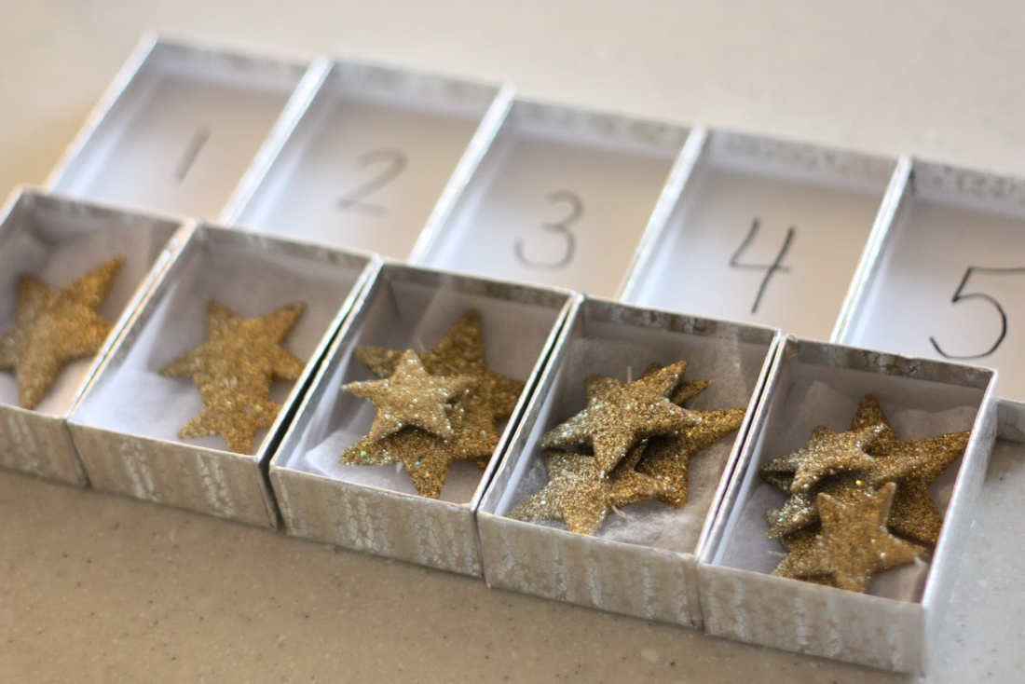
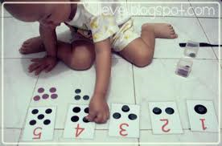
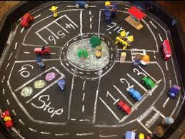
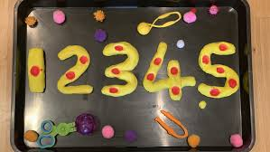
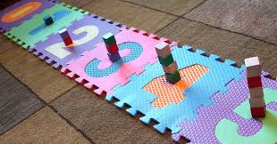
Making links and developing understanding of number
The children make connections between the number symbol - saying the number name - exploring with objects - matching to pictures.
This strongly reinforces their understanding of number.

Slide 7
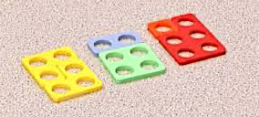
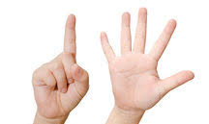
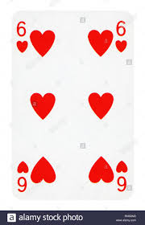
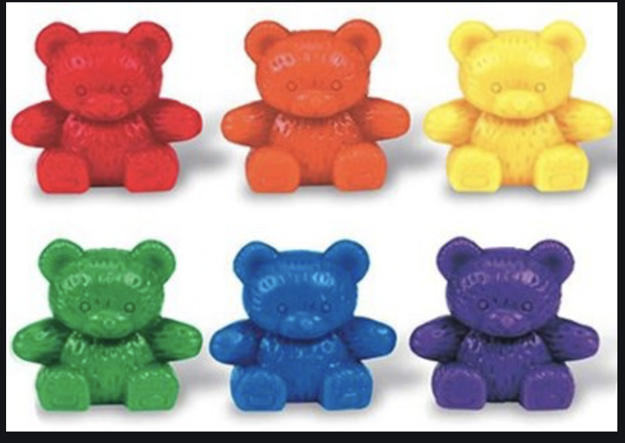
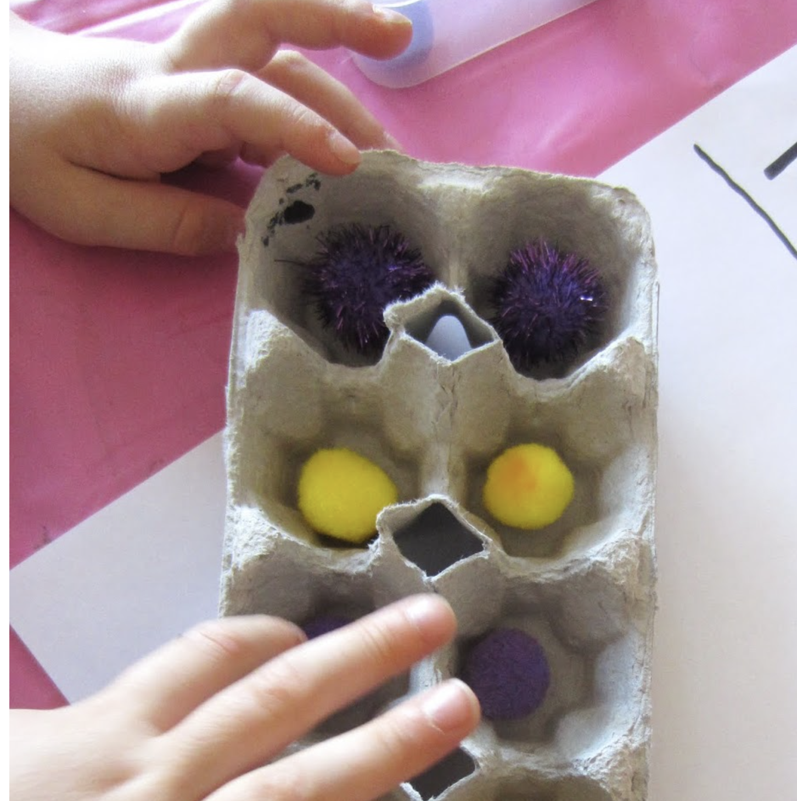
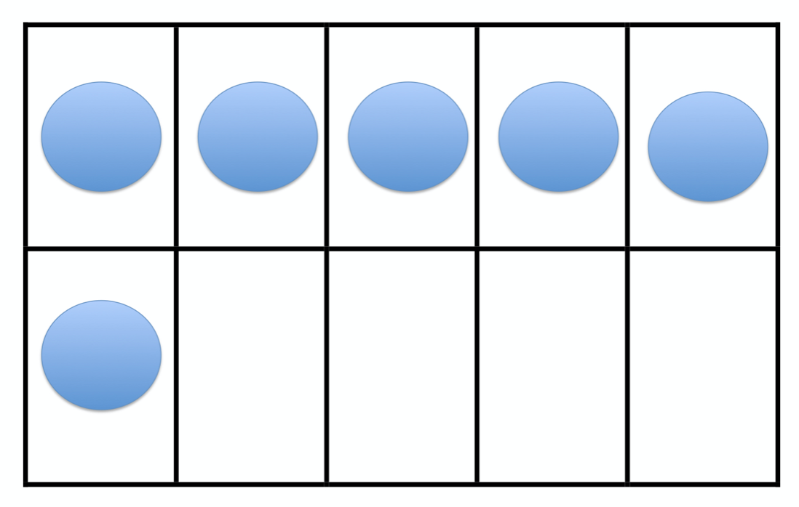
Different ways of representing numbers
6

Slide 8
Addition
Add, more, plus, total, altogether, the same as, equals
In practical activities and through discussion children will use the vocabulary of addition
Children will begin to add two sets of objects by putting them together and counting them all.
They then move on to counting on from a given number. They will respond to simple questions involving addition such as:-
“You have 5 biscuits and I have 2. How many biscuits altogether?”
Five……………………..six, seven
Eventually the children move towards recording formally.

Slide 9
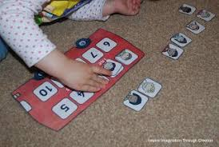
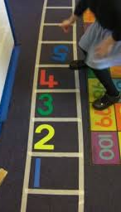
Subtraction
Subtract, take away, less, minus
Children practice counting back from a given number and use number tracks extensively.
They play number games, sing number songs and use props involving one less, counting back and taking away.
First they subtract by using practical equipment to count out the first number and then remove or take away the second number to find the solution by counting how many are left.
“If I have 9 marbles and I give my friend 4, how many will I have left?”
Children use bead strings to subtract a single digit number from a up to ten.
“What is 10 take away 6?” “What number is 6 less than 10?”
They may begin to record their calculations by drawing objects or marks and then crossing some out or rubbing them out.

Slide 10
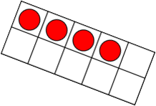
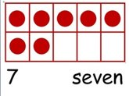
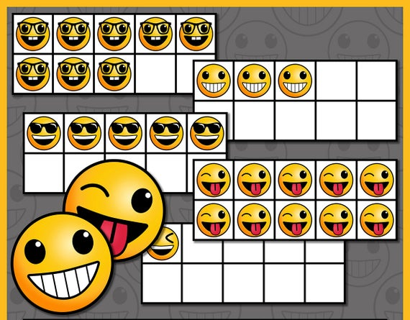
Tens Frames
Ten-Frames are two-by-five rectangular frames into which objects like counters can be placed to show numbers less than or equal to ten.
They may be used by a teacher to help children to visualise numbers, help them learn to count between 0 and 10 or use different coloured counters to teach them simple additions and numbers to 10.
They help children to find ‘How many more do you need to make…7’
Tens frames can also be used to compliment and assist in solving part-part-whole problems.

Slide 11
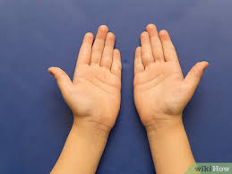
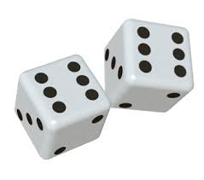
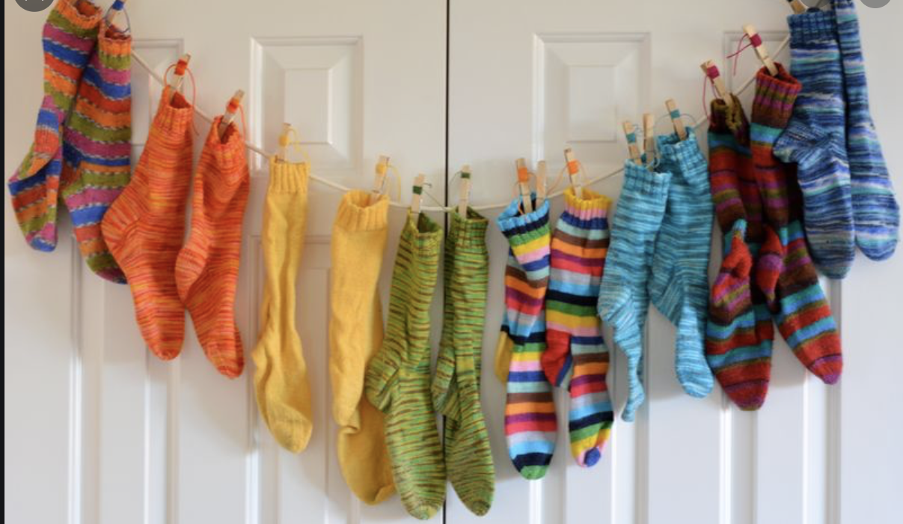
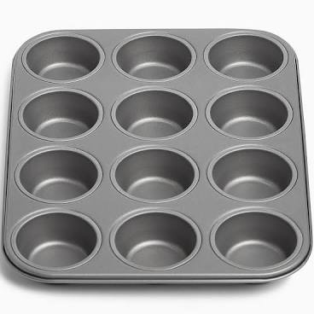
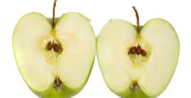
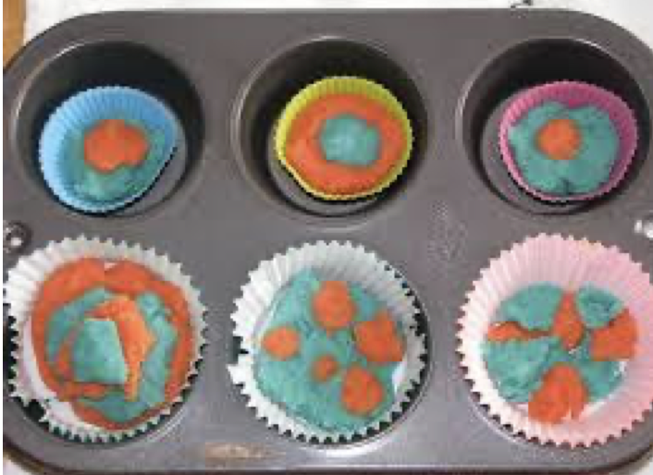
Solving problems using multiplication
Double, lots of/ groups of
The children are given a wide experience of practical calculation opportunities using a variety of equipment, including small world play, role play, counters, cubes etc.
Children start to learn about doubling and think about equal groups or sets of objects in their play.
Children begin to develop mental recall of some doubles through these experiences. They quickly recognise double 5 as 10 through using their fingers when counting and doubles such as double 2 and double 3 through their use of dice when playing games.
….and division
The concept of a half and sharing fairly is often introduced by
using food.
The children also organise sets of objects into equal
groups
Half, share, how many each, divide, groups of

Slide 12
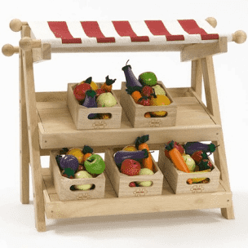
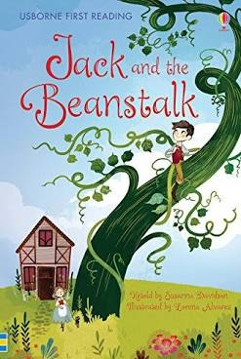
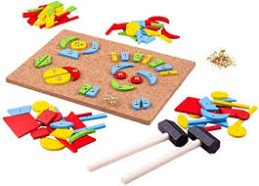
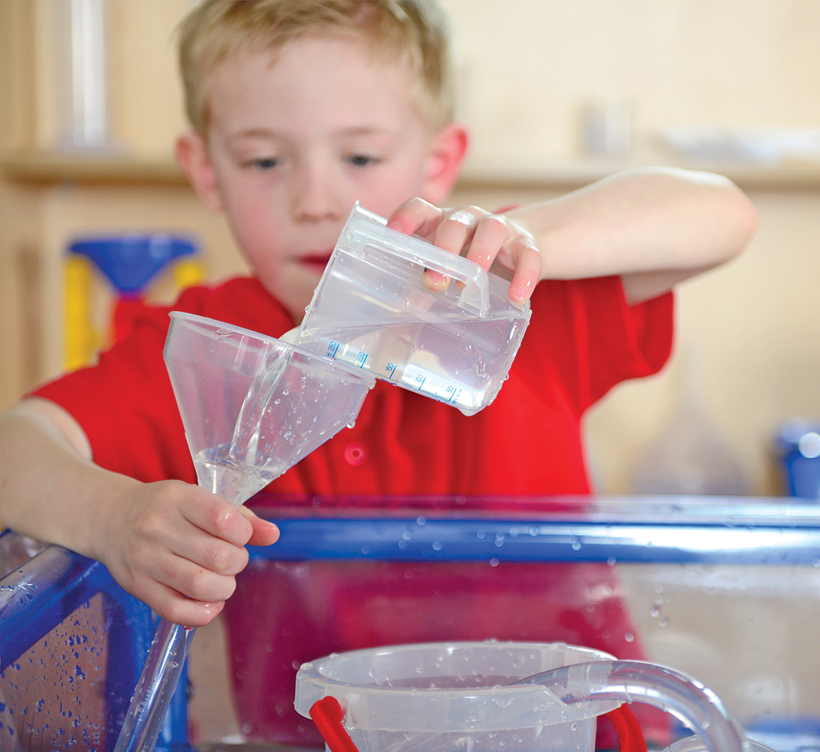
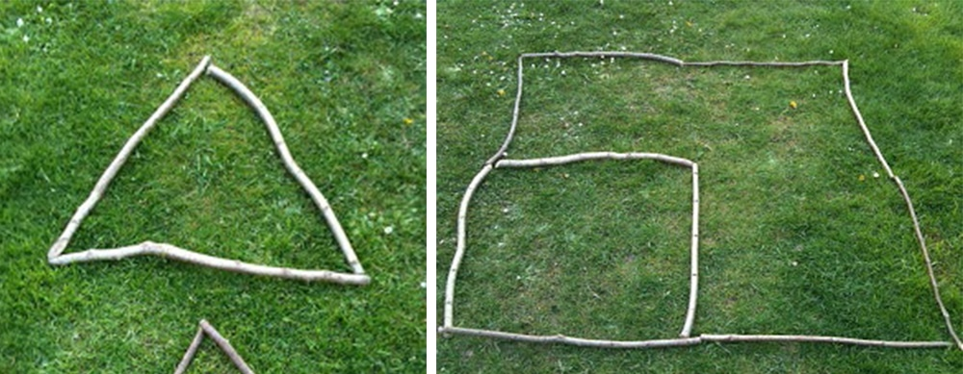
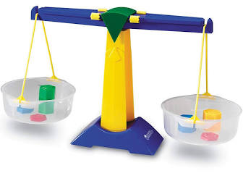
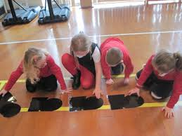
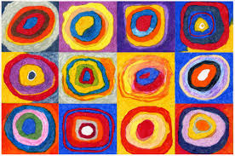
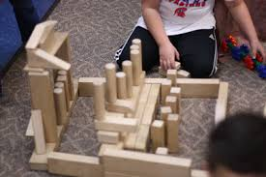
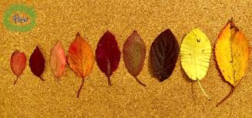
Shape, space and measure
Children enjoy exploring mathematical concepts of size, length, weight, capacity, time, money and position through story, songs, art and outdoor activities.
They use comparative language.
They explore characteristics of everyday objects and shapes, including making models and pictures.
They notice, copy, continue and create patterns.
They solve problems and communicate their mathematical thinking in a range of ways.

Slide 13
Maths vocabulary
Number | Calculation | Shape | Measures | Problem solving
Count, order, compare, greatest, larger, largest, greater than, less than, bigger, biggest, more, fewer, fewest, small, smallest, before, after, halfway, between, zero, one, two etc First, second, third etc, ‘teens’ numbers, twenty, numberline, number track, count on, count back, count up to, the same, as many as, equal to, enough, not enough, too much, too little, too few, nearly, about, close to, just over, just under, half, half way, between, half, quarter, whole, part, equal parts | Correct, wrong The same number as, as many as, equal to More, more than, most, less, fewer, less than, least, greater Add, makes, altogether, take away, minus, leaves, difference, combine, partition, total, altogether, how many? How many more? How much more is? How much less is? Group, share, equal, groups of, double, half, count up count on from, count in 1s, count in 2s, compare, | Make, build, draw, curved, straight, hollow, solid, flat, side, corner, point, face, edge, side, roll, stack, symmetrical, cube, cone, pyramid, cylinder, sphere, triangle, rectangle, square, circle Above, below, between, behind, in front of, underneath | Measure, compare, order, thick, thicker, thickest, thin, thinner, thinnest, long, longer, longest, heavy, heavier, heaviest, short, shorter, shortest Wide, wider, widest High, higher, highest holds more, holds less, Weigh, balance scales, Money, coin, buy,sell, pay, change, price Before, after, times of day Days of week,months, seasons, long time, short time, minute, hour, second | Problem, pattern, repeating, answer, compare, explain, show me, sort, match, compare, different, tally
Teachers introduce children to a range of mathematical vocabulary and model its usage.
Children are are encouraged to use it to explain their mathematical ideas and thinking.

Slide 14
How to help your child at home
In the street • Recognising bus numbers • Number plate hunt. Who can find a 7? Add the numbers up. • Comparing door numbers • Counting–how many lampposts on the way to school? | Doing the washing • Counting in 2s – matching shoes • Sorting by colour and size. • Matching/pairing up socks. • Find four shoes that are different sizes. Can you put them in order. | Time • What day is it yesterday, today, tomorrow? • Use timers, phones and clocks to measure short periods of time. • Count down 10/ 20 seconds to get to the table/ into bed etc. • Recognising numbers on the clock. If you cover a number, what number was missing?
Food! • Can you cut your toast into 4 pieces? Can you cut it into triangles? • Setting the table. Counting the right number of plates etc. How many more do we need? • Can you make shapes/ patterns out of the knives and forks. Can you put them in the right place in the drawers? • Helping with the cooking by measuring and counting ingredients. • Setting the timer. • Positional language at dinner time: what is on the rice, where are the carrots etc? | Going shopping • Reading price tags • Counting items into the basket • Finding and counting coins • Comparing weights – which is heavier? Shapes • Cut a potato into shapes (circles, triangle etc). Use with paint to make pictures and patterns. • Cut out shapes from coloured paper and arrange into pictures. • Shape hunt: Can you find a square in your house (windows etc), a circle ... | Measuring • Are you taller than a ...? • Marking height on the wall. • Cut hand shapes out of paper. How many hands long is the couch? How long is the table? Which is longer? • Who has the biggest hands in our family? • How many steps from the gate to the front door?

