Slide 1
Roman Catholic Diocese of Hexham and Newcastle
St. John Vianney
Catholic Primary School
Curriculum PowerPoint 2023
Mission Statement
Through following Jesus,
we aim to be a caring, happy school,
where everyone is valued and appreciated
and can reach their true potential.
We hope to: act justly, love tenderly and walk humbly with our God.

Slide 2
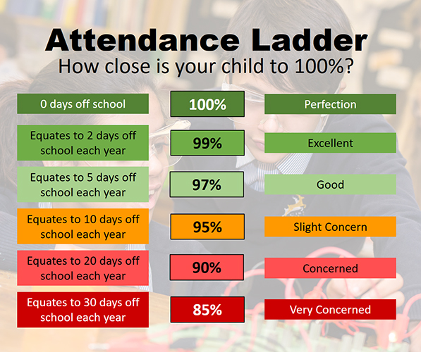
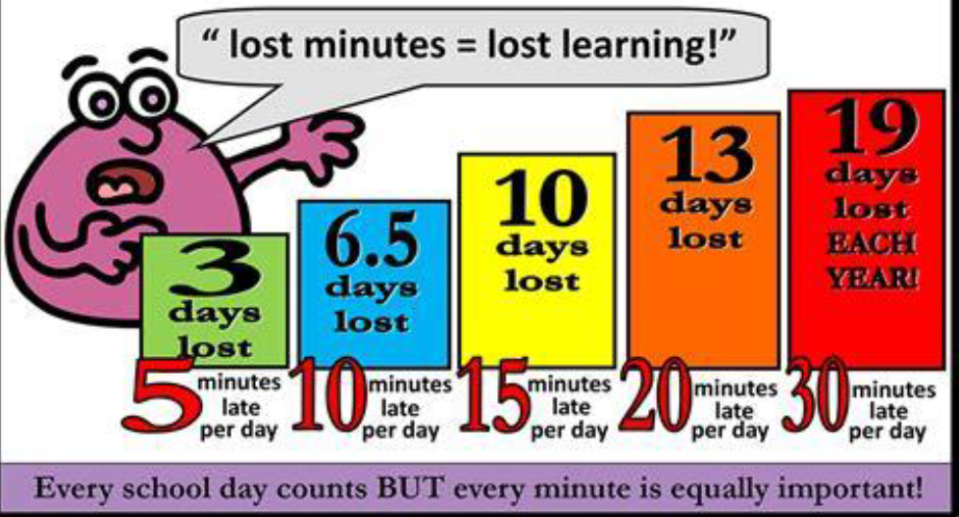
Roman Catholic Diocese of Hexham and Newcastle
St. John Vianney
Catholic Primary School
Attendance and Lateness

Slide 3
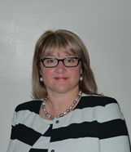
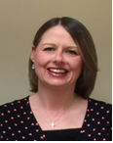
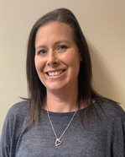
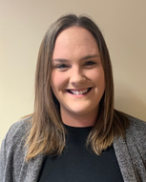
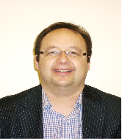
Roman Catholic Diocese of Hexham and Newcastle
St. John Vianney
Catholic Primary School
Safeguarding
St John Vianney is a safeguarding school where children’s safety is absolutely central to all that we do.
Please encourage your children to talk to a responsible adult if they have any concerns. It is this step that allows us to support vulnerable children.
As part of the Computing curriculum, the children will be taught about how to stay safe online.
Cyber-bullying is an important issue that children of all ages will be made aware of in lessons and assemblies throughout the year.
There are further resources for parents online, to address this subject sensitively. https://www.thinkuknow.co.uk/parents/
All staff are trained in the PREVENT agenda and our Designated Safeguarding Leads are:
Mrs Thorpe Mrs Meldrum Mrs McDine Miss Cherry Mrs Spencer Mrs Watanabe Mr Bell
Notes:
3

Slide 4
Roman Catholic Diocese of Hexham and Newcastle
St. John Vianney
Catholic Primary School
Curriculum
Our foundation (non-core subjects) curriculum is regularly being updated in order to provide children with a range of new learning experiences, which may include educational visits linked to their new topics.
A copy of the updated foundation curriculum is available on the school website.
stjohnvianneynewcastle.org

Slide 5
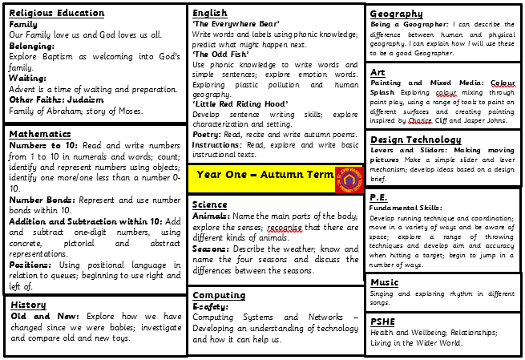
Roman Catholic Diocese of Hexham and Newcastle
St. John Vianney
Catholic Primary School

Slide 6
Roman Catholic Diocese of Hexham and Newcastle
St. John Vianney
Catholic Primary School
Reading: Year One children are taught to:
Apply phonic knowledge and skills to decode words
Read accurately by blending sounds in words
Read ‘tricky’ words that cannot be decoded using phonics (e.g. the)
Read words of more than one syllable
Listen to and discuss a wide range of poems, stories and non-fiction at a level beyond that at which they can read independently
Become very familiar with key stories, fairy tales and traditional tales
Predict what might happen next in stories
Explain clearly their understanding of what is read to them
Notes:
Reading is taught within English and Phonics lessons, as well as one to one reading weekly with a teacher or teaching assistant.
It is very helpful if children can bring their reading books and reading records into school daily so they can be read with at any point during the week.

Slide 7
Roman Catholic Diocese of Hexham and Newcastle
St. John Vianney
Catholic Primary School
Reading
Children have access to a rich Reading diet. They will participate in: daily phonics sessions, whole class shared reading, comprehension activities, daily story time and home-school reading.
Every class has a library, which promotes reading for pleasure.
School has recently updated the reading scheme with new books, including a wider range of classic and non-fiction texts.
Please continue to leave comments in your child’s reading record, as this allows us to tailor reading experiences for all children.
Notes:
7
Daily phonics, shared reading in class with comprehension activities, stories before hometime and home-school reading of levelled books.
It is very important that children access a range of different texts, our new reading scheme reflects this a range of fiction, non-fiction and classic texts.

Slide 8
Roman Catholic Diocese of Hexham and Newcastle
St. John Vianney
Catholic Primary School
How to help your child with Reading in KS1
By encouraging a variety of strategies to decode words e.g. using the sounds of letters.
By asking your child about what has happened in the story so far.
By asking them to make predictions about what will happen.
By reading a variety of texts of different genres and authors.
By discussing the text: I wonder…? Why…? What…? How…? Who…?
Even when the children become free readers, they still need to read aloud to an adult regularly and to hear adults reading aloud to them.
Notes:
8
Encourage and demonstrate segmenting of unfamiliar words rather than just giving them the answer.
Discuss what has happened or might happen in a story to promote comprehension skills.
It is so important that children have the opportunity to read aloud to an adult as much as possible as well as hearing adults read to them, by hearing expressive and fluent reading chn can pick up new skills in their own reading.
Progression of Reading Skills document on school website, as well as Phonics sound mats for practise of digraph recognition at home or to support identifying graphemes in their reading.
Children should be encouraged to follow the words of a book with their finger

Slide 9
Roman Catholic Diocese of Hexham and Newcastle
St. John Vianney
Catholic Primary School
Writing: Year One children are taught to:
Use phonic skills and knowledge to spell words
Spell common exception words
Write from memory simple sentences dictated by the teacher
Sit correctly at a table, holding a pencil comfortably and correctly
Form lower case and capital letters using the correct letter formation
Compose a sentence orally before writing it
Sequence sentences to form short narratives
Read aloud what they have read to check it makes sense
Notes:
Use of phonics to form words is the foundation of Year 1 writing. We encourage say it, sound it, write it to tackle new words.
CEW are learnt, practised and revisited in phonics lessons and available on display in class.
Please don’t worry if your child is reversing letters and numbers, this is very common in year 1 as they are learning new skills and sounds daily that they forget letter and number formation.
We start from dictating sentences for the chn to write, then building their own sentences (counting out the words in their sentence and reciting it to writing it down). Eventually chn will confidently sequence sentences together to form short narratives.
By the end of the year chn will be able to use capital letters and full stops in sentences, as well as understanding why a writer uses these and commas, question marks and exclamation marks. end of year expectations on website.

Slide 10
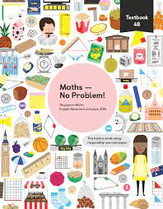
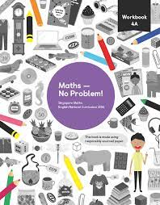
Roman Catholic Diocese of Hexham and Newcastle
St. John Vianney
Catholic Primary School
Maths-No Problem!
This September, we have fully adopted a Maths-No Problem! mastery scheme from Reception to Year 6. It is delivered using the concrete, pictorial and abstract methodology to ensure children have a deep understanding of mathematical concepts.
Notes:
10
As a whole school we follow a maths scheme called MNP which encourages children to use manipulatives and practical resources to help deepen their understanding of concepts and independence in reasoning and problem solving.

Slide 11
Roman Catholic Diocese of Hexham and Newcastle
St. John Vianney
Catholic Primary School
Maths: Year One children are taught to:
Use and understand maths vocabulary
Count to and across 100, forwards and backwards from any given number
Count, read and write numbers to 100 in numerals
Read and write numbers from 1-20 in numerals and words
Identify 1 more and 1 less than a given number
Use number bonds and related subtraction facts within 20
Recognise, find and name a half as 1 of 2 equal parts and a quarter as 1 of 4 equal parts of an object, shape or quantity
Solve measurement problems
Tell the time to the hour and half past the hour
Our school calculation policy can be found on our school website.
Notes:
Focus on use and understanding of vocabulary across subjects.
Counting to and back from 100.
Writing numbers to 100 in numerals and numbers to 20 in words.
Identify one more and less than a number.
Use number bonds to 20
Simple fractions, halves and quarters
Measuring and telling the time to half past the hour on an analogue clock.

Slide 12
Roman Catholic Diocese of Hexham and Newcastle
St. John Vianney
Catholic Primary School
PSHE
Personal, Social, Health and Economic (PSHE) Education is a subject through which pupils develop the knowledge, skills and attributes they need to manage their lives, now and in the future. It helps children to stay healthy and safe, while preparing them to make the most of life and work.
(PSHE Association 2021)
The PSHE Curriculum is broken up into three core themes:
Health and Wellbeing
Relationships
Living in the Wider World
Notes:
12
E – wellbeing
Health and wellbeing – childs development of their own personal skills and exploring how to keep our bodies healthy.
Relationships – here we look at keeping healthy friendships, the importance of being kind and what it means to be part of a family group
Living in the wider word – we explore british values and inclusivity

Slide 13
Roman Catholic Diocese of Hexham and Newcastle
St. John Vianney
Catholic Primary School
Positivity and Wellbeing
Strategies used across school to promote positive mental health in children include:
Worry boxes
Zones of Regulation
Rainbows (Bereavement/ Separation Anxiety)
SEMH Mentor
Counselling (from specially trained counsellors)

Slide 14
Roman Catholic Diocese of Hexham and Newcastle
St. John Vianney
Catholic Primary School
How will you know how your child is getting on?
Parents evenings
School reports
Facebook updates
Notes:
We have an open door policy if you ever feel like you need to speak to a member of staff about your child.
You can email or ring the school office and all messages will be passed onto us, we will get back to you as soon as we can to help.

Slide 15
Roman Catholic Diocese of Hexham and Newcastle
St. John Vianney
Catholic Primary School
Important Class Information
Spellings – given on a Friday to learn for the following Friday
Homework – Daily (Spellings, Reading and NumBots)
P.E. – Monday and Tuesday
Reading Books – Changed weekly, collected in on a Tuesday and handed back out on a Wednesday
NumBots – Logins will be in children’s Reading Records, this supports the foundations for Maths in Year One.
Notes:
15
NumBots- helps with fluency in mathematics skills
KON class currently doing dance on a wednesday morning this half term and will change to ED class next half term in addition to the 2 PE lessons per week.

Slide 16
Roman Catholic Diocese of Hexham and Newcastle
St. John Vianney
Catholic Primary School
Our Behaviour and Rewards System
Parents
Time out
Talk
Caution
Reminder
Notes:
16
Reminder – children are spoken to and reminded about how they should be behaving
Caution – second reminder with sometimes the child being moved seats / space on carpet to support them in their behaviour
Talk – a child will be spoken to 1:1 with a teacher and given a further reminder of expectations
Time Out – a child will have time out of class to reflect on their choices. We employ a restorative approach where we discuss behaviour choices and what could be done better next time.
Parents – if these steps haven’t worked, our final step would be to speak to parents about your childs behaviour.
Children are rewarded for their good behaviour and attitude to learning through stickers and house points.

Slide 17
Roman Catholic Diocese of Hexham and Newcastle
St. John Vianney
Catholic Primary School
Questions
If you have any further questions arising from this PowerPoint, please contact us at office@stjohnvianneynewcastle.org and we will be more than happy to help.
Thank You.
Notes:
17

