Slide 1
Roman Catholic Diocese of Hexham and Newcastle
St. John Vianney
Catholic Primary School
Curriculum PowerPoint 2024
Mission Statement
Through following Jesus,
we aim to be a caring, happy school,
where everyone is valued and appreciated
and can reach their true potential.
We hope to: act justly, love tenderly and walk humbly with our God.

Slide 2
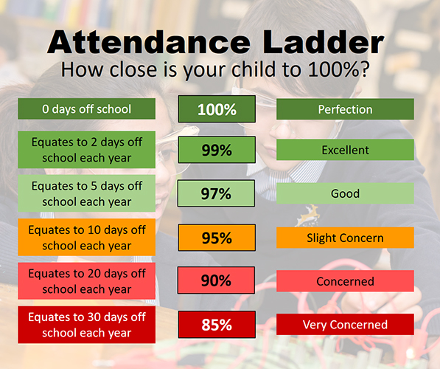
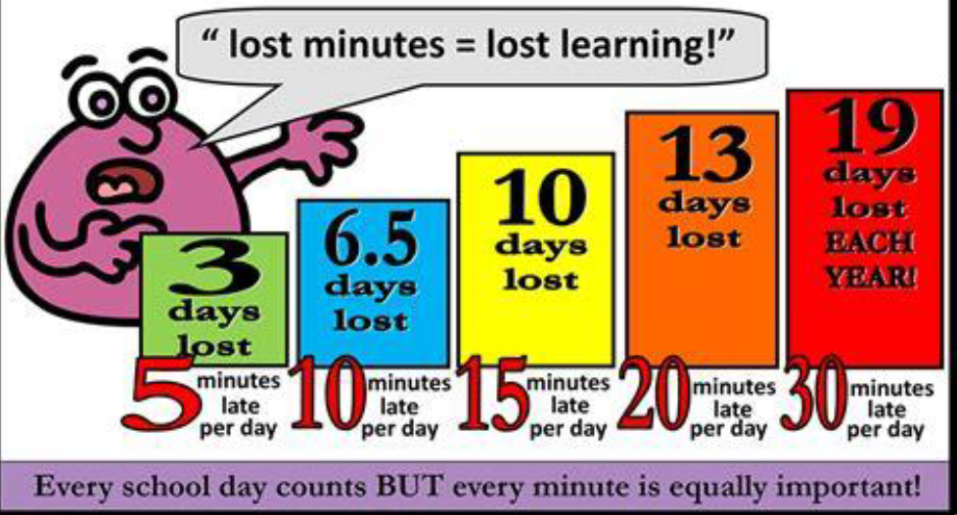
Roman Catholic Diocese of Hexham and Newcastle
St. John Vianney
Catholic Primary School
Attendance and Lateness
Notes:
Attendance and punctuality is so important to make sure your child gets the most out of their education.
We’re not saying to send them in when they’re sick but please try and make sure they get here on time.
Doors open at 8.30, close at 8.45.
Then we do the register and teaching starts as soon as the register is done.
If they’re 10 minutes late they’re missing out on important learning

Slide 3
Roman Catholic Diocese of Hexham and Newcastle
St. John Vianney
Catholic Primary School
Safeguarding
St John Vianney is a safeguarding school where children’s safety is absolutely central to all that we do.
Please encourage your children to talk to a responsible adult if they have any concerns. It is this step that allows us to support vulnerable children.
As part of the Computing curriculum, the children will be taught about how to stay safe online.
Cyber-bullying is an important issue that children of all ages will be made aware of in lessons and assemblies throughout the year.
There are lots of websites available to support you helping your child stay safe such as:
https://www.nspcc.org.uk/keeping-children-safe/online-safety/
Notes:
3
Safeguarding is a priority in our school.
As well as teaching your children a big part of our job is to also keep them safe.
We encourage children to talk to adults in school about anything they’re worried about.
If that could be reiterated at home too that would be great.
Our computing curriculum focusses on e-safety where we teach children how to be safe online.
This is then embedded throughout the year during assemblies and workshops to reinforce what they’ve learnt during the Autumn term.
There are lots of websites available to support you helping your child stay safe such as the NSPCC or National Online Safety.
Alternatively if you have any concerns please come and talk to us and we will do our best to help.

Slide 4
Roman Catholic Diocese of Hexham and Newcastle
St. John Vianney
Catholic Primary School
Curriculum
Our curriculum is split into
Core subjects: phonics/English, maths, science and RE
Foundation subjects: history, geography, computing, art, DT, PE, music and PSHE
A copy of the updated foundation curriculum is available on the school website.
stjohnvianneynewcastle.org
Notes:
An overview of what we teach is updated termly on the school website for you to have a look at.
We block teach some of our foundation subjects, so for example this half term we are teaching history and DT. Next half term we will teach geography and art.
PE and music are taught by specialist teachers.
PSHE is weaved into our day-to-day teaching as well as discrete lessons when certain topics arise, we will tailor a PSHE lesson towards the current needs of our children.

Slide 5
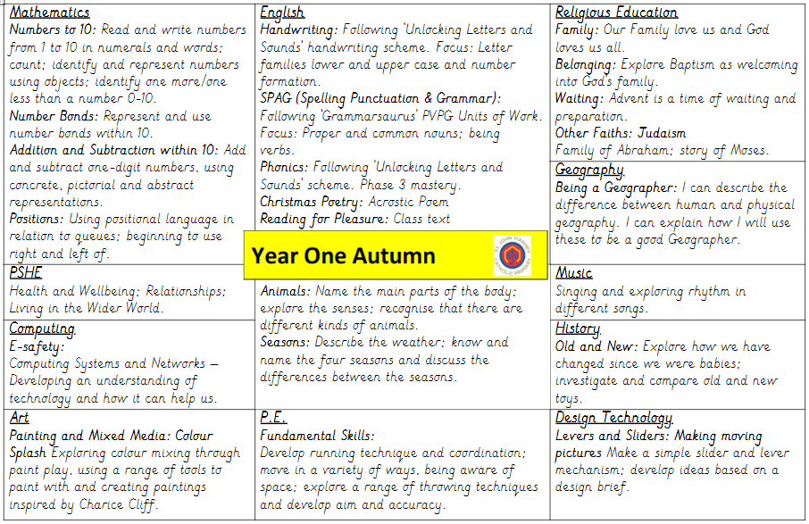
Roman Catholic Diocese of Hexham and Newcastle
St. John Vianney
Catholic Primary School
Notes:
This is our current overview of what we are teaching and this can be found on the school website.
We’ve printed some off if you’d like to take one on your way out.

Slide 6
Roman Catholic Diocese of Hexham and Newcastle
St. John Vianney
Catholic Primary School
Phonics
We have a huge phonics focus in Year 1
We are currently revisiting all phase 3 sounds
Phase 4 looks at the sounds that two consonants make when they are together
After Christmas we will begin phase 5 sounds
Notes:
Revisit phase 3 sounds initially covered in reception
Once we have finished revisiting phase 3 we will move on to phase 4 which looks at the sounds two consonants make within words when they are together.
After Christmas we will begin phase 5 which looks at alternative graphemes for phonemes. For example Phase 3 ai is A I but in phase 5 they’re taught two alternative ways to spell ai.
If your child is currently struggling with their phonics they have been identified via baseline assessments carried out by us at the start of the year and are taking part in phonics interventions to help them progress.

Slide 7
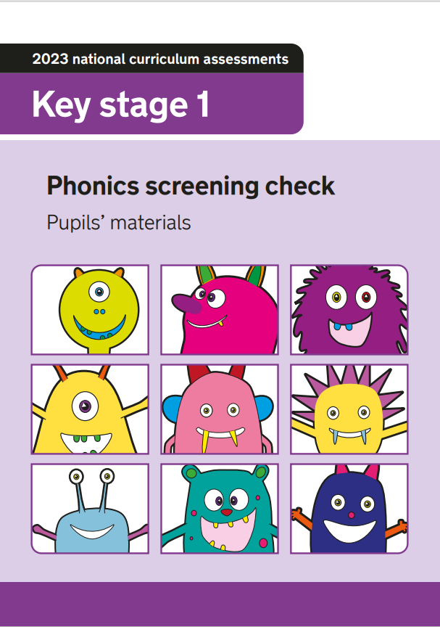
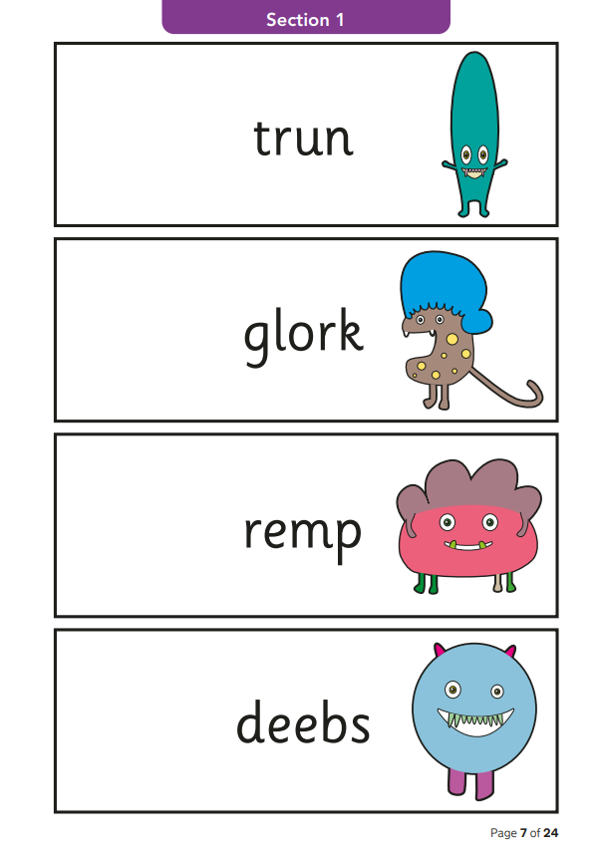
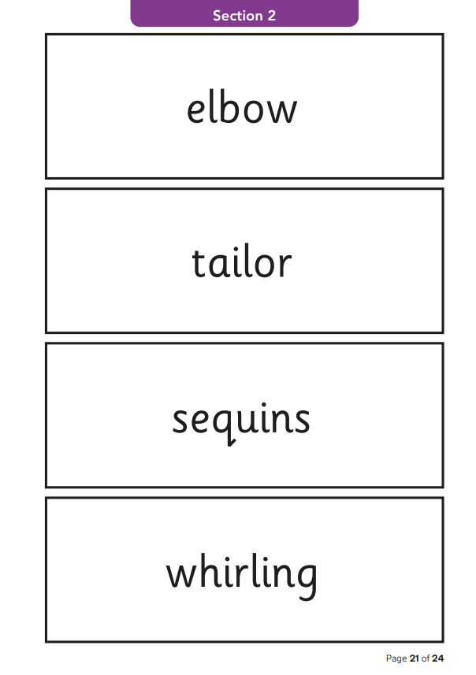
Roman Catholic Diocese of Hexham and Newcastle
St. John Vianney
Catholic Primary School
Phonics screening check
Notes:
Statutory assessment which takes place at the beginning of June for all children in Year 1 across the country.
Consists of 40 words, mixture of ‘real’ and ‘nonsense’ words for the children to sound out and blend.
It’ll be carried out 1:1, my class with me and Mrs O’Neill’s class with her.
It’ll be very informal and the children will have a lot of practice doing this with us so it’ll feel very familiar to them.
We don’t them it’s a test, we try to keep it stress free for them.
32/40 is a pass
If they don’t pass they can resit in Year 2
If we don’t think they’re ready to sit the test in Year 1 we will let you know closer to the time and they can sit it for the first time in year 2.

Slide 8
Roman Catholic Diocese of Hexham and Newcastle
St. John Vianney
Catholic Primary School
Reading: Year One children are taught to:
Apply phonic knowledge and skills to decode words
Read accurately by blending sounds in words
Read ‘tricky’ words that cannot be decoded using phonics (e.g. the)
Read words of more than one syllable
Listen to and discuss a wide range of poems, stories and non-fiction at a level beyond that at which they can read independently
Become very familiar with key stories, fairy tales and traditional tales
Predict what might happen next in stories
Explain clearly their understanding of what is read to them
Notes:
Reading is taught within Phonics lessons, as well as one to one reading weekly with a teacher or teaching assistant.
It is very helpful if children can bring their reading books and reading records into school daily so they can be read with at any point during the week.
Baseline assessments on entry to Year 1, and we are looking now at their home reading books which is why they might’ve received some familiar texts.
Our priority in Year 1 is reading fluency and to develop them as readers. So to sight read rather than sounding out every word to make sure there is flow in their reading rather than being disjointed.
This supports comprehension skills as they have a better understanding of the text.

Slide 9
Roman Catholic Diocese of Hexham and Newcastle
St. John Vianney
Catholic Primary School
Reading
Children have access to a rich Reading diet. They will participate in: daily phonics sessions, daily story time and home-school reading.
As the year progresses children will begin to take part in comprehension activities.
Every class has a library, which promotes reading for pleasure.
Our reading scheme includes a wide range of classic and non-fiction texts.
Notes:
9
Daily phonics, shared reading in class with comprehension activities, stories before home time and home-school reading of levelled books.
It is very important that children access a range of different texts, our reading scheme reflects this a range of fiction, non-fiction and classic texts.
We understand that all children will enjoy different types of books but it is still important that they are exposed to and read a variety of texts.
English – discuss fiction and non-fiction. A variety of reading at home can support their understanding.

Slide 10
Roman Catholic Diocese of Hexham and Newcastle
St. John Vianney
Catholic Primary School
Home Reading
Your child will be given a reading book to take home every Monday.
Please aim to read with your child at least 4 times per week. This could be as little as half a book per night.
We encourage your children to re-read their book once they have finished it. This develops reading fluency and confidence in tackling new words and phonic sounds.
Please leave a comment in your child’s reading record, as this allows us to tailor reading experiences for all children.
As per our reading policy, we will only change your child’s book when it has been read in full and their reading record has been signed by an adult at home.
Notes:
10
Read little and often, it will make a significant difference.
We collect home reading books in on a Monday. We aim to hand them out on a Monday afternoon however sometimes this isn’t possible. If they aren’t given out on a Monday they will be handed out on a Tuesday.
Unfortunately Monday is the only day we can change reading books so if your childs book isn’t handed in on a Monday, singed and fully read, we wont have the opportunity to change it until the following Monday.

Slide 11
Roman Catholic Diocese of Hexham and Newcastle
St. John Vianney
Catholic Primary School
How to help your child with Reading in KS1
By encouraging a variety of strategies to decode words e.g. using the sounds of letters rather than letter names.
By asking your child about what has happened in the story so far.
By asking them to make predictions about what will happen.
By reading a variety of texts of different genres and authors.
By discussing the text: I wonder…? Why…? What…? How…? Who…?
Even when the children become free readers, they still need to read aloud to an adult regularly and to hear adults reading aloud to them.
Notes:
11
Encourage and demonstrate segmenting of unfamiliar words rather than just giving them the answer.
Discuss what has happened or might happen in a story to promote comprehension skills.
It is so important that children have the opportunity to read aloud to an adult as much as possible as well as hearing adults read to them, by hearing expressive and fluent reading chn can pick up new skills in their own reading.
Progression of Reading Skills document on school website, as well as Phonics sound mats for practise of digraph recognition at home or to support identifying graphemes in their reading.
Children should be encouraged to follow the words of a book with their finger

Slide 12
Roman Catholic Diocese of Hexham and Newcastle
St. John Vianney
Catholic Primary School
Writing: Year One children are taught to:
Use phonic skills and knowledge to spell words
Spell common exception words
Write from memory simple sentences dictated by the teacher
Sit correctly at a table, holding a pencil comfortably and correctly
Form lower case and capital letters using the correct letter formation
Compose a sentence orally before writing it
Sequence sentences to form short narratives
Read aloud what they have read to check it makes sense
Notes:
Use of phonics to form words is the foundation of Year 1 writing. We encourage say it, sound it, write it to tackle new words.
CEW are learnt, practised and revisited in phonics lessons and available on display in class.
Please don’t worry if your child is reversing letters and numbers, this is very common in year 1 as they are learning new skills and sounds daily that they forget letter and number formation.
We start from dictating sentences for the chn to write, then building their own sentences (counting out the words in their sentence and reciting it to writing it down). Eventually chn will confidently sequence sentences together to form short narratives.
By the end of the year chn will be able to use capital letters and full stops in sentences, as well as understanding why a writer uses these and commas, question marks and exclamation marks. end of year expectations on website.

Slide 13
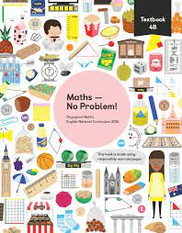
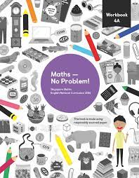
Roman Catholic Diocese of Hexham and Newcastle
St. John Vianney
Catholic Primary School
Maths-No Problem!
We follow the ‘Maths-No Problem!’ mastery school from Reception up to Year 6.
It is delivered using the concrete, pictorial and abstract methodology to ensure children have a deep understanding of mathematical concepts.
In Year 1 we mainly focus on using concrete resources during whole class teaching to embed new concepts.
Notes:
13
As a whole school we follow a maths scheme called MNP from reception to Year 6.
This scheme encourages children to use manipulatives and practical resources to help deepen their understanding of concepts and develops independence in reasoning and problem solving.
When learning new concepts we use the concrete, pictorial and abstract methodology. For example in addition, children might be given multilink cubes (the concrete resources) and physically add more on to get an answer. We’d then move on to pictorial where children might draw the cubes to help them understand addition. Finally the abstract part is where children would be confident enough to write a number sentence.
Workbooks are very pictorial focused to help the children understand their learning. We’ve left some out if you’d like to have a look through before you go.

Slide 14
Roman Catholic Diocese of Hexham and Newcastle
St. John Vianney
Catholic Primary School
Maths: Year One children are taught to:
Use and understand maths vocabulary
Count to and across 100, forwards and backwards from any given number
Count, read and write numbers to 100 in numerals
Read and write numbers from 1-20 in numerals and words
Identify 1 more and 1 less than a given number
Use number bonds and related subtraction facts within 20
Recognise, find and name a half as 1 of 2 equal parts and a quarter as 1 of 4 equal parts of an object, shape or quantity
Solve measurement problems
Tell the time to the hour and half past the hour
Our school calculation policy can be found on our school website.
Notes:
Children are taught to use and understanding key vocabulary
Counting to and back from 100.
Writing numbers to 100 in numerals and numbers to 20 in words.
Identify one more and less than a number.
Identify and use number bonds to 20
Simple fractions, halves and quarters
Ttelling the time to half past the hour, o’clock on an analogue clock.

Slide 15
Roman Catholic Diocese of Hexham and Newcastle
St. John Vianney
Catholic Primary School
PSHE
Personal, Social, Health and Economic (PSHE) Education is a subject through which pupils develop the knowledge, skills and attributes they need to manage their lives, now and in the future. It helps children to stay healthy and safe, while preparing them to make the most of life and work.
(PSHE Association 2021)
The PSHE Curriculum is broken up into three core themes:
Health and Wellbeing
Relationships
Living in the Wider World
Notes:
15
Economics is wellbeing
Health and wellbeing – childs development of their own personal skills and exploring how to keep our bodies healthy.
Relationships – here we look at keeping healthy friendships, the importance of being kind and what it means to be part of a family group
Living in the wider word – we explore british values and inclusivity

Slide 16
Roman Catholic Diocese of Hexham and Newcastle
St. John Vianney
Catholic Primary School
Positivity and Wellbeing
Strategies used across school to promote positive mental health in children include:
Whole class movement breaks
Zones of Regulation
Mindfulness activities
Praise / rewards / celebration assembly

Slide 17
Roman Catholic Diocese of Hexham and Newcastle
St. John Vianney
Catholic Primary School
How will you know how your child is getting on?
Parents evenings
School reports
Facebook updates
Notes:
We have an open door policy if you ever feel like you need to speak to a member of staff about your child.
You can email or ring the school office and all messages will be passed onto us, we will get back to you as soon as we can to help.
Talk to us

Slide 18
Roman Catholic Diocese of Hexham and Newcastle
St. John Vianney
Catholic Primary School
Important Class Information
Spellings – given on a Friday to learn for the following Friday
Homework:- daily spelling practise
- daily reading practise
- Friday homework will vary and link to topics covered that week in school or the following week
P.E. – Monday
Reading Books – Changed weekly, collected in on a Monday and handed back out on a Tuesday
Notes:
18
Reading books – try to get them out on Monday but might not always be possible
Please continue to bring your children into school dressed for PE on Mondays. How are you finding that?

Slide 19
Roman Catholic Diocese of Hexham and Newcastle
St. John Vianney
Catholic Primary School
Our Behaviour policy
Notes:
19
Are you ready to learn
Are you showing respect to others around you
Are your actions keeping yourself and your peers safe
We follow a restorative approach to behaviour where we recognise a wrong choice that might’ve been made, we have a talk with the child and discuss what happened/why it happened and what could be done in the future to make the right choice.

Slide 20
Roman Catholic Diocese of Hexham and Newcastle
St. John Vianney
Catholic Primary School
Questions
If you have any further questions arising from this PowerPoint, please contact us at office@stjohnvianneynewcastle.org and we will be more than happy to help.
Thank You.
Notes:
20

