Slide 1
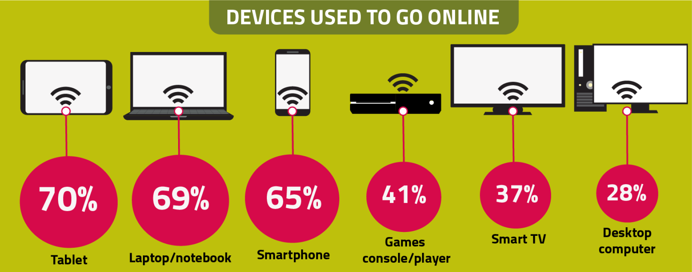
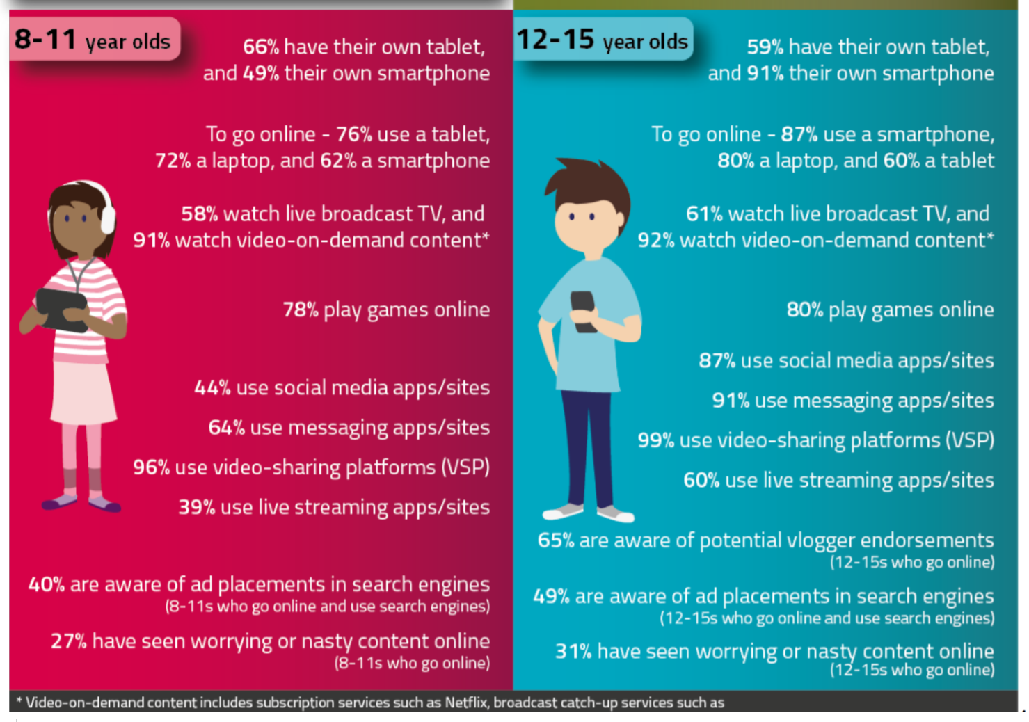
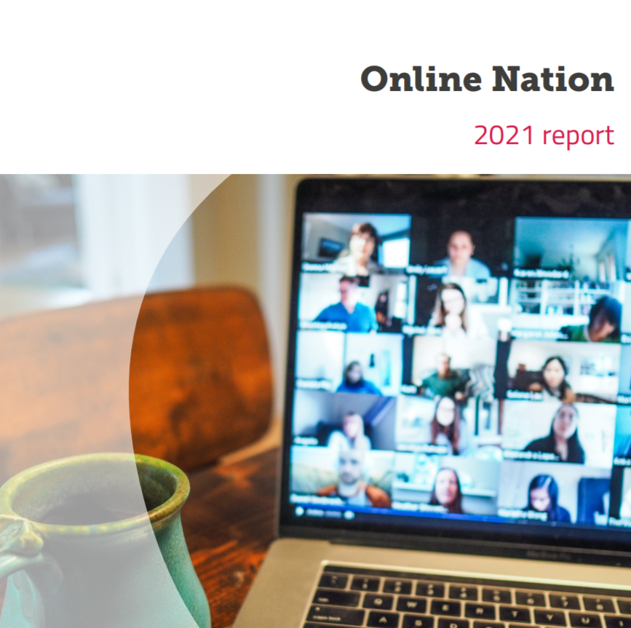
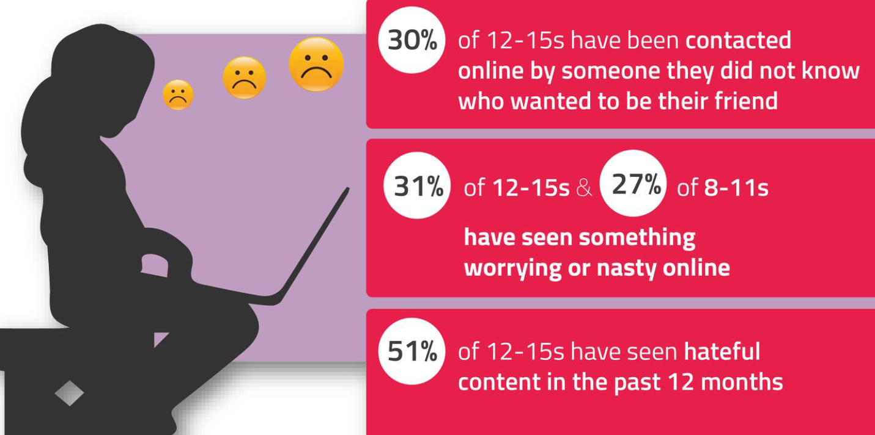
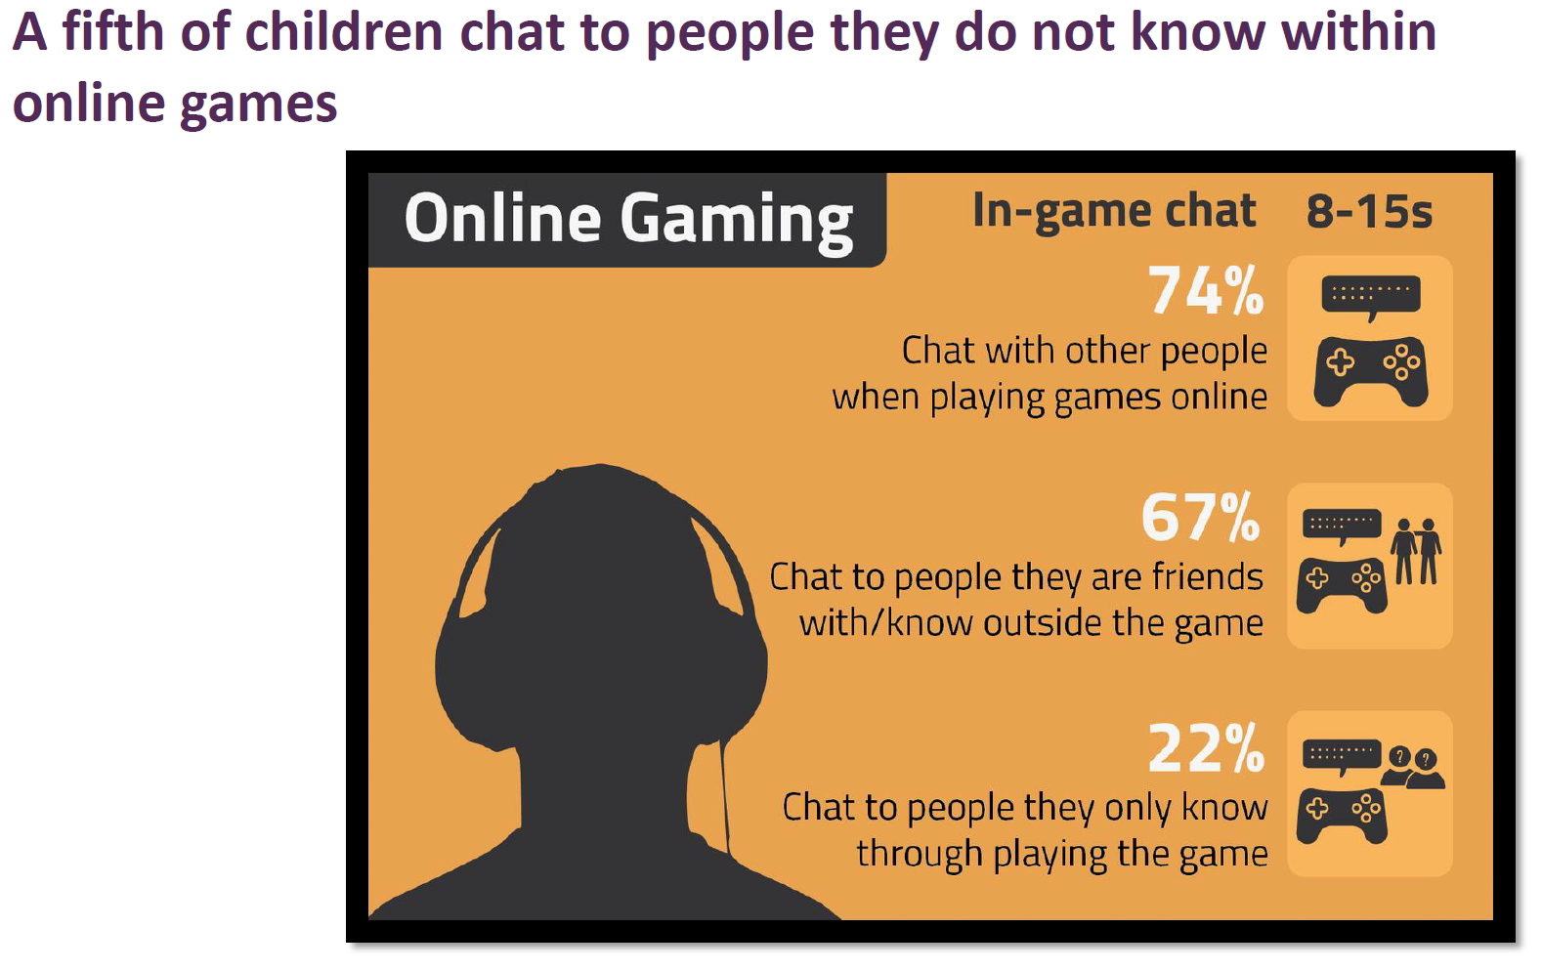
Parent Ofcom Starter activity from LGfL DigiSafe
Children and parents: Media Use and Attitudes report 2020/2021 and Online Nation 2021
Notes:
This presentation brings together key findings from:
Children and parents: Media Use and Attitudes report - examines children’s media literacy, media use, attitudes and understanding among children and young people aged 5-15, as well as about the media access and use of young children aged 3-4., as well as parents’ views about their children’s media use, and the ways that parents seek – or decide not – to monitor or limit use of different types of media.
Online Nation report - which is an annual report that looks at what people are doing online, how they are served by online content providers and platforms, and their attitudes to and experiences of using the internet.
Along with suggested resources to empower parents to keep up with the latest trends/apps and games, manage controls and settings, and talk to children about risk - from bullying and sharing content, to extremism and gangs

Slide 2
This presentation brings together:
Key findings from Ofcom’s:
Children and parents: Media Use and Attitudes report - examines children’s media literacy, media use, attitudes and understanding among children and young people aged 5-15, as well as parents’ views about their children’s media use, and the ways that parents seek – or decide not – to monitor or limit use of different types of media.
Online Nation report - an annual report that looks at what people are doing online, how they are served by online content providers and platforms, and their attitudes to and experiences of using the internet.
Suggested resources to empower parents to:
keep up with the latest trends, apps and games
manage controls and settings
talk to children about risk

Slide 3
At a glance…
Children aged 7 to 16 spend nearly four hours a day online
Much of internet use is centred on watching video content and gaming
YouTube continues to be used by virtually most, while TikTok grew rapidly in 2020
Whilst the internet was a vital lifeline in 2020, over half of children had a negative experience online
YouTube removed 34.8 million videos in 2020, while TikTok removed 194 million videos - child safety was the most common reason
The pandemic has resulted in an abundance of information, which includes inaccurate and misleading information
https://www.ofcom.org.uk/__data/assets/pdf_file/0013/220414/online-nation-2021-report.pdf
Notes:
Online Nation is an annual research report using research produced by Ofcom, which look at what people in the UK are doing online, how they are served by online content providers and platforms, and their experiences of using the internet, alongside industry trends. This year’s report includes more recent data looking at online behaviour in the UK during the coronavirus (Covid-19) pandemic.

Slide 4
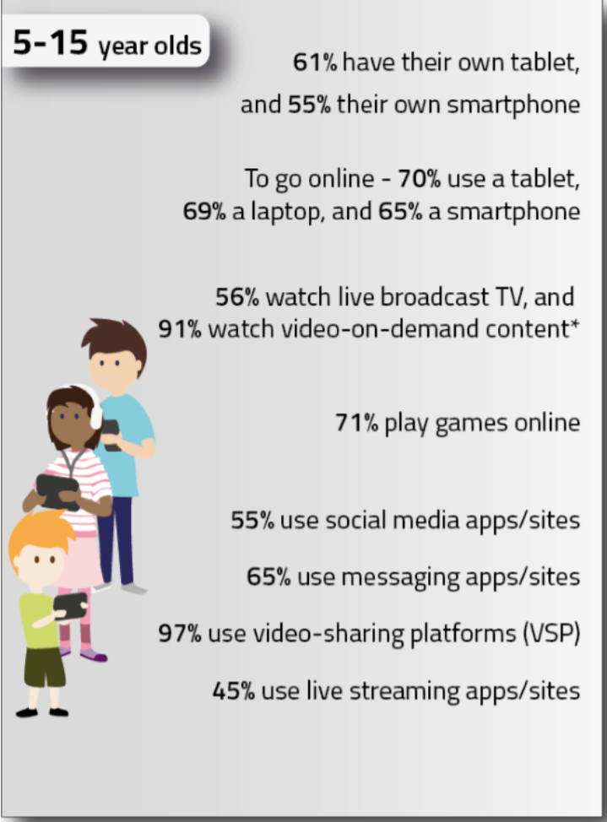
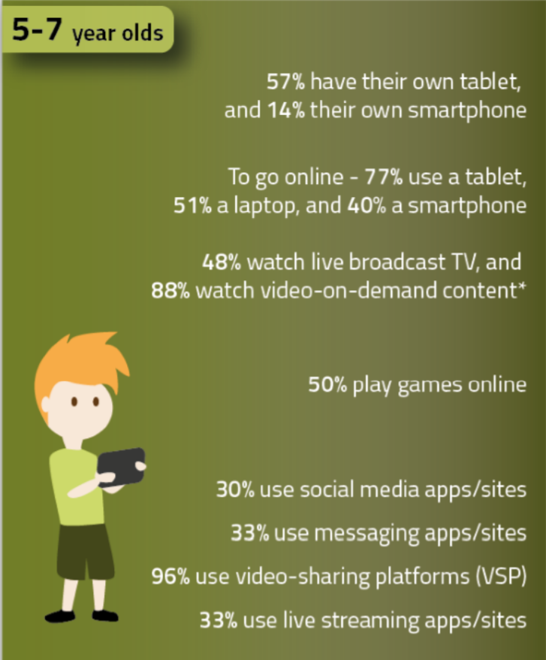
Have you talked to your child about their life and experiences online
– during and after lockdown?
Source: Children and parents: media use and attitudes report 2020/21

Slide 5
Visit parentsafe.lgfl.net for tips and ideas to help parents:
Manage screen time
Set controls and settings
Understand apps and games
Talk to children about risk - from bullying and sharing content, to extremism and gangs
Source: Children and parents: media use and attitudes report 2020/21
Notes:
Parents found it harder to control their child’s screen time during the Covid-19 pandemic and up to half of parents of children aged 5-15 said they had to relax some rules about what their child did online during 2020. However, parents also recognised the value of the internet in helping their child stay connected with their friends.
Awareness of technical tools and controls among parents was high, but only a minority used them While around six in ten parents of 5-15s, who had fixed broadband at home and a child who went online, were aware of certain technical tools and controls, around half of these actually used the tools and controls available. Almost six in ten were aware of parental controls built into the device by the manufacturer; 32% said they used them. Half were aware of technical controls that allowed them to restrict access to inappropriate online content, for example Google SafeSearch, YouTube Restricted Mode, or TikTok Family Safety Mode; but again, just three in ten had adopted them to manage their child’s online use.

Slide 6
Visit parentsafe.lgfl.net for tips and ideas to help parents:
Manage screen time
Set controls and settings
Understand apps and games
Talk to children about risk - from bullying and sharing content, to extremism and gangs
Source: Children and parents: media use and attitudes report 2020/21
Notes:
Parents found it harder to control their child’s screen time during the Covid-19 pandemic and up to half of parents of children aged 5-15 said they had to relax some rules about what their child did online during 2020. However, parents also recognised the value of the internet in helping their child stay connected with their friends.
Awareness of technical tools and controls among parents was high, but only a minority used them While around six in ten parents of 5-15s, who had fixed broadband at home and a child who went online, were aware of certain technical tools and controls, around half of these actually used the tools and controls available. Almost six in ten were aware of parental controls built into the device by the manufacturer; 32% said they used them. Half were aware of technical controls that allowed them to restrict access to inappropriate online content, for example Google SafeSearch, YouTube Restricted Mode, or TikTok Family Safety Mode; but again, just three in ten had adopted them to manage their child’s online use.

Slide 7
Are you familiar with the apps your child is on and if they are age appropriate? Go to apps.lgfl.net for guidance on apps and social media sites
Source: Children and parents: media use and attitudes report 2020/21
Notes:
More than four in ten children reported using social media sites or apps before they reached the minimum age requirement, and a substantial minority of parents said they would allow this. For most social media platforms, the minimum age requirement is 13; however, our research showed that 42% of children under the minimum age requirement (that is, aged between 5 and 12 years old) used social media. Parents were asked if they were aware of a minimum age requirement to have a profile on most social media sites or apps, such as Instagram, Snapchat, Facebook or TikTok. Almost nine in ten parents of 5-15s said they were aware of this, yet less than four in ten were able to accurately state the minimum age requirement for most social media sites and apps as 13 years-old.60 Around half stated an incorrect age or were unsure of the correct age. Three in ten parents of children below the minimum age requirement (that is, aged between

Slide 8
Have you set up parental controls/privacy settings for ALL devices/networks?
Visit www.internetmatters.org/parental-controls/ to find out how
Source: Children and parents: media use and attitudes report 2020/21
Notes:
Laptops, tablets, and mobiles were the most-used devices for going online in 2020 In 2020, nearly all children aged 5-15 (97%) went online via any device; an increase since 201926. Seven in ten used a laptop to go online – comparable to the proportion using a tablet or mobile phone, while around four in ten used a games console or player or a smart TV, and three in ten used a desktop.
These figures indicate a shift in the principal device for going online in 2020. In 2019, the tablet was the device most likely to be used to go online among 5-15s, higher than a laptop or mobile phone. However, use of a tablet to go online remained stable in 2020, while use of laptops, mobile phones, gaming devices, smart TVs and even desktops increased among each age group. The increased use of laptops and desktops, in particular, was probably due to the need for online home learning during 2020.

Slide 9
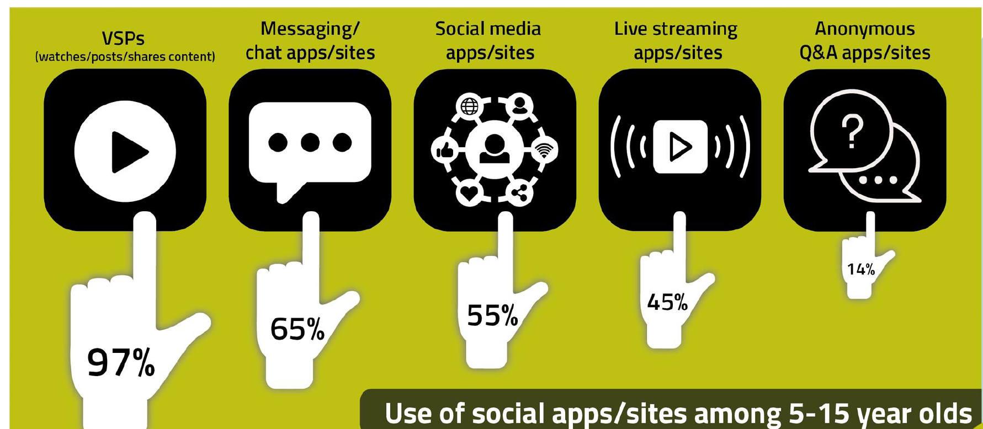
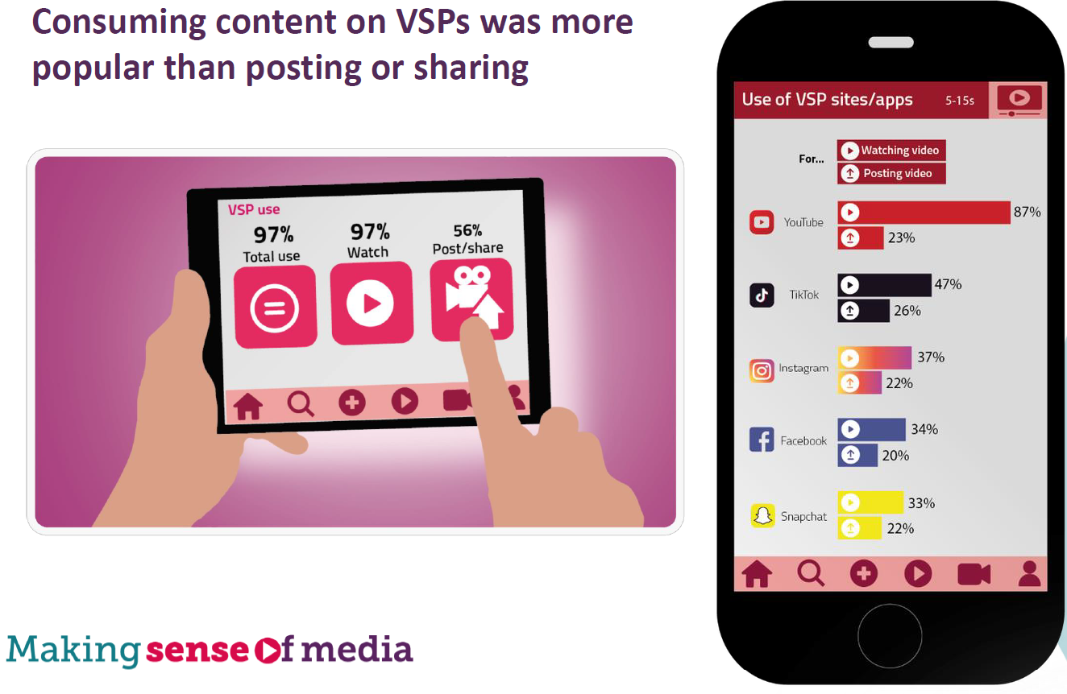
Do you talk to your child about the sites they use and what they share?
Do you know what they are watching?
Find conversation starters, story time ideas and top tips to reinforce key safety messages at parentsafe.lgfl.net
Source: Children and parents: media use and attitudes report 2020/21
Notes:
Consumption - Research from CHILDWISE showed that children spent more time watching content (programmes, video and short clips) in 2020 than they did before (from 2 hours 54 minutes in 2019 to 3 hours 18 minutes in 2020) - Covid-19 increased this behaviour; seven in ten children aged 8-15 said they had used VSPs more during the Covid-19 pandemic than before. In line with this, research by The Insights Family35 revealed that at the end of 2020, two of the top three favourite apps among children aged 5-15 were VSPs (YouTube and TikTok). While use of YouTube (to watch content) was consistent across ages, TikTok (65%), Instagram (65%), Facebook (50%) and Snapchat (53%) were more likely to be used by 12-15s. Among this age group, girls were more likely than boys to use TikTok and Snapchat. Up to half of children said they watched vloggers or YouTube influencers
Sharing - Three-quarters of older children posted or shared content on VSPs. making videos was one of the online creative activities that children were most likely to do in 2020. No single platform was used by a majority of children for posting or sharing content. Around a quarter of 5-15s said they used TikTok, YouTube, Instagram, or Snapchat for posting or sharing content. Among older children (aged 12-15), around four in ten used TikTok, Instagram and Snapchat for posting or sharing; a quarter said they used YouTube. Up to a fifth of children posted or shared content via live streaming platforms. Among the older age group, Instagram Live and YouTube Live were the sites or apps most likely to be used (38% and 32% respectively among 12-15s), followed by a quarter using Facebook Live. While YouTube Live was also the most likely to be used by 8-11 year-olds (by 30%), around one in ten used Instagram Live or Facebook Live.

Slide 10
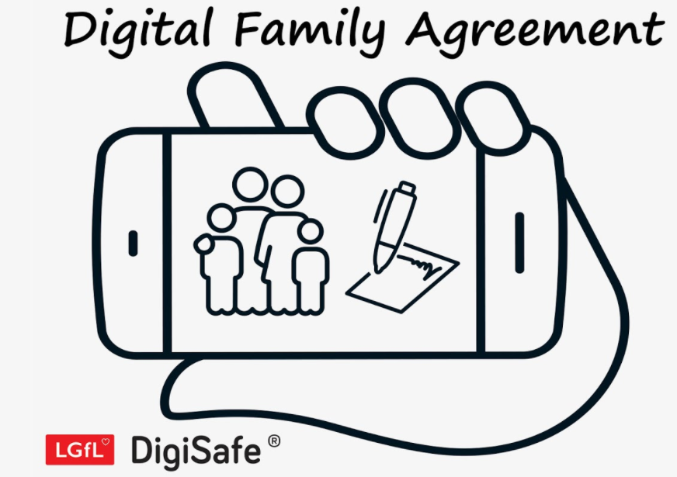
Why not have a family agreement to:
clarify what is allowed...or not
establish ground rules like no phones at the table or in the bedroom at night-time
agree shared expectations to reduce arguments and keep everyone safe & healthy
Download it at parentsafe.lgfl.net/digital-family-agreement
Source: Children and parents: media use and attitudes report 2020/21
Notes:
Half of parents talked to their child about online safety every few weeks Talking to children about online safety is another key mediation strategy, and nine in ten parents of children who went online said they had ever done this. Within this group, half talked to their child at least every few weeks; this was more likely among parents of the younger children aged 5-7 and 8- 11, than among parents of 12-15s. A further three in ten spoke to their child every few months, comparable between each age group. Fewer than one in five said they did it less often than this but had done so more than once.

Slide 11
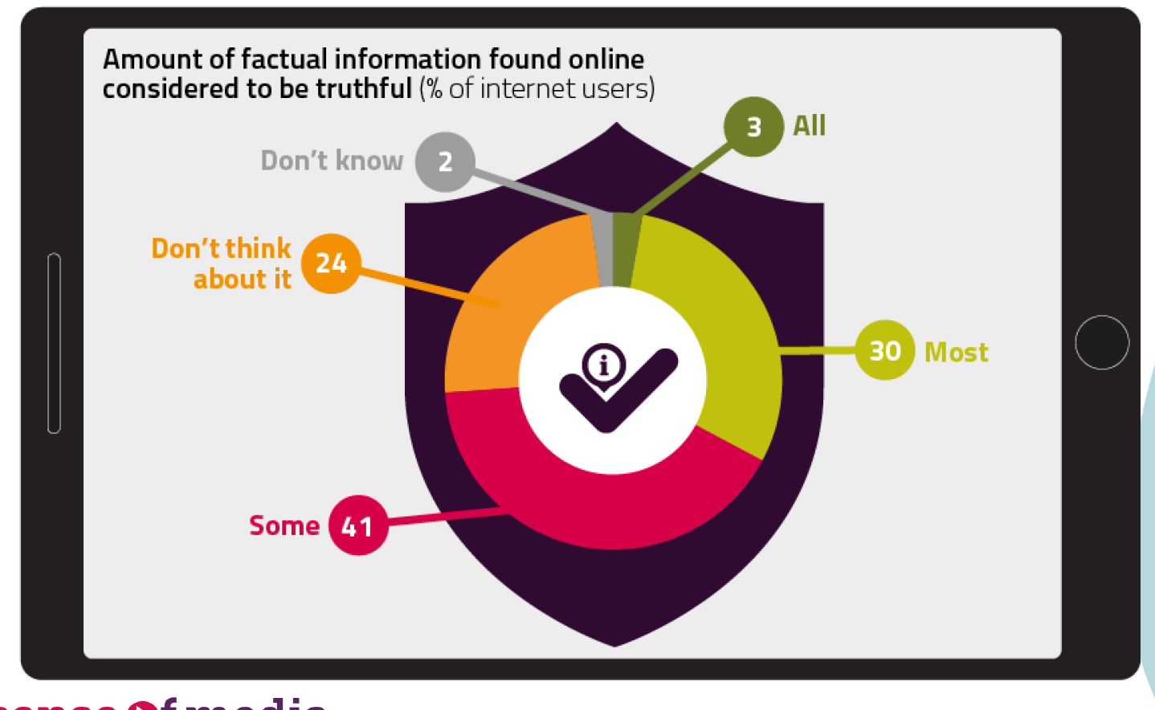
Do your children trust everything they see online?
Try our Critical Thinking Quiz at believe.lgfl.net
Source: Children and parents: media use and attitudes report 2020/21

Slide 12
Do they know who to talk to or how to report any concerns?
Go to reporting.lgfl.net to find out how to remove content from social media and where to report bullying, racial hatred, terrorism, sexual abuse and more
Source: Children and parents: media use and attitudes report 2020/21
Notes:
Awareness of reporting functions was high, but only a minority of 12-15s have ever reported content On seeing worrying or upsetting content online, children have the option of reporting this direct to the platform, using the reporting function available on many sites, apps and games.71 Overall, seven in ten children aged 12-15 were aware of reporting functions. Fourteen per cent said they had ever reported something they had seen online, while a smaller proportion (9%) said they had seen something that worried them but hadn’t reported it, despite being aware of the reporting function.

Slide 13
Are you familiar with who they are in contact with whilst playing games?
Visit gaming.lgfl.net for advice and activities to keep them safe
Source: Children and parents: media use and attitudes report 2020/21
Notes:
Children were using a range of devices to play games online. Gaming seems to be increasing in popularity among girls. Boys, in particular, used online gaming to connect to others. The most likely method of playing games online among children aged 5-15 was with or against someone else they knew or had met in person (57%), followed by half playing on their own (against the games console/ player/ computer). However, a quarter said they played games online with or against people they did not know or had not met in person. Chatting to others within games increased in 2020, to three-quarters of children aged 8-15s.55 Boys were more likely to do this than girls; 81% vs. 66% of girls. Children were more likely to chat to people they knew (67%) than to those they did not know outside of the game (22%) – comparable by gender.
Twitch, one of the leading streaming platforms for gamers, was used by 7% of 5-15s overall.

Slide 14
What if they come across hateful or extremist behaviour or content online?
Visit goingtoofar.lgfl.net to find out how to:
recognise extremist behaviour and content
understand actions likely to attract police investigation
get help
report concerns
Source: Children and parents: media use and attitudes report 2020/21
Notes:
Just under one in ten 12-15s said they often saw ‘hateful content’ online For the purposes of our survey, we described ‘hateful content’ as anything that had been directed at a particular group of people based on, for instance, their gender, religion, disability, sexuality, or gender identity. Overall, half of 12-15s said they had encountered this type of content online in the past year72, with 8% saying that they had seen it often.

Slide 15
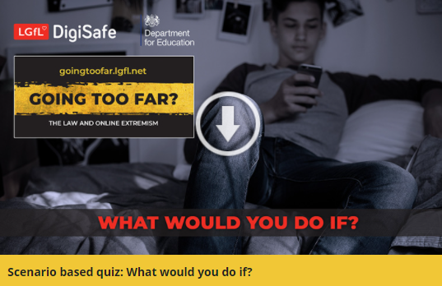
Are they aware of the implications their actions could have?
Could they be breaking the law?
Or putting themselves or others at risk?
Visit goingtoofar.lgfl.net to find out more.
Why not take the quiz together at takingastand.lgfl.net
Source: Children and parents: media use and attitudes report 2020/21
Notes:
Children had adopted different strategies for dealing with hateful content. Six in ten 12-15 year-olds said they had taken some action on seeing it. But some, depending on their actions, might have inadvertently shared the content further. Around a fifth said they had responded to the post/video/comment by ‘disliking’ it or commented on it to say they thought it was wrong, or shared it with their friends, saying it was wrong. Doing this brings the risk that their action will appear in their own social media feed, which is then seen by others, inadvertently further sharing the content. Meanwhile, 25% chose to block the person who shared or made the comments, while 22% reported it to the website. Although girls aged 12-15 were more likely than boys to inadvertently share the content by disliking the post/comment/video (27% vs. 13%), they were also more likely than boys to take constructive action in reporting the content to the website (33% vs. 10%).

