Slide 1
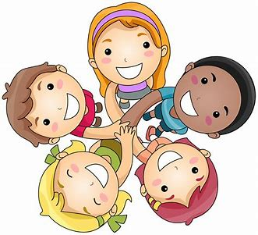
United Against Bullying

Slide 2
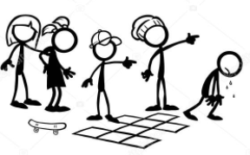
What is bullying?

Slide 3
Bullying is when someone is unkind to someone else.
It is bullying if it happens lots of times to the same person.

Slide 4
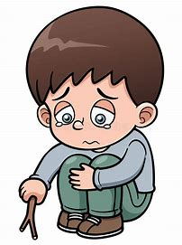
What does unkind look like?
Calling someone unkind names
Hurting someone
Sending unkind messages
Making someone feel sad

Slide 5
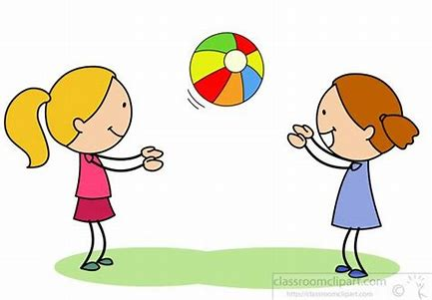
Is this bullying?
Katie is playing on the yard.
She is playing with a ball.
She throws the ball and it hits someone else.
She says sorry.
No, this is an accident

Slide 6
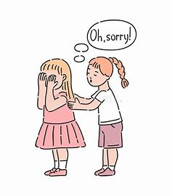
Is this bullying?
Tim calls Adam silly.
He says sorry.
He knows this was a wrong choice and doesn’t do it again.
No, although this was unkind, Tim said sorry and he doesn’t do it again.

Slide 7
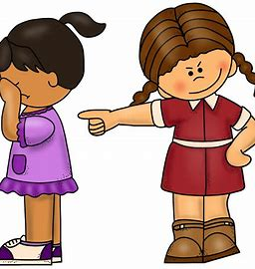
Is this bullying?
Cathy pushes Bob at playtime.
She calls Bob an unkind name at lunch time.
She won’t let Bob join in with
the game.
Cathy pushes Bob the next day and the next week.
Yes. Cathy is unkind to Bob lots of times.

Slide 8
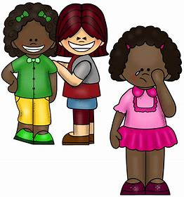
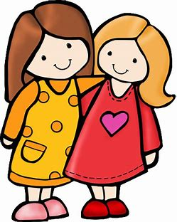
What can we do if we see bullying?
See bullies
Tell someone
Offer kindness
Protect each other

